Slide 1

This Course Is Accredited By:
International Certification Alliance (ICA)

Slide 2
Slide 3 or 32
Play the Welcome Video
A brief message from our team celebrating
why it’s important that your course is
accredited by ICA.
OR
Play the End of Class Video
An opportunity to encourage learners to continue on their learning journey. It also sets expectations about next steps for claiming the certification or credential.
Slide 4
We ask that all ICA-accredited courses use and demonstrate knowledge associated with this slide.
(optional for micro-credential courses)
ONE Slide from slides 7-31
Share key details of the certification they will earn in the class (see the slide specific to that certification)
About the ICA Required Content.
We ask that all ICA-accredited courses incorporate our required slides into your course.
No need to include this entire slide deck, we simply ask that you include the following:
International Certification Alliance

Slide 3



Slide 4


Tomorrow-Ready™ Skills.
Available Today.
We say Tomorrow-Ready™, not future proof, because no one can predict or protect against every possible future.
Readiness isn't a only a mindset, it's a set of skills and capabilities you build deliberately, one discipline at a time.
Our Tomorrow-Ready™ certifications help move people and organizations from where they are to where they need to be next.
International Certification Alliance

Slide 5
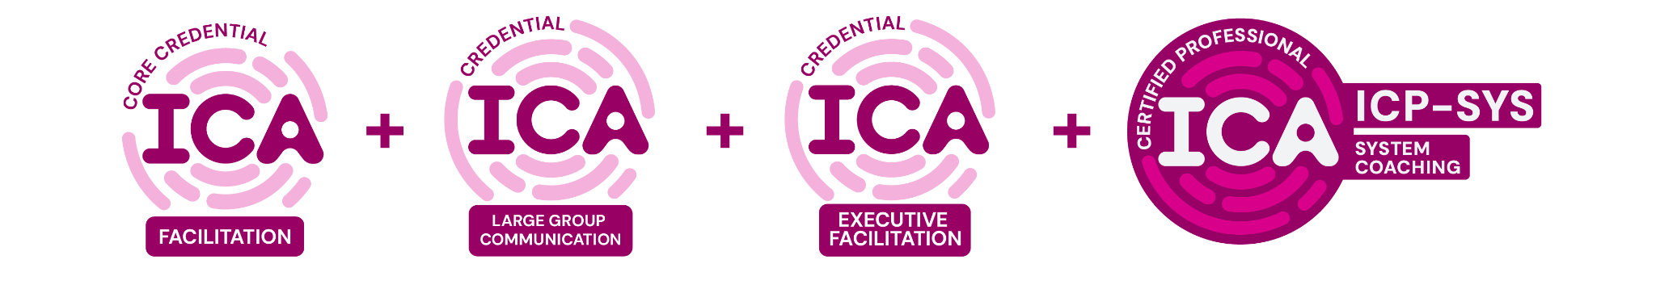
From Standardized to Modular
Learning as individual as you.
Now, learners can earn certifications and credentials that meet their unique needs. In this modular approach, earning a certification requires learners to complete a combination of a core credential and at least two specialized credentials.
‍
A core credential covers learning objectives focused on the foundational elements and basic competency as the backbone of the certification. Specialized credentials, on the other hand, allow learners the flexibility to explore concepts to deepen expertise in a specific area.
‍
Together, they create stability and flexibility: the core credential ensures consistency, while the specialized credentials allow for individualization.
Combine a core credential with at least two specialized credentials to earn a certification.
International Certification Alliance

Slide 6
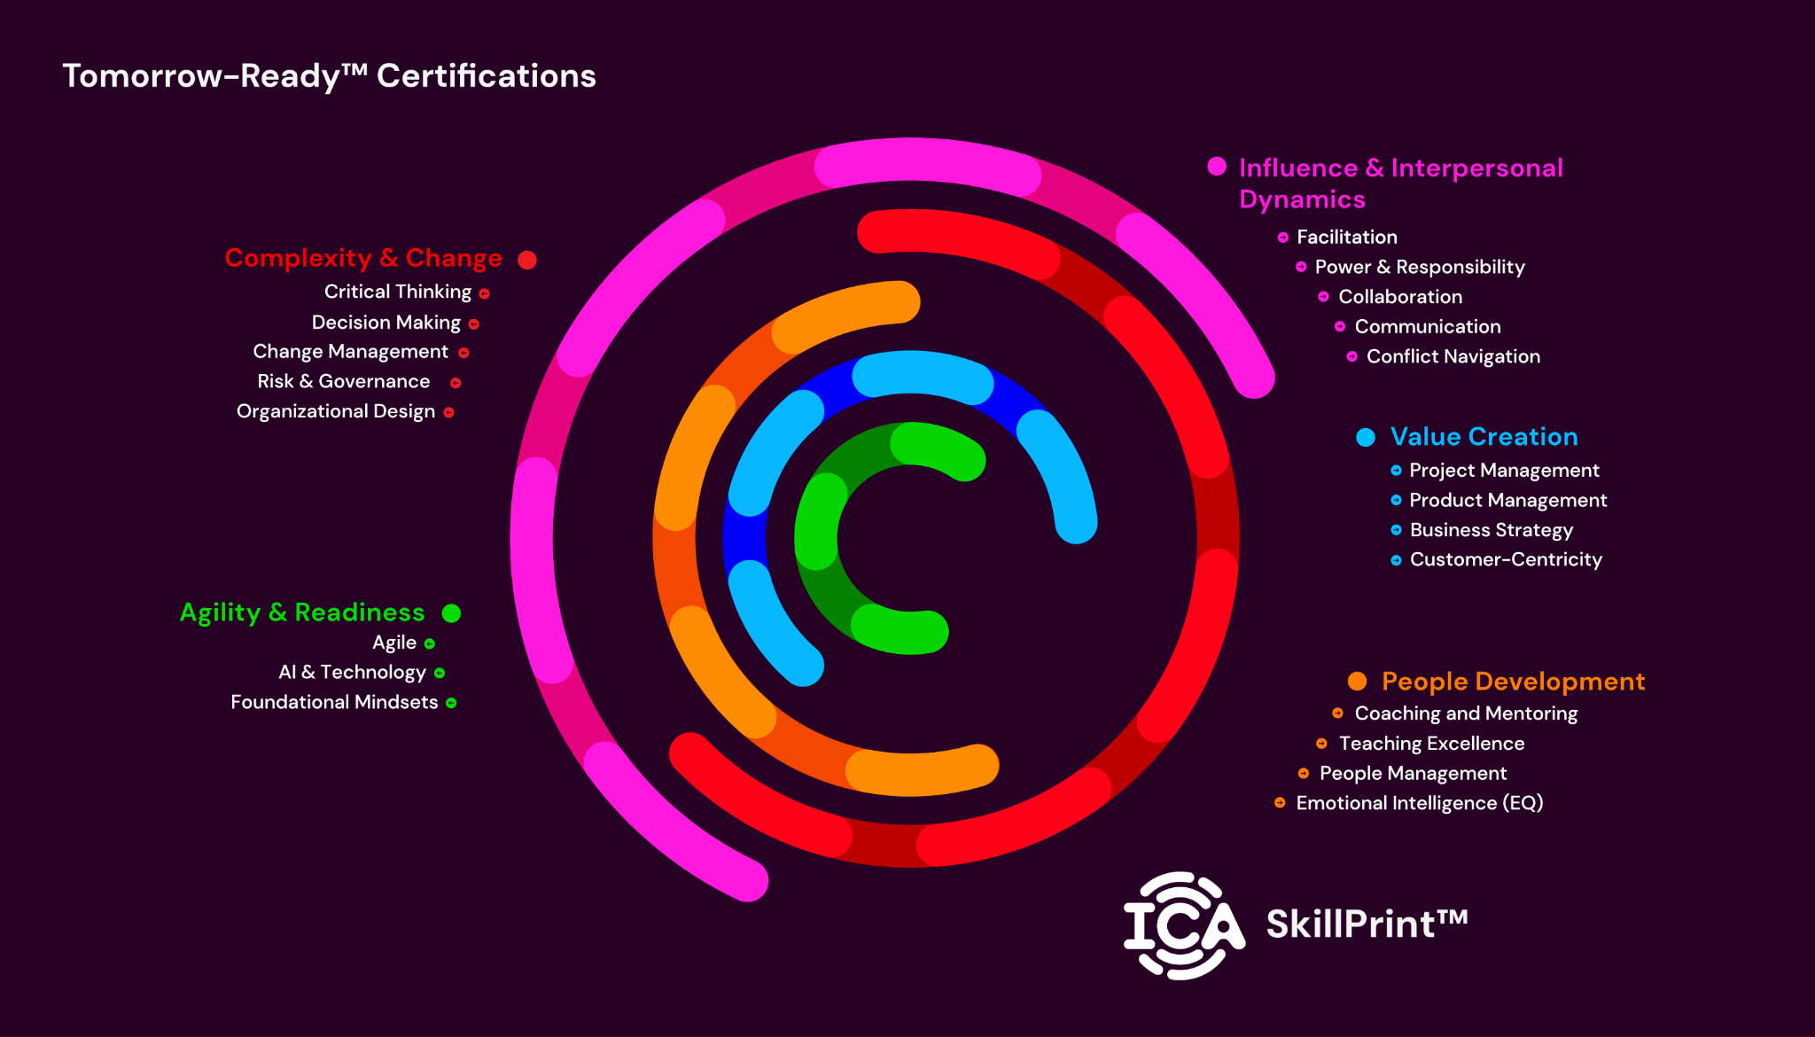
International Certification Alliance

Slide 7

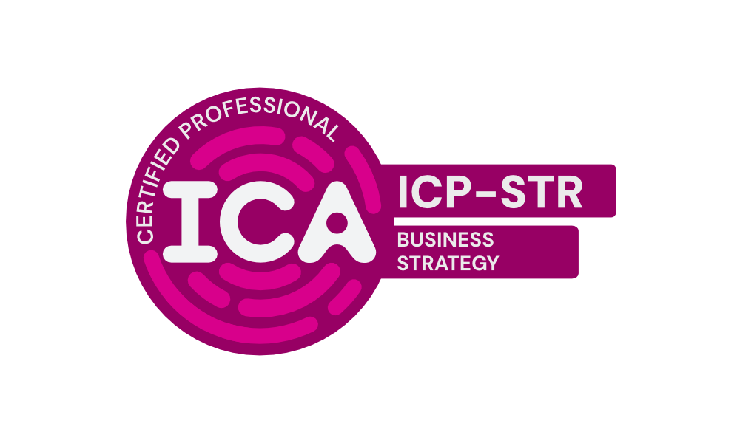
Tomorrow-Ready™ Certifications
Value Creation
SPECIALIZED CREDENTIALS
Business Model Design
Growth Strategy
AI for Product Strategy
CX Metrics and ROI
Competitive Analysis and Positioning
Strategy Execution and Prioritization
Customer-Centric Strategy
Operating Model Design
Prioritization
Business Strategy Certification
.
Turn strategic choices into action.
Strategy is more than setting goals or improving operations. It requires clear choices about where to compete, how to create value, and what an organization will prioritize.
The Business Strategy certification builds the judgment and practical skills needed to analyze competitive position, make strategic trade-offs, allocate resources, and translate direction into coordinated action.
CORE CREDENTIAL:
BUSINESS STRATEGY
International Certification Alliance

Slide 8
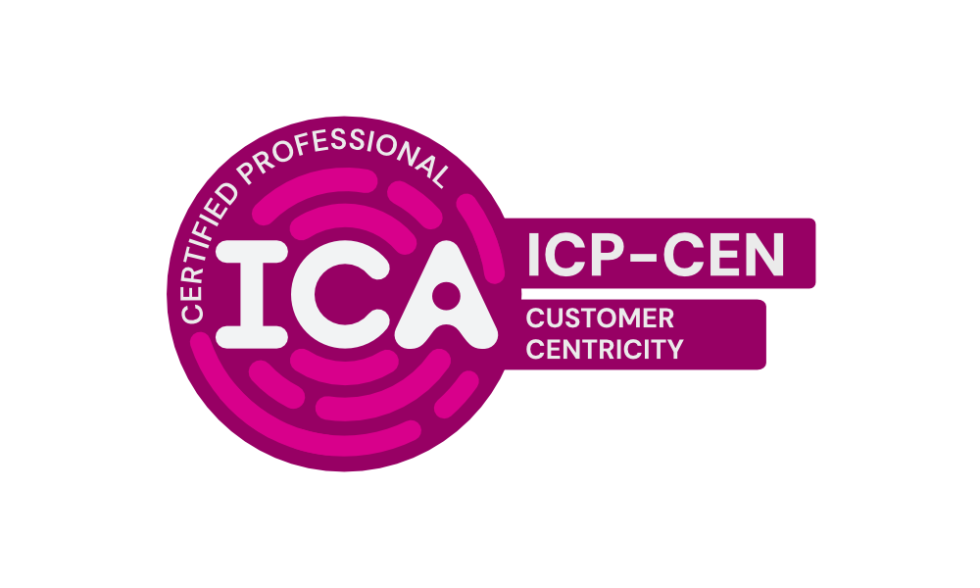
Tomorrow-Ready™ Certifications
Value Creation
SPECIALIZED CREDENTIALS
AI for Customer Insights
Customer Experience (CX)
Customer-Centric Culture Leadership & Decision-Making
Journey Mapping Facilitation
CX Metrics and ROI
Customer Success & Relationship Management
Customer-Centric Strategy
Voice of the Customer Programs
Customer-Centricity Certification
Put customer understanding into action.
Customer-centricity does not mean saying yes to every request or treating every customer the same. It means understanding the customers an organization chooses to serve, the outcomes they value, and how everyday decisions affect their experience.
The Customer-Centricity certification helps professionals use real customer evidence, balance customer and business value, and turn customer signals into meaningful organizational action.
CORE CREDENTIAL:
CUSTOMER-CENTRICITY
International Certification Alliance

Slide 9
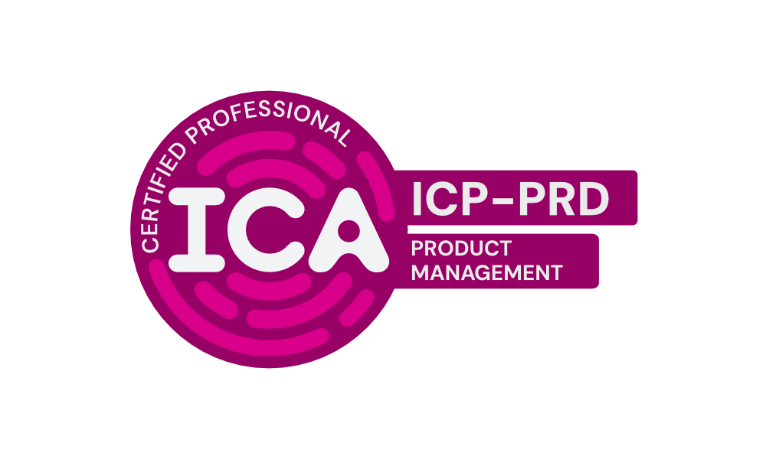
Tomorrow-Ready™ Certifications
Value Creation
SPECIALIZED CREDENTIALS
AI for Product Discovery | AI for Product Metrics
AI for Product Planning | AI for Product Strategy
AI for Stakeholder Management | Measuring Product Value
Product Discovery and Experimentation | Product Strategy and Roadmapping
Stakeholder Alignment | Business Model Design
Customer Experience (CX) | Customer Success & Relationship Management
Customer-Centric Strategy | Growth Strategy
Journey Mapping Facilitation | Stakeholder Progress Communication
Voice of the Customer Programs
Product Management Certification
Build products around outcomes.
Product management begins with four essential questions: What problem are we solving, who are we solving it for, why does it matter, and how will we know we succeeded?
The Product Management certification builds a shared understanding of how organizations conceive, shape, deliver, and sustain products. It helps professionals connect customer needs, market context, strategy, discovery, planning, and measurement.
CORE CREDENTIAL:
PRODUCT MANAGEMENT
International Certification Alliance

Slide 10

Tomorrow-Ready™ Certifications
Value Creation
SPECIALIZED CREDENTIALS
AI for Product Discovery | AI for Product Metrics
AI for Product Planning | AI for Product Strategy
AI for Stakeholder Management | Measuring Product Value
Product Discovery and Experimentation | Product Strategy and Roadmapping
Stakeholder Alignment | Business Model Design
Customer Experience (CX) | Customer Success & Relationship Management
Customer-Centric Strategy | Growth Strategy
Journey Mapping Facilitation | Stakeholder Progress Communication
Voice of the Customer Programs
Project Management Certification
Deliver value reliably and responsively.
Project management is not a single methodology. It is a set of practical skills that must adapt to different types of work, organizational contexts, and levels of uncertainty.
The Project Management certification builds the shared disciplines needed to plan work, coordinate stakeholders, manage dependencies, communicate progress, and respond when delivery diverges from expectations.
CORE CREDENTIAL:
PROJECT MANAGEMENT
International Certification Alliance

Slide 11
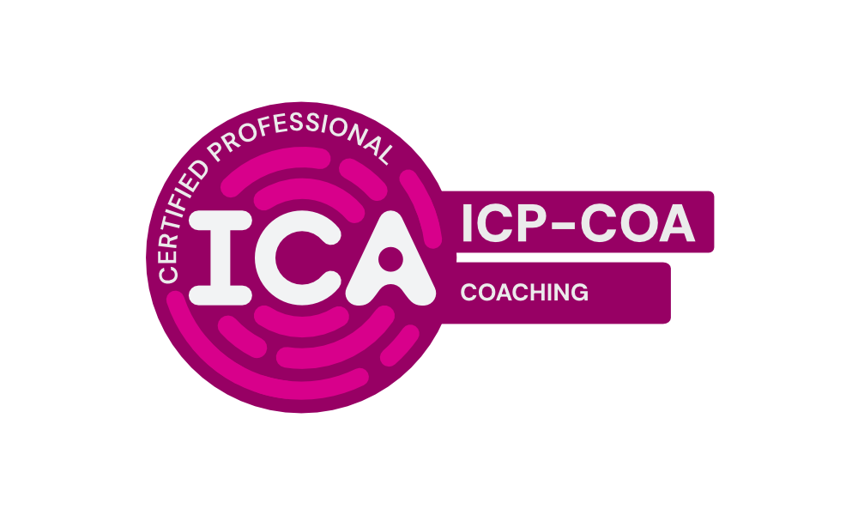
Tomorrow-Ready™ Certifications
People Development
SPECIALIZED CREDENTIALS
Coaching Ethics and Boundaries
Coaching and Mentoring Conversations
Team Coaching
Team Development
Coaching Presence and Stance
Systems Coaching
Listening and Inquiry
Coaching Certification
Build thinking through conversation.
Coaching requires establishing trust, listening deeply, asking questions that create insight, and preserving the other person’s ownership of their choices and actions.
The Coaching certification builds practical judgment to establish coaching boundaries, develop coaching presence, ask questions that evoke awareness, and facilitate conversations where people discover their own solutions.
CORE CREDENTIAL:
COACHING
International Certification Alliance

Slide 12

Tomorrow-Ready™ Certifications
People Development
SPECIALIZED CREDENTIALS
EQ Across Culture and Identity | EQ for People Managers
EQ in Remote and Hybrid Environments | Giving and Receiving Feedback with EQ
Self-Regulation and Resilience Under Pressure | Authentic Leadership
Coaching Presence and Stance | Difficult Conversations
Impactful Feedback | Inclusion and Belonging
Personal Resilience | Rebuilding Trust
Recognition Motivation and Retention | Remote and Hybrid Collaboration
Emotional Intelligence Certification
Lead with awareness and authenticity.
Emotional intelligence is more than managing your emotions. It requires understanding how your emotions shape your decisions, recognizing what others experience, and responding with intention rather than reaction.
The Emotional Intelligence certification builds the self-awareness, self-management, and relationship skills needed to navigate interpersonal dynamics with clarity, build trust-based relationships, and create environments where people feel safe.
CORE CREDENTIAL:
EMOTIONAL INTELLIGENCE
International Certification Alliance

Slide 13
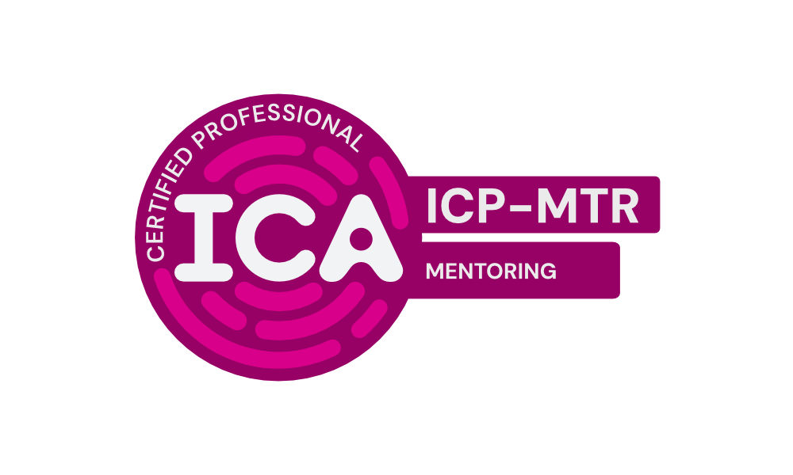
Tomorrow-Ready™ Certifications
People Development
SPECIALIZED CREDENTIALS
Mentoring Programs and Matching
Coaching and Mentoring Conversations
Peer and Reverse Mentoring
Mentoring Certification
Transfer knowledge and wisdom to accelerate growth.
Mentoring is more than sharing advice or pointing someone in a direction. It requires drawing on deep experience, offering perspective that comes from navigating similar challenges, and creating relationships built on trust and genuine investment in someone else's development.
The Mentoring certification builds the judgment and practical skills needed to share knowledge and experience effectively, and create lasting impact through intentional relationship-building.
CORE CREDENTIAL:
MENTORING
International Certification Alliance

Slide 14

Tomorrow-Ready™ Certifications
People Development
SPECIALIZED CREDENTIALS
Team Development | Authentic Leadership
Delegation and Developing Others | Hiring and Selection
Leadership Styles | Performance Management
Recognition Motivation and Retention | Customer-Centric Culture Leadership & Decision-Making
Decision-Making Delegation | Diagnosing Learning & Performance Needs
EQ for People Managers | Impactful Feedback
Leading in an AI-Augmented Organization | Mentoring Programs and Matching
Span of Control and Organizational Layering
People Management Certification
Unlock potential and enable growth in others.
People management is more than assigning tasks or evaluating performance. It requires recognizing individual strengths, creating environments where people can thrive, and developing talent intentionally.
The People Management certification builds the skills needed to champion people's capabilities, foster a culture of continuous feedback and growth, elevate individual and team potential, and create conditions for sustained high performance.
CORE CREDENTIAL:
PEOPLE MANAGEMENT
International Certification Alliance

Slide 15
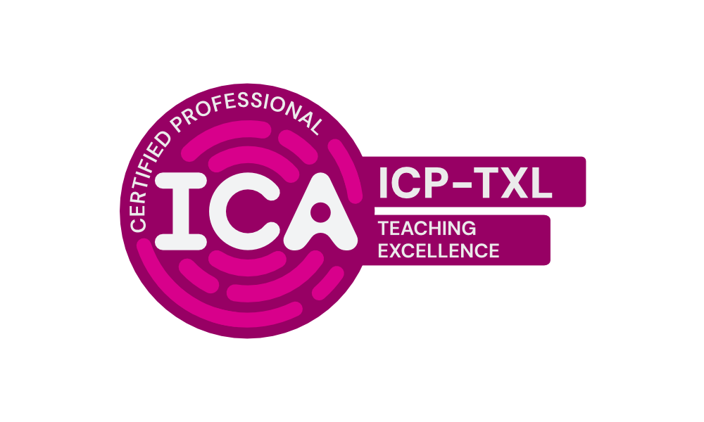
Tomorrow-Ready™ Certifications
People Development
SPECIALIZED CREDENTIALS
Blended Learning
Diagnosing Learning & Performance Needs
Training Delivery
Co-Training
Learning Design Foundations
Learning Agility
Teaching Excellence Certification
Transfer knowledge that sticks.
Effective training is more than presenting information. It connects learning to real performance needs and creates meaningful opportunities to practice, receive feedback, and apply new skills.
The Teaching Excellence certification builds practical judgment across the learning lifecycle from diagnosing needs and designing experiences to delivering learning and evaluating impact.
CORE CREDENTIAL:
TEACHING EXCELLENCE
International Certification Alliance

Slide 16

Tomorrow-Ready™ Certifications
Complexity & Change
SPECIALIZED CREDENTIALS
Reasoning Quality | Insight Storytelling
Evidence Quality | Problem Framing and Root Cause Analysis
AI and Human Judgment | AI for Customer Insights
AI for Product Metrics | Competitive Analysis and Positioning
CX Metrics and ROI | Decision-Making Under Uncertainty
Diagnosing Learning & Performance Needs | Innovation and Creative Problem Solving
Measuring Change | Measuring Product Value
Product Discovery and Experimentation | Systems Mapping
Voice of the Customer Programs
Analytical Thinking Certification
See the whole problem more clearly.
Analytical thinking requires more than gathering data. It requires reasoning clearly, questioning assumptions, evaluating evidence rigorously, and turning incomplete information into defensible insight.
The Analytical Thinking certification builds the judgment to identify patterns, navigate uncertainty, distinguish high-quality evidence, and recognize effective places to intervene.
CORE CREDENTIAL:
ANALYTICAL THINKING
International Certification Alliance

Slide 17

Tomorrow-Ready™ Certifications
Complexity & Change
SPECIALIZED CREDENTIALS
AI-Enabled Change
Change Communication
Measuring Change
Leading in an AI-Augmented Organization
Systemic Intervention Design
Adoption Design
Change Sponsorship
Navigating Resistance
Resistance and Conflict
Change Management Certification
Move from communication to adoption.
Change management is more than announcing transition. It requires understanding people, systems, and outcomes to design change journeys that build readiness, engage stakeholders, and support meaningful adoption.
The Change Management certification builds practical judgment to frame change for context, navigate resistance, clarify ownership, and sustain results.
CORE CREDENTIAL:
CHANGE MANAGEMENT
International Certification Alliance

Slide 18
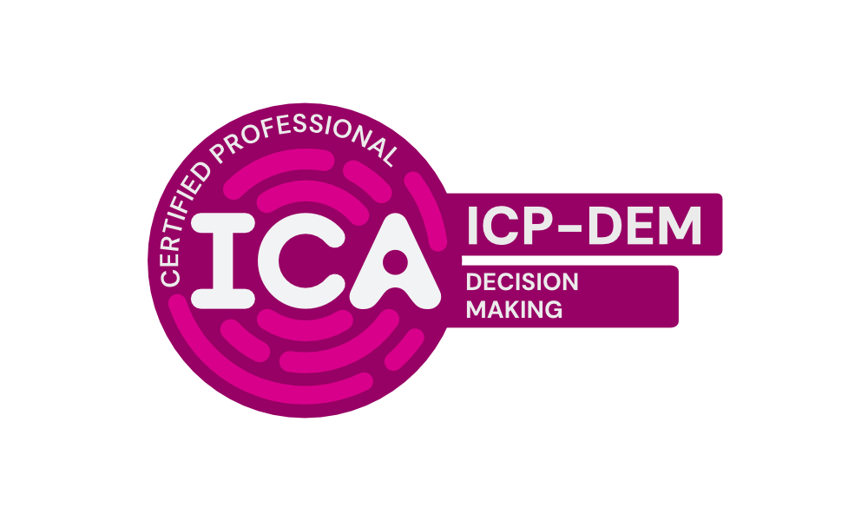
Tomorrow-Ready™ Certifications
Complexity & Change
SPECIALIZED CREDENTIALS
Data AI and Decision Accountability | Decision-Making Delegation
Decision-Making Under Uncertainty | AI and Human Judgment
Customer-Centric Culture Leadership & Decision-Making | Delegation and Developing Others
Evidence Quality | Facilitating Decision-Making
Prioritization | Problem Framing and Root Cause Analysis
Reasoning Quality | Risk Appetite and Tolerance Design
Decision-Making Certification
Make choices with clarity and accountability.
Good decisions require more than selecting an option. They demand understanding context, examining assumptions, weighing evidence, and clarifying accountability.
The Decision-Making certification builds practical judgment to make and communicate responsible decisions amid complexity and uncertainty.
CORE CREDENTIAL:
DECISION-MAKING
International Certification Alliance

Slide 19

Tomorrow-Ready™ Certifications
Complexity & Change
SPECIALIZED CREDENTIALS
Governance Design and Decision Rights
Portfolio and Investment Governance
Risk Appetite and Tolerance Design
Governance for Agile Delivery
Data AI and Decision Accountability
Risk Escalation and Reporting Design
Governance & Accountability Certification
Create oversight that enables action.
Governance is more than control and compliance. It requires distributing decision authority appropriately, clarifying accountability, and maintaining oversight that adapts as conditions change.
The Governance & Accountability certification builds practical judgment to define decision rights, align authority with responsibility, and establish governance that supports both accountability and action.
CORE CREDENTIAL:
GOVERNANCE &
ACCOUNTABILITY
International Certification Alliance

Slide 20
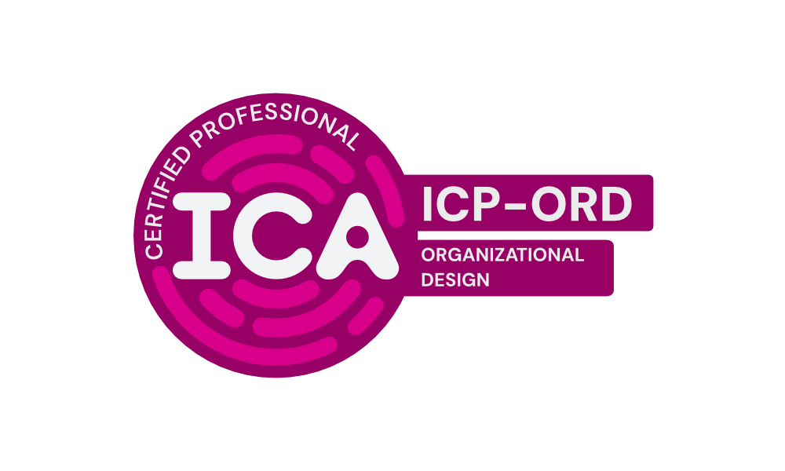
Tomorrow-Ready™ Certifications
Complexity & Change
SPECIALIZED CREDENTIALS
Designing for Organizational Agility | Operating Model Design
Span of Control and Organizational Layering | Team and Network Design
Designing for Delivery Team Effectiveness | Governance Design and Decision Rights
Governance for Agile Delivery | Power Incentives and Organizational Design
Strategy Execution and Prioritization | Systemic Intervention Design
Systems Mapping
Organizational Design Certification
Design the conditions for better work.
Organizational design is more than reporting structure and org charts. It requires diagnosing how structure, incentives, processes, and decision rights either reinforce or undermine strategy.
The Organizational Design certification builds practical judgment to identify structural problems, evaluate design options, align supporting systems, and implement organizational change responsibly.
CORE CREDENTIAL:
ORGANIZATIONAL DESIGN
International Certification Alliance

Slide 21
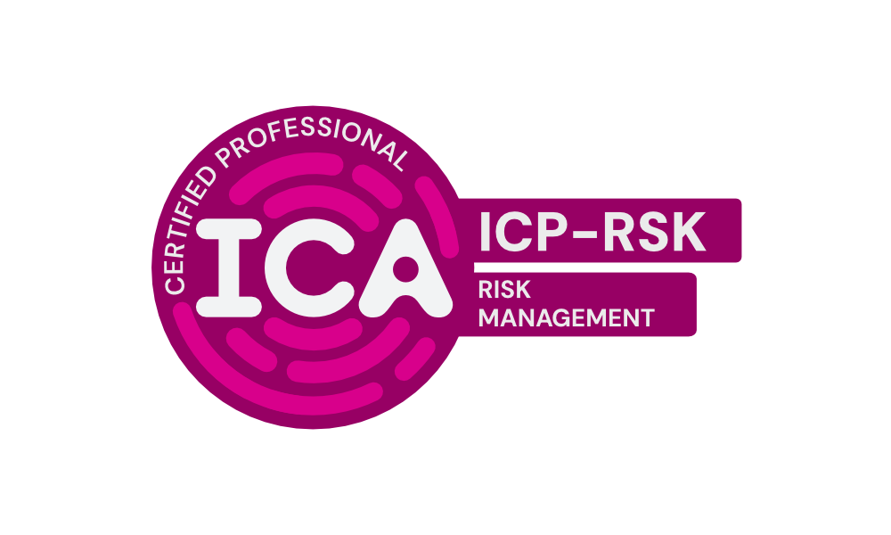
Tomorrow-Ready™ Certifications
Complexity & Change
SPECIALIZED CREDENTIALS
Risk Appetite and Tolerance Design
AI-Augmented Cybersecurity Awareness
Growth Strategy
Risk Escalation and Reporting Design
Decision-Making Under Uncertainty
Portfolio and Investment Governance
Risk Management Certification
Navigate risk with clarity.
Risk management is more than compliance and control. It requires distinguishing emerging from traditional risk, understanding risk appetite, recognizing interconnections, and building a culture where risk ownership is distributed.
The Risk Management certification builds practical judgment to identify and assess risk systematically, surface hidden assumptions, anticipate cascading effects, and act decisively despite uncertainty.
CORE CREDENTIAL:
RISK MANAGEMENT
International Certification Alliance

Slide 22
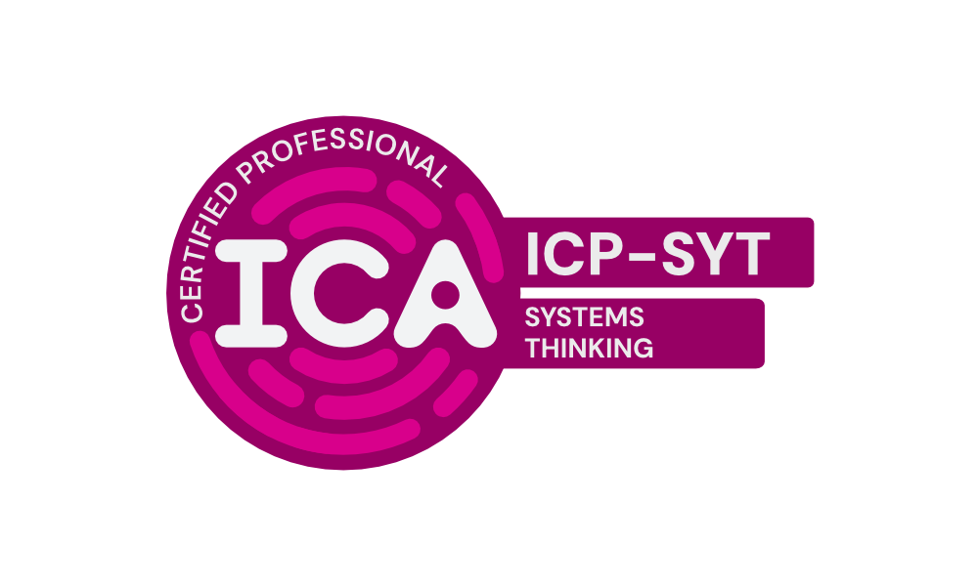
Tomorrow-Ready™ Certifications
Complexity & Change
SPECIALIZED CREDENTIALS
Systemic Intervention Design
Adoption Design
Hybrid Delivery Planning
Innovation and Creative Problem Solving
Systems Coaching
Systems Mapping
Designing for Delivery Team Effectiveness
Improving Flow
Problem Framing and Root Cause Analysis
Systems Thinking Certification
Understand the system, not just the symptoms.
Systems thinking is more than identifying problems in isolation. It requires understanding interconnections, feedback patterns, and how interventions ripple through a system.
The Systems Thinking certification builds the judgment to map systems, diagnose recurring problems, anticipate unintended consequences, and find effective leverage points for intervention.
CORE CREDENTIAL:
SYSTEMS THINKING
International Certification Alliance

Slide 23
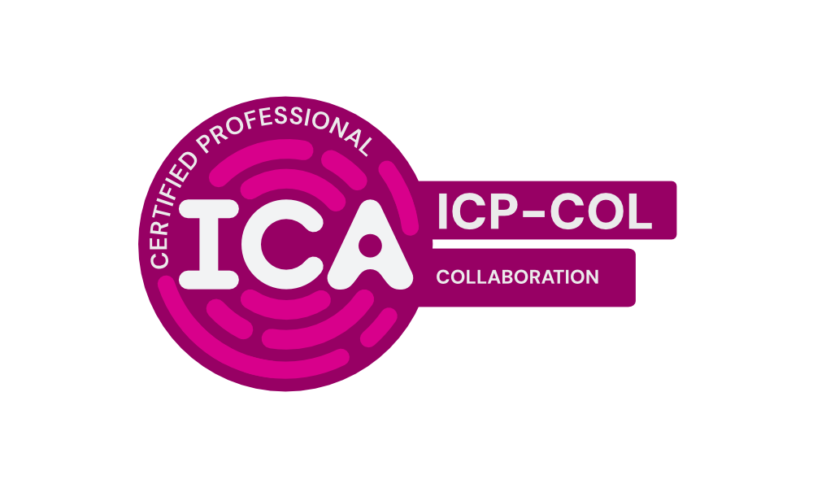
Tomorrow-Ready™ Certifications
Influence & Interpersonal Dynamics
SPECIALIZED CREDENTIALS
Cross-Boundary Collaboration | Inclusion and Belonging
Remote and Hybrid Collaboration | Co-Training
Conflict Across Difference | Conflict and Team Health
Customer Success & Relationship Management | EQ Across Culture and Identity
EQ in Remote and Hybrid Environments | Group Communication
Large Group Facilitation | Leading Without Authority
Navigating Competing Interests | Peer and Reverse Mentoring
Rebuilding Trust | Team and Network Design
Team Coaching | Team Development
Collaboration Certification
Turn working together into shared ownership.
Effective collaboration does not happen simply because people are placed on the same team. It requires shared purpose, clear interdependence, mutual accountability, and deliberate attention to how people work together.
The Collaboration certification develops the practical skills needed to create, assess, and sustain collaborative relationships across teams, functions, locations, and organizational boundaries.
CORE CREDENTIAL:
COLLABORATION
International Certification Alliance

Slide 24

Tomorrow-Ready™ Certifications
Influence & Interpersonal Dynamics
SPECIALIZED CREDENTIALS
Difficult Conversations | Group Communication
Impactful Feedback | Listening and Inquiry
Presenting and Speaking | Storytelling
Written Communication | Change Communication
EQ in Remote and Hybrid Environments | Giving and Receiving Feedback with EQ
Insight Storytelling | Large Group Facilitation
Negotiation and Influence | Performance Management
Remote and Hybrid Collaboration | Risk Escalation and Reporting Design
Stakeholder Alignment | Stakeholder Progress Communication
Visual Facilitation Introduction
Communication Certification
Create understanding that leads to action.
Communication is not only about sending information. It is the process through which people interpret meaning, coordinate work, make decisions, and build relationships.
The Communication certification develops the practical skills needed to listen actively, ask purposeful questions, structure messages, choose appropriate channels, and adapt communication across audiences and differences.
CORE CREDENTIAL:
COMMUNICATION
International Certification Alliance

Slide 25
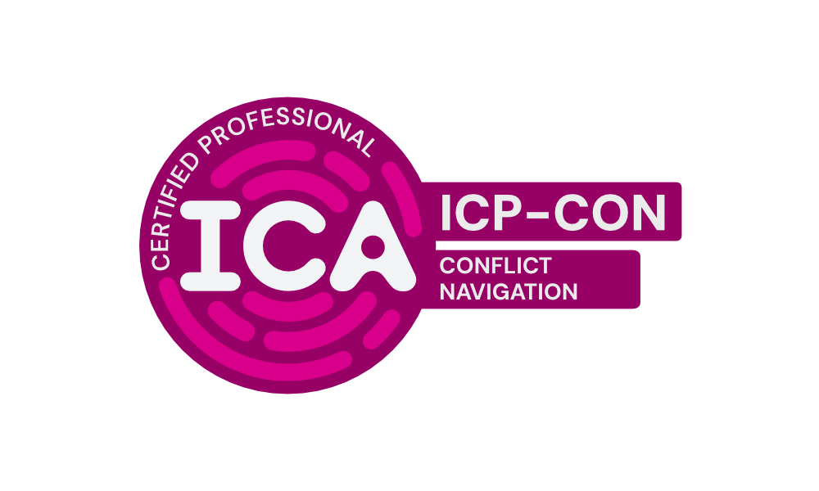
Tomorrow-Ready™ Certifications
Influence & Interpersonal Dynamics
SPECIALIZED CREDENTIALS
Conflict Across Difference | Conflict and Team Health
Rebuilding Trust | Resistance and Conflict
Difficult Conversations | EQ Across Culture and Identity
Facilitating Conflict | Navigating Competing Interests
Navigating Resistance | Negotiation and Influence
Team Coaching
Conflict Navigation Certification
Engage conflict without avoiding what matters.
Conflict is not always harmful. It can reveal competing needs, unclear expectations, different interpretations, or important problems that have not been addressed.
The Conflict Navigation certification develops the self-awareness, emotional regulation, communication, and practical judgment needed to understand conflict, reduce harmful escalation, and decide how best to engage.
CORE CREDENTIAL:
CONFLICT NAVIGATION
International Certification Alliance

Slide 26
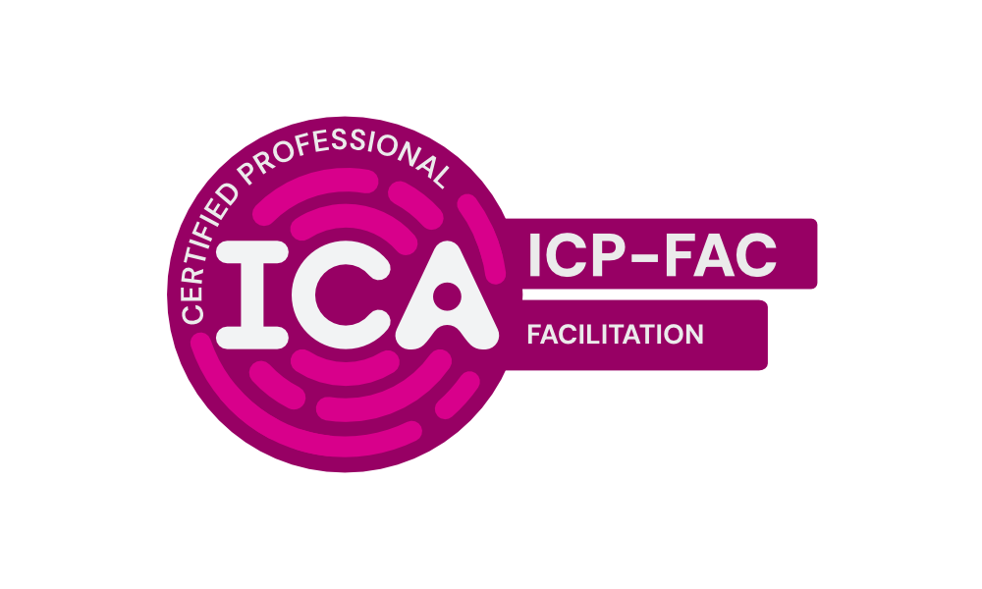
Tomorrow-Ready™ Certifications
Influence & Interpersonal Dynamics
SPECIALIZED CREDENTIALS
Facilitating Conflict
Large Group Facilitation
Group Communication
Listening and Inquiry
Facilitating Decision-Making
Visual Facilitation Introduction
Journey Mapping Facilitation
Facilitation Certification
Create the conditions for productive group work.
Facilitation is more than leading an agenda. It requires clarity of purpose, thoughtful session design, attention to participation, and the ability to respond to what is happening in the room.
The Facilitation certification develops the practical judgment needed to define the facilitator’s role, design fit-for-purpose sessions, support inclusive participation, and adapt to changing group dynamics.
CORE CREDENTIAL:
FACILITATION
International Certification Alliance

Slide 27

Tomorrow-Ready™ Certifications
Influence & Interpersonal Dynamics
SPECIALIZED CREDENTIALS
Leading Without Authority | Navigating Competing Interests
Negotiation and Influence | Power Incentives and Organizational Design
The Ethical Use of Power | Authentic Leadership
Change Sponsorship | Conflict Across Difference
Cross-Boundary Collaboration | Decision-Making Delegation
EQ for People Managers | Governance Design and Decision Rights
Inclusion and Belonging | Peer and Reverse Mentoring
Power & Responsibility Certification
Use power with awareness and accountability.
Power exists in every professional relationship, whether it comes from formal authority, expertise, access, relationships, identity, or control of information and resources.
The Power & Responsibility certification develops the awareness and judgment needed to recognize sources of power, understand the boundaries of personal agency, evaluate impact, and use influence responsibly.
CORE CREDENTIAL:
POWER & RESPONSIBILITY
International Certification Alliance

Slide 28
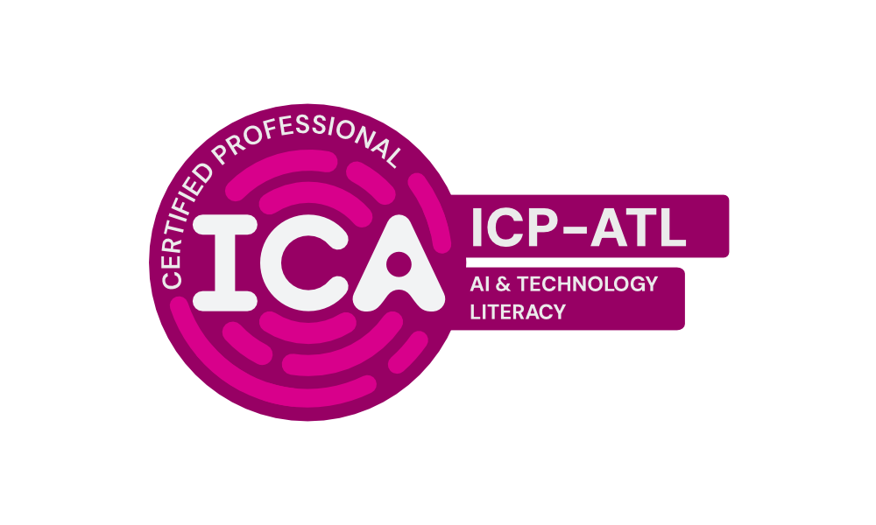
Tomorrow-Ready™ Certifications
Agility & Readiness
SPECIALIZED CREDENTIALS
AI and Human Judgment
Leading in an AI-Augmented Organization
AI for Product Discovery
AI for Product Planning
AI for Stakeholder Management
Data AI and Decision Accountability
AI-Augmented Cybersecurity Awareness
AI for Customer Insights
AI for Product Metrics
AI for Product Strategy
AI-Enabled Change
AI & Technology Literacy Certification
Use AI with confidence and judgment.
AI is changing how information is produced, decisions are made, and value is created. Working effectively with AI requires more than knowing how to use a tool. It requires understanding what AI does, recognizing its limits, and applying responsible human judgment.
The AI & Technology Literacy certification builds the foundational understanding and practical skills professionals need to work thoughtfully with AI across roles, teams, and organizational contexts.
CORE CREDENTIAL:
AI & TECHNOLOGY
International Certification Alliance

Slide 29

Tomorrow-Ready™ Certifications
Agility & Readiness
SPECIALIZED CREDENTIALS
Innovation and Creative Problem Solving
Personal Resilience
Learning Agility
Self-Regulation and Resilience Under Pressure
Foundational Mindsets Certification
Respond thoughtfully as work evolves.
The Foundational Mindsets credential prepares you to respond thoughtfully and effectively to ongoing change. Readiness is not about predicting every possible future, it is about developing the mindset and practices to adapt as new challenges, opportunities, and expectations emerge.
Recognize different types of challenges, uncover assumptions and habits that may be limiting progress, and develop practical responses for real professional situations.
CORE CREDENTIAL:
FOUNDATIONAL MINDSETS
International Certification Alliance

Slide 30
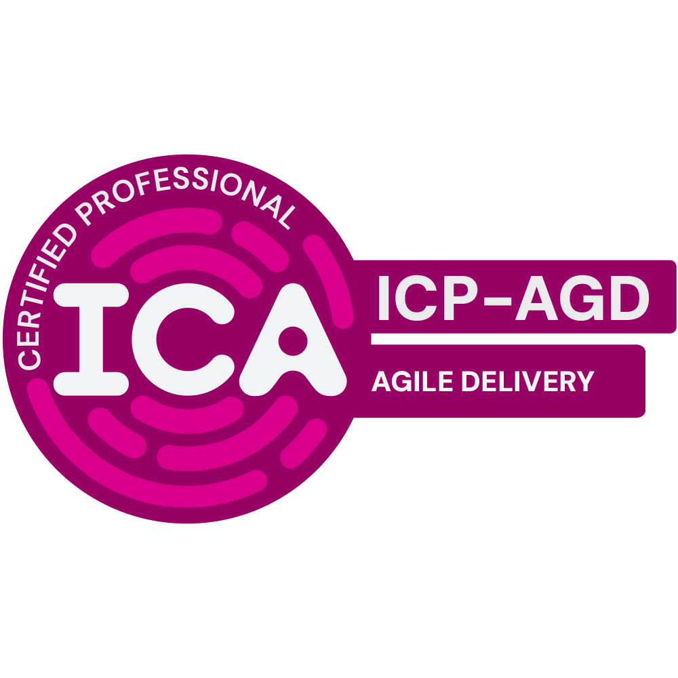
Tomorrow-Ready™ Certifications
Agility & Readiness
SPECIALIZED CREDENTIALS
Continuous Improvement
Improving Flow
Agile Delivery Certification
Understand the system, not just the symptoms.
The Agile Delivery credential prepares you to understand and participate effectively in modern agile delivery. It is framework-neutral and focuses on the common ideas and practices that sit underneath various frameworks..
Recognize what makes agile delivery different, why customers and feedback sit at the heart of the approach and how teams respond to change without creating chaos..
CORE CREDENTIAL:
AGILE DELIVERY
International Certification Alliance

Slide 31
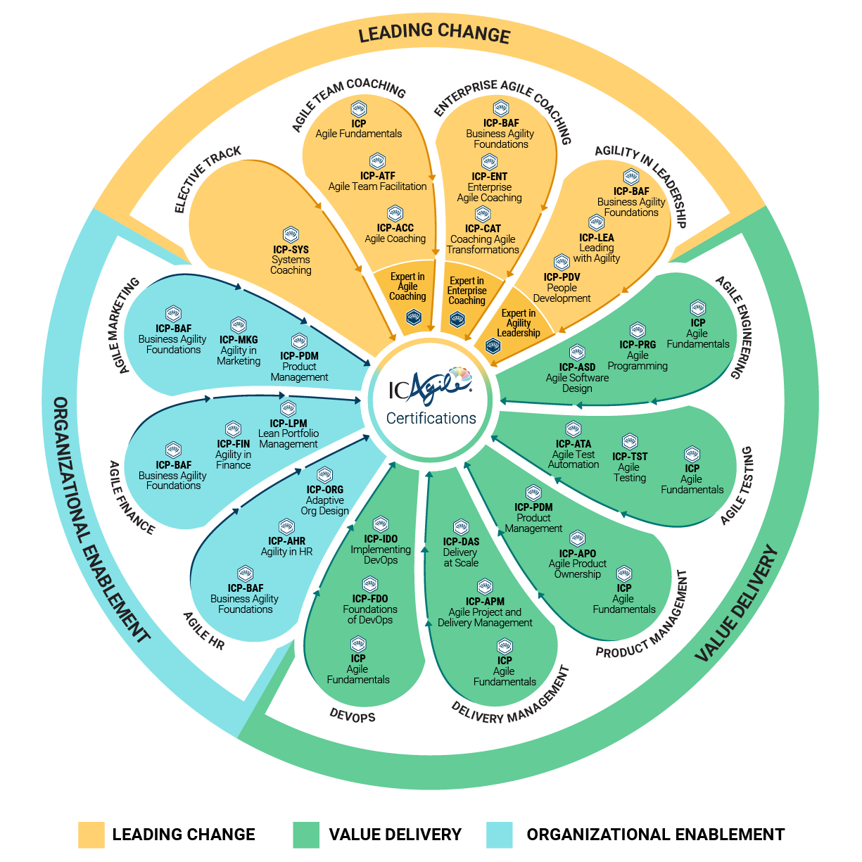
Tomorrow-Ready™ Certifications
Agility & Readiness
Agile Certifications for
Every Professional
ICA offers the widest range of agile certifications in the industry. With 27 certification programs in 15+ languages, you will find a course that’s relevant to your unique needs. We group them in three tracks:
LEADING CHANGE
Realize sustainable agility through cultural change, not process change.
VALUE DELIVERY
Delight your target audience with effective high-quality products and customer-centric outcomes
ORGANIZATIONAL ENABLEMENT
Build adaptive capability across the organization through dynamic structures and systems.
International Certification Alliance
International Certification Alliance

Slide 32


