Slide 1

THIS COURSE IS ACCREDITED BY

Slide 2

About the ICAgile Required Content
We ask that all ICAgile-accredited courses incorporate our required slides into your course. No need to include this entire slide deck, we simply ask that you include the following:
Slide 3- Play the Welcome Video- A brief message from our team celebrating why it’s important that your course is accredited by ICAgile.
Slide 4- We ask that all ICAgile-accredited courses (optional for micro-credential courses)
ONE Slide from slides 10-44- Share key details of the certification they will earn in the class (see the slide specific to that certification)
Slide 45- Play the End of Class Video- An opportunity to encourage learners to continue on their learning journey. It also sets expectations about next steps for claiming the certification.

Slide 3

Notes:
Class Introduction Video

Slide 4
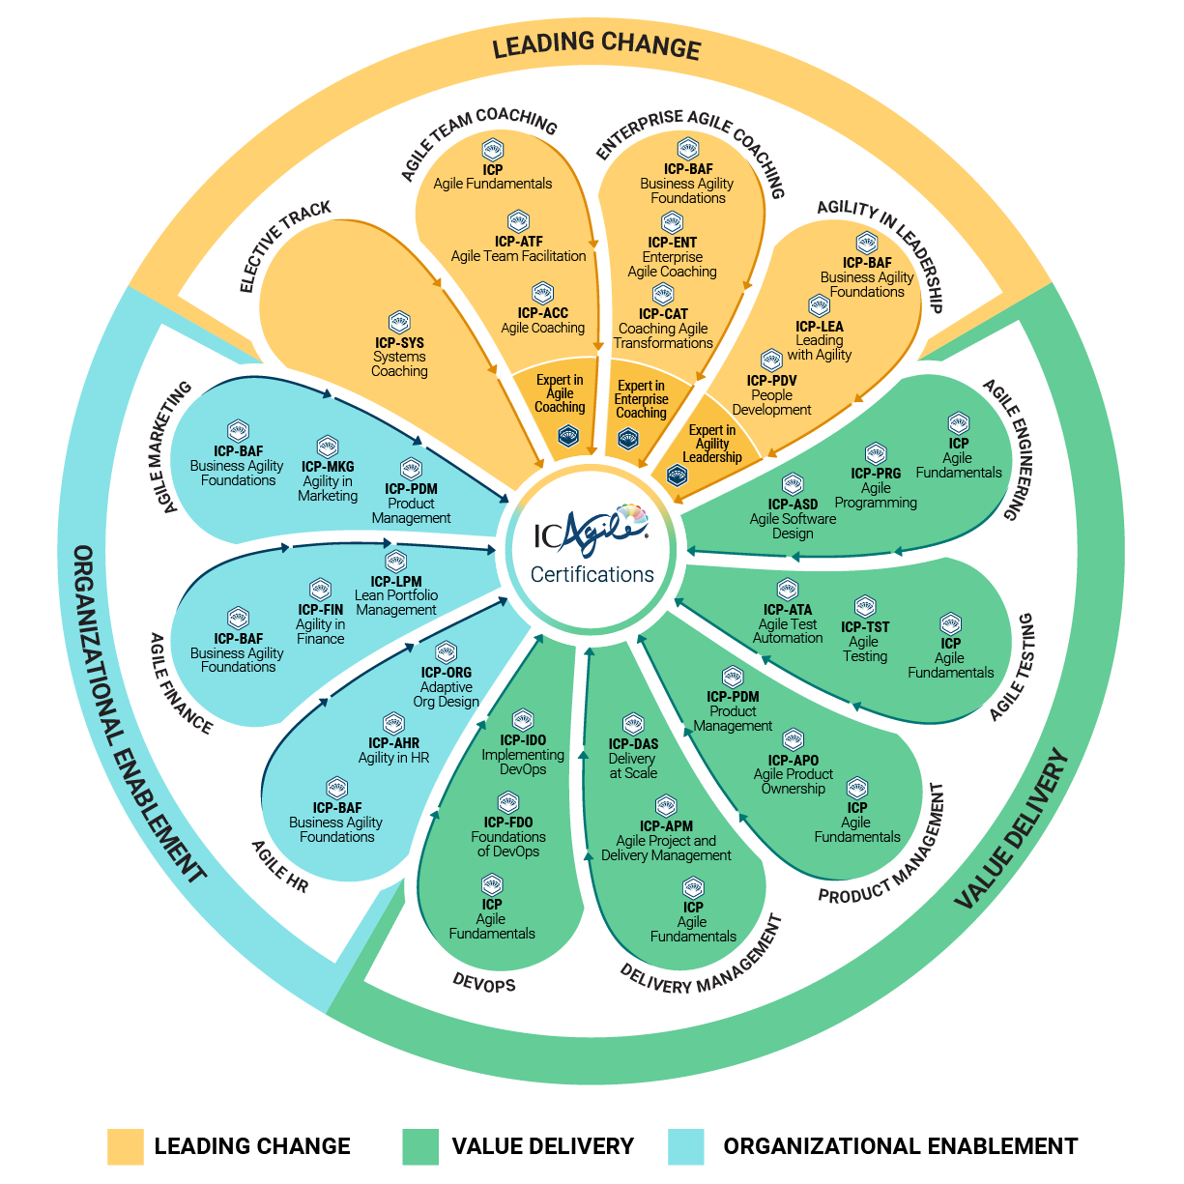
LEADING
CHANGE
Realize sustainable agility through cultural change, not process change.
VALUE
DELIVERY
Delight your target audience with effective high-quality products and customer-centric outcomes.
ORGANIZATIONAL
ENABLEMENT
Build adaptive capability across the organization through dynamic structures and systems.
Visit our website for an interactive version.
Notes:
Leading Change
Successful business agility journeys begin with leadership and coaching that catalyzes mindset shifts and unleashes human potential. This Learning Program focuses on the cultural and behavioral changes needed at all levels of the organization to thrive in uncertainty. It also emphasizes the systemic paradigm shifts and ongoing self-development leaders and coaches need to lead organizations through complexity and continuous change.
Value Delivery
Agility is a “must-have” for organizations that seek to deliver value consistently in dynamic environments. This Learning Program encompasses the strategy, technical excellence, product ownership, and delivery management needed to bring highly relevant products to market in today’s fast-moving world.
Organizational Enablement
Essential organizational functions, such as finance and HR, are often seen as impediments to agility. However, with the right shifts in mindset and structure, these functions have the power to enable and amplify agility. This Learning Program covers new ways of working in enabling functions to help accelerate the journey to business agility.

Slide 5
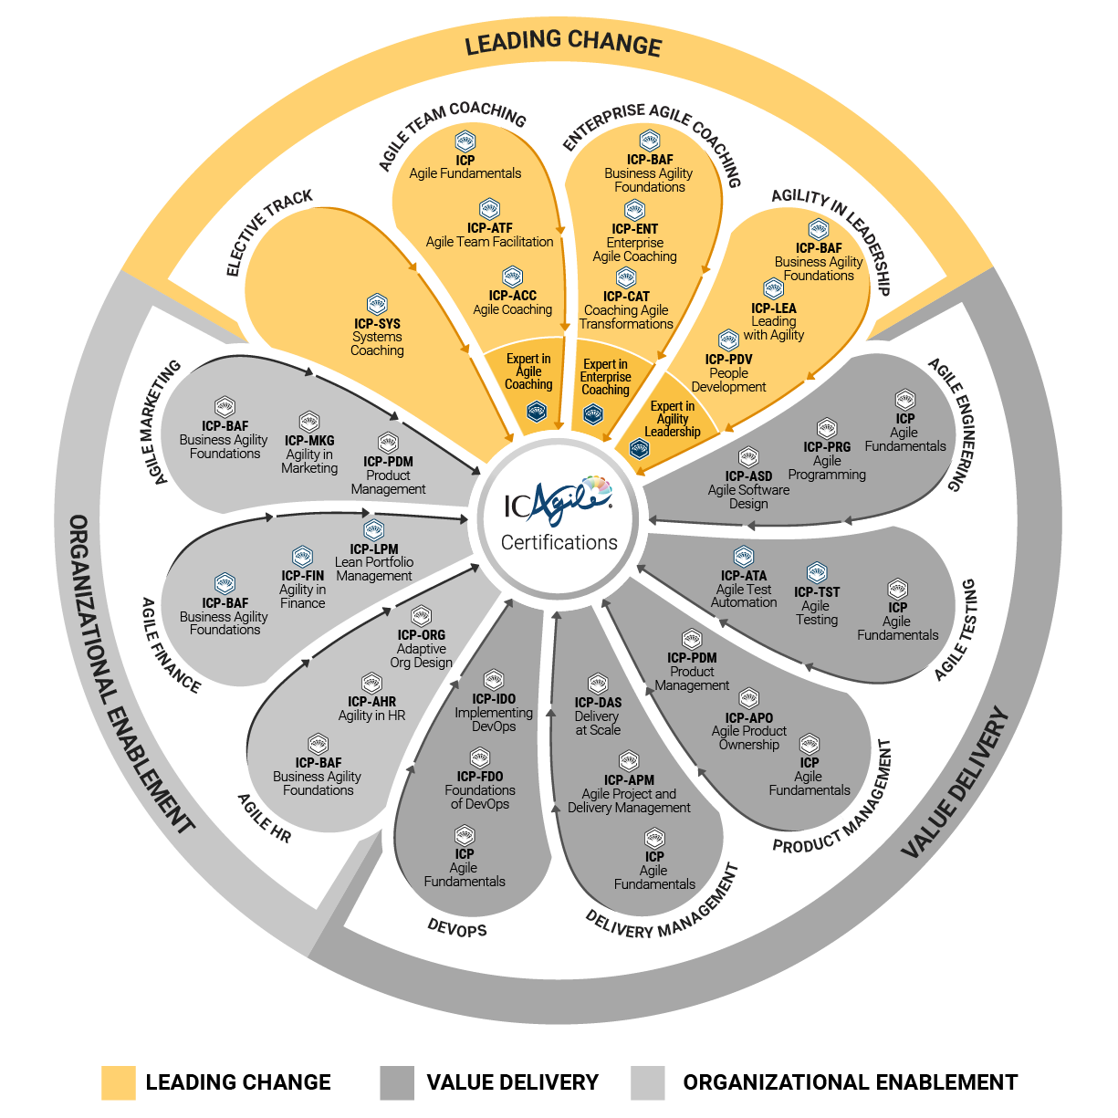
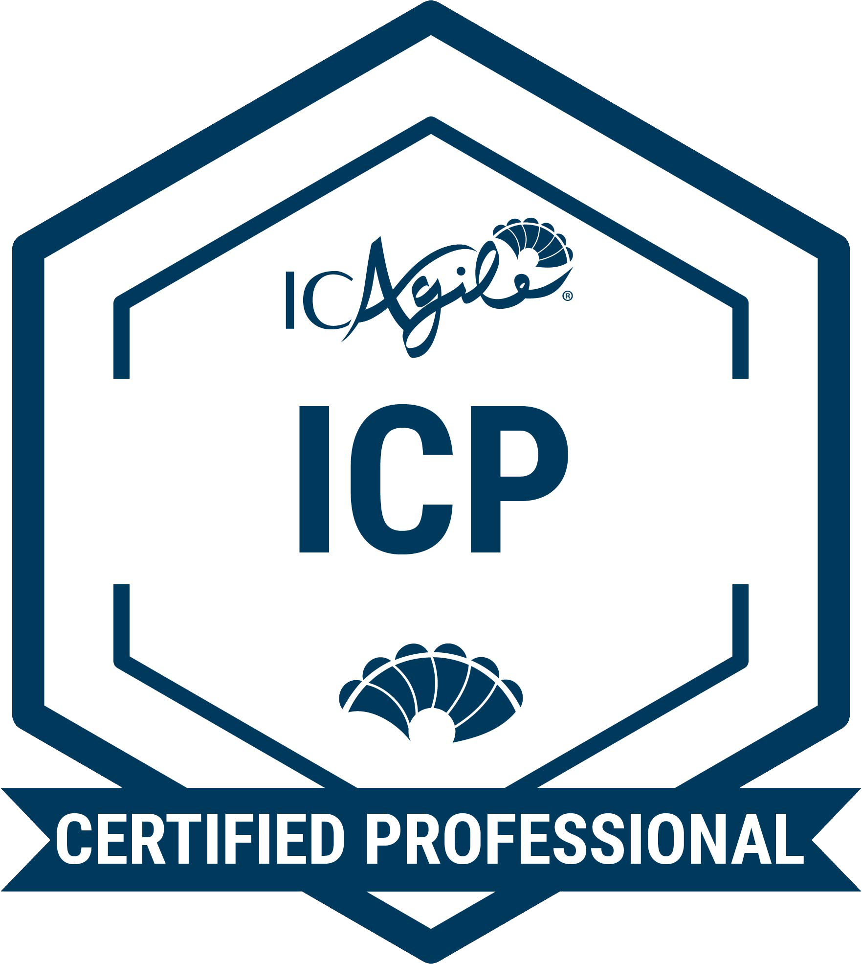
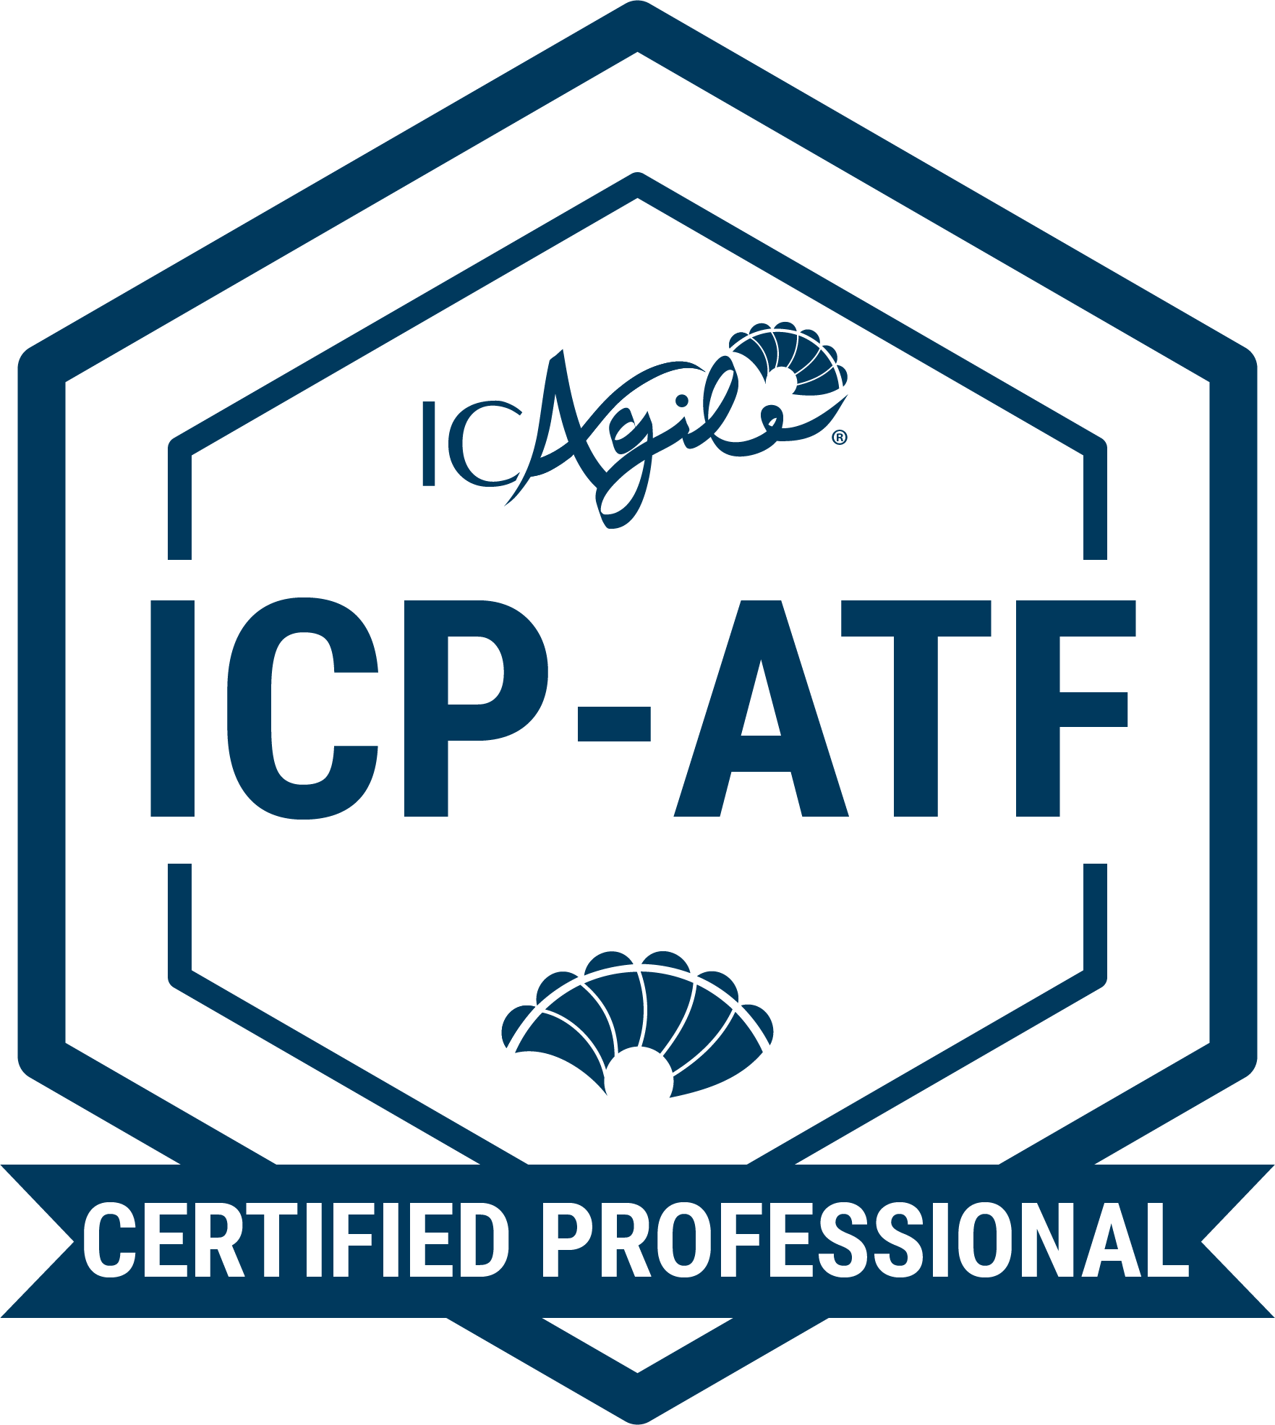
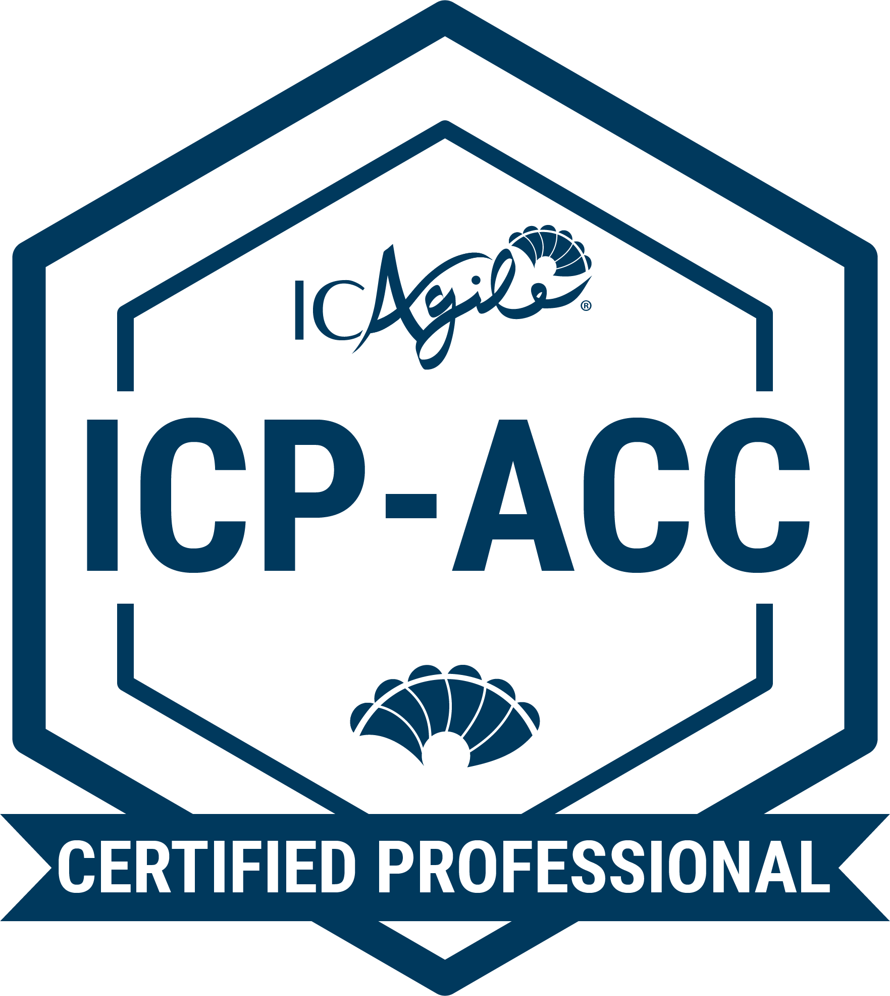
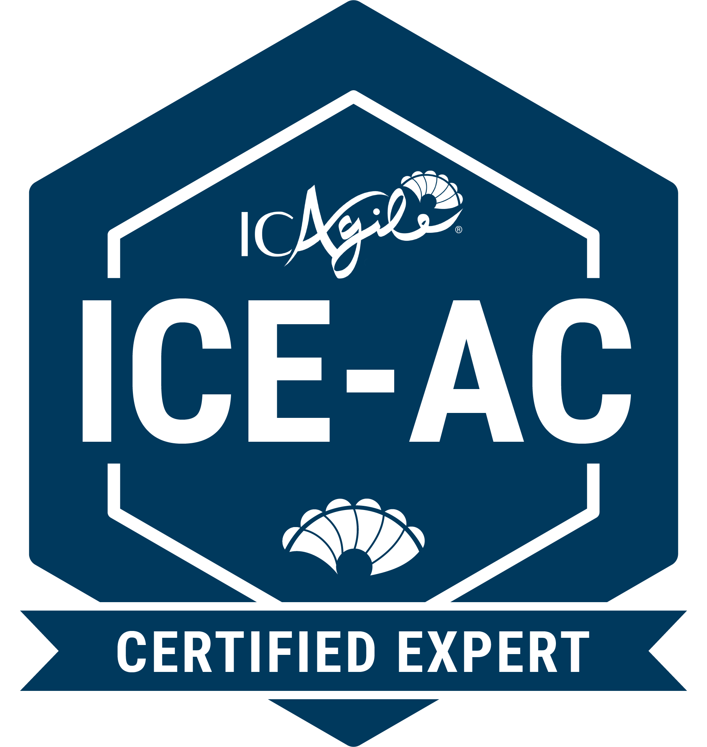
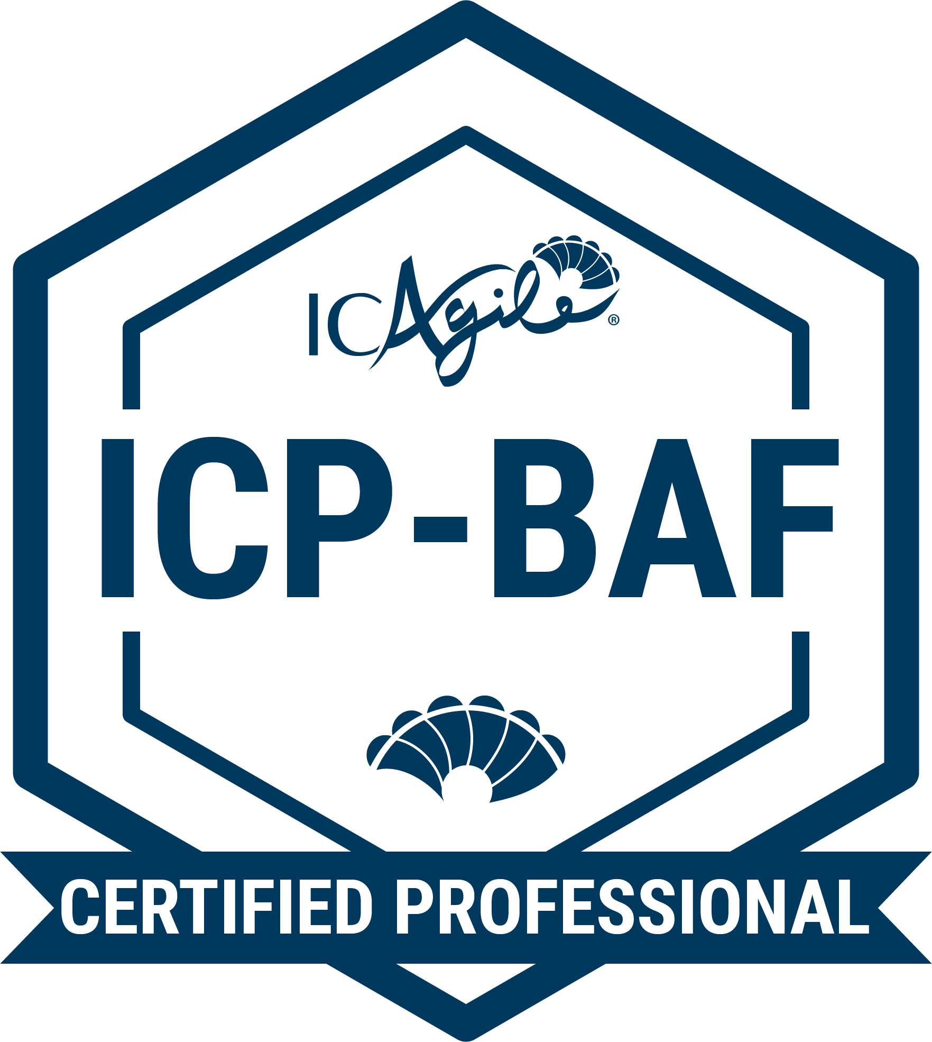
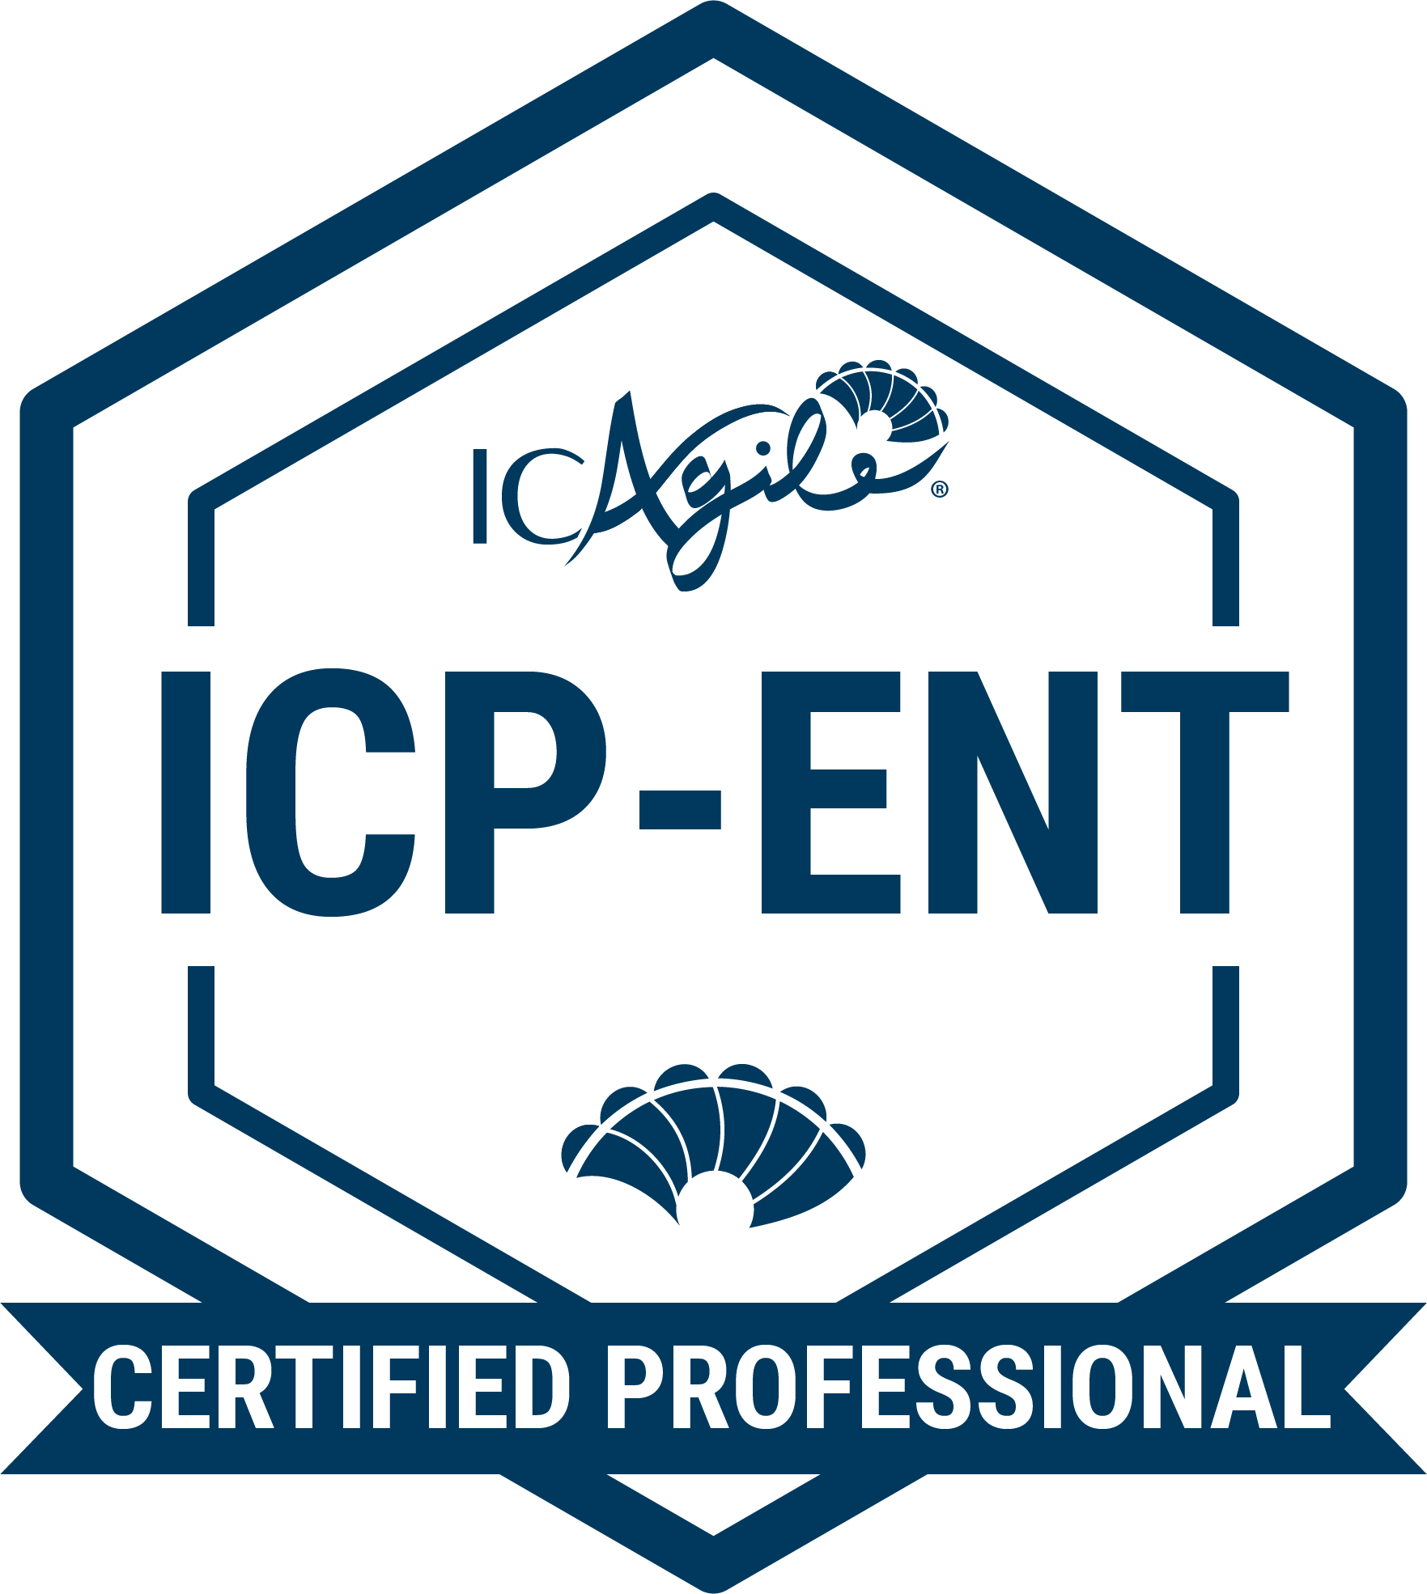
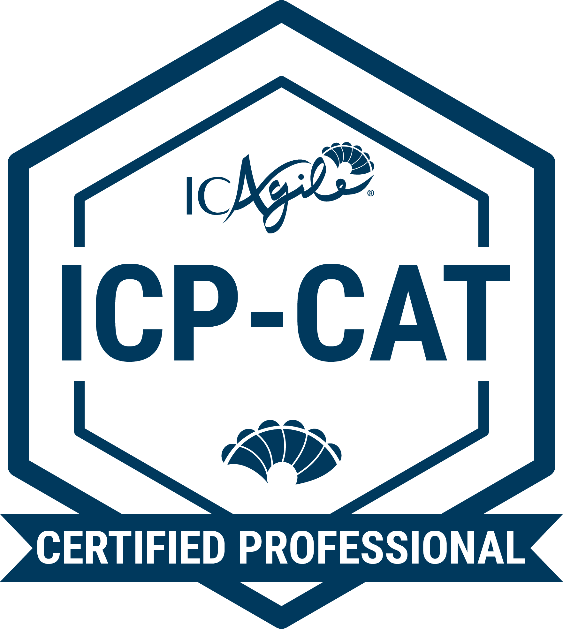
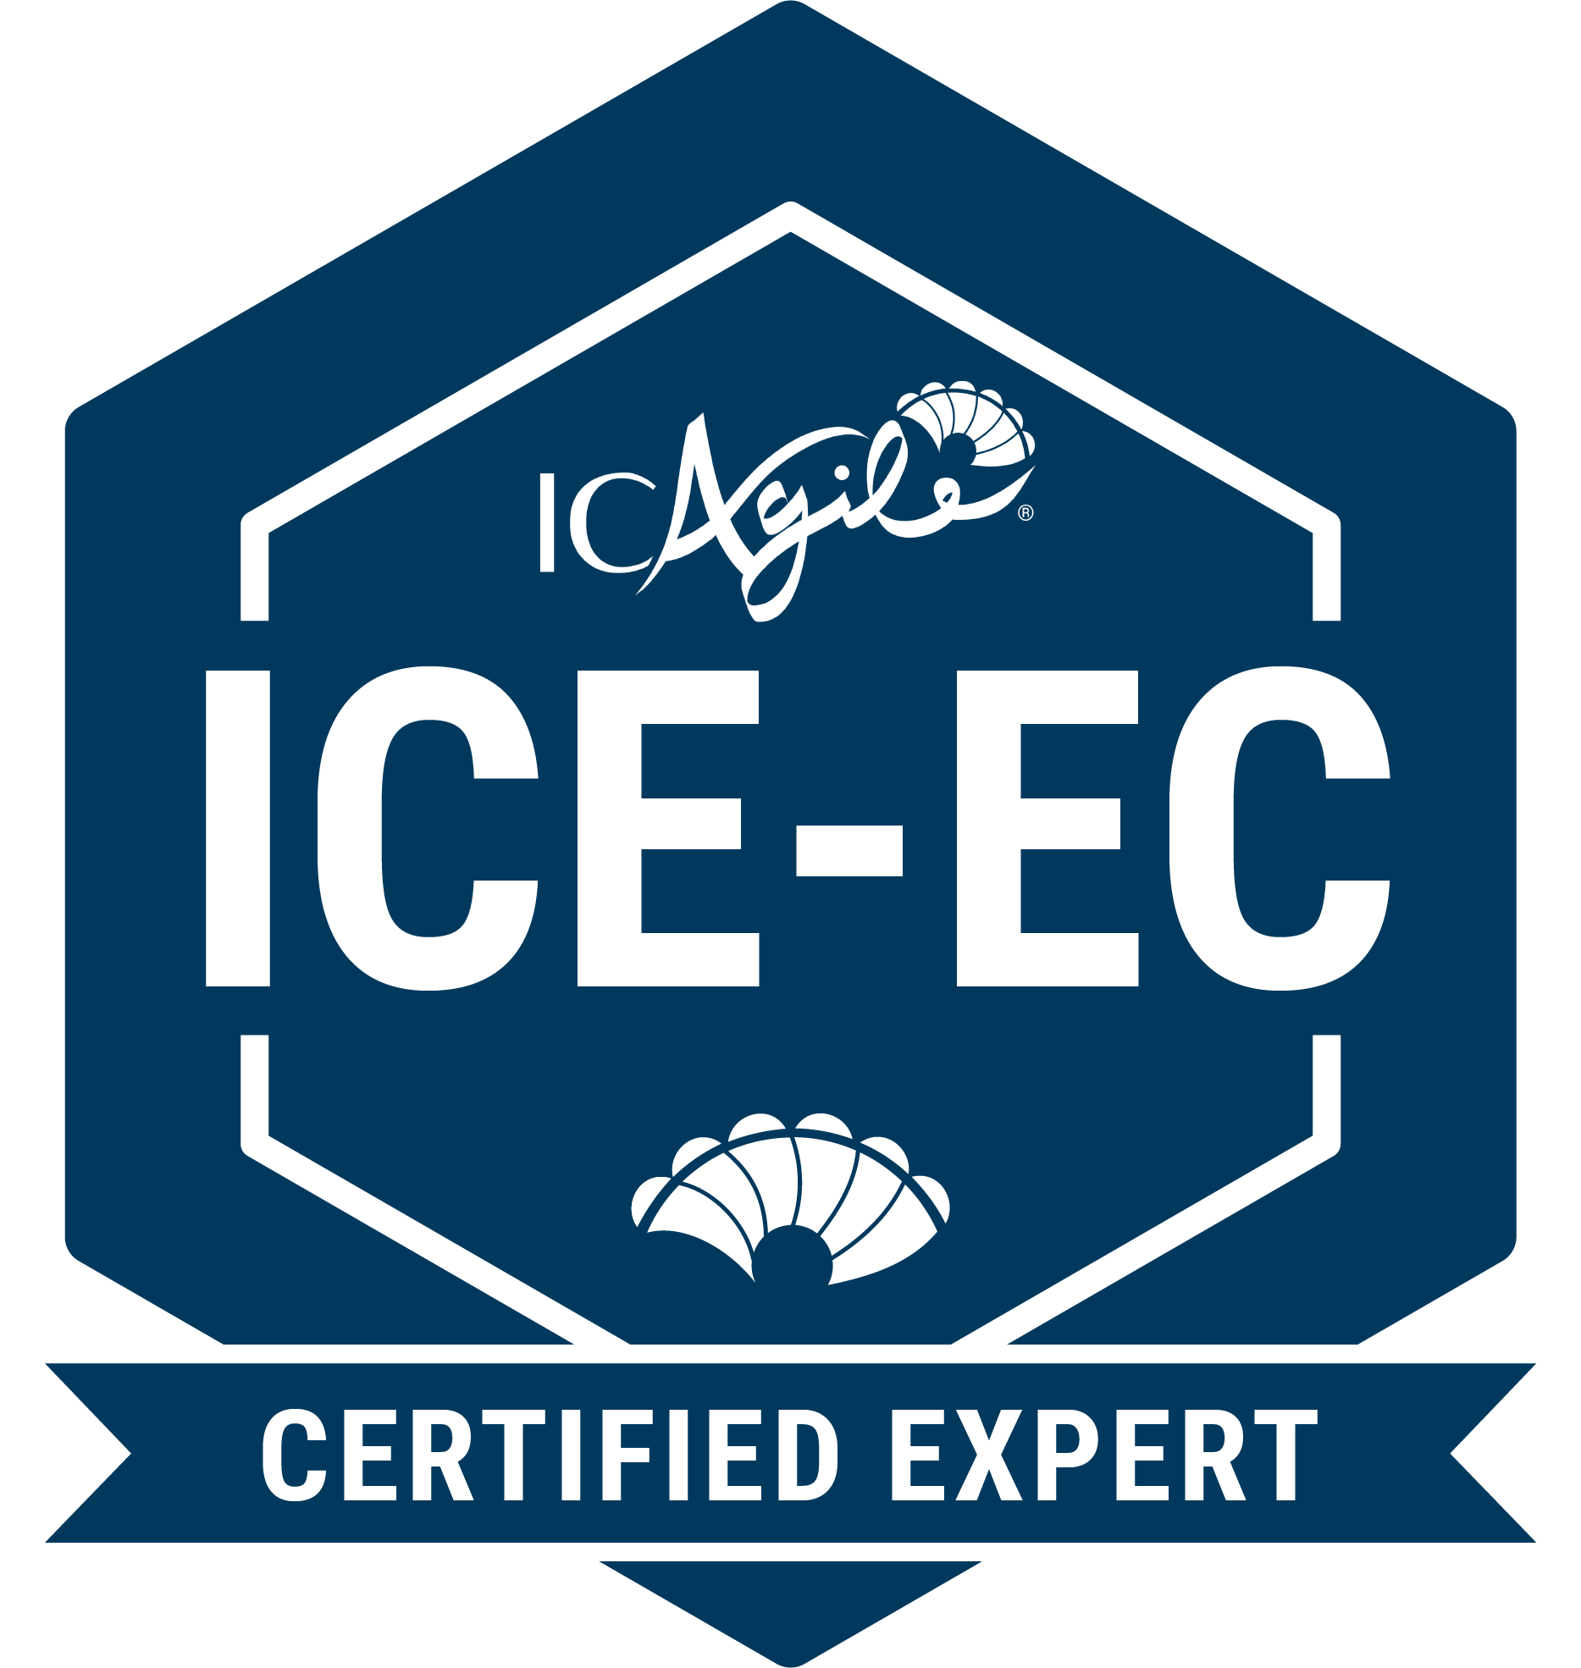
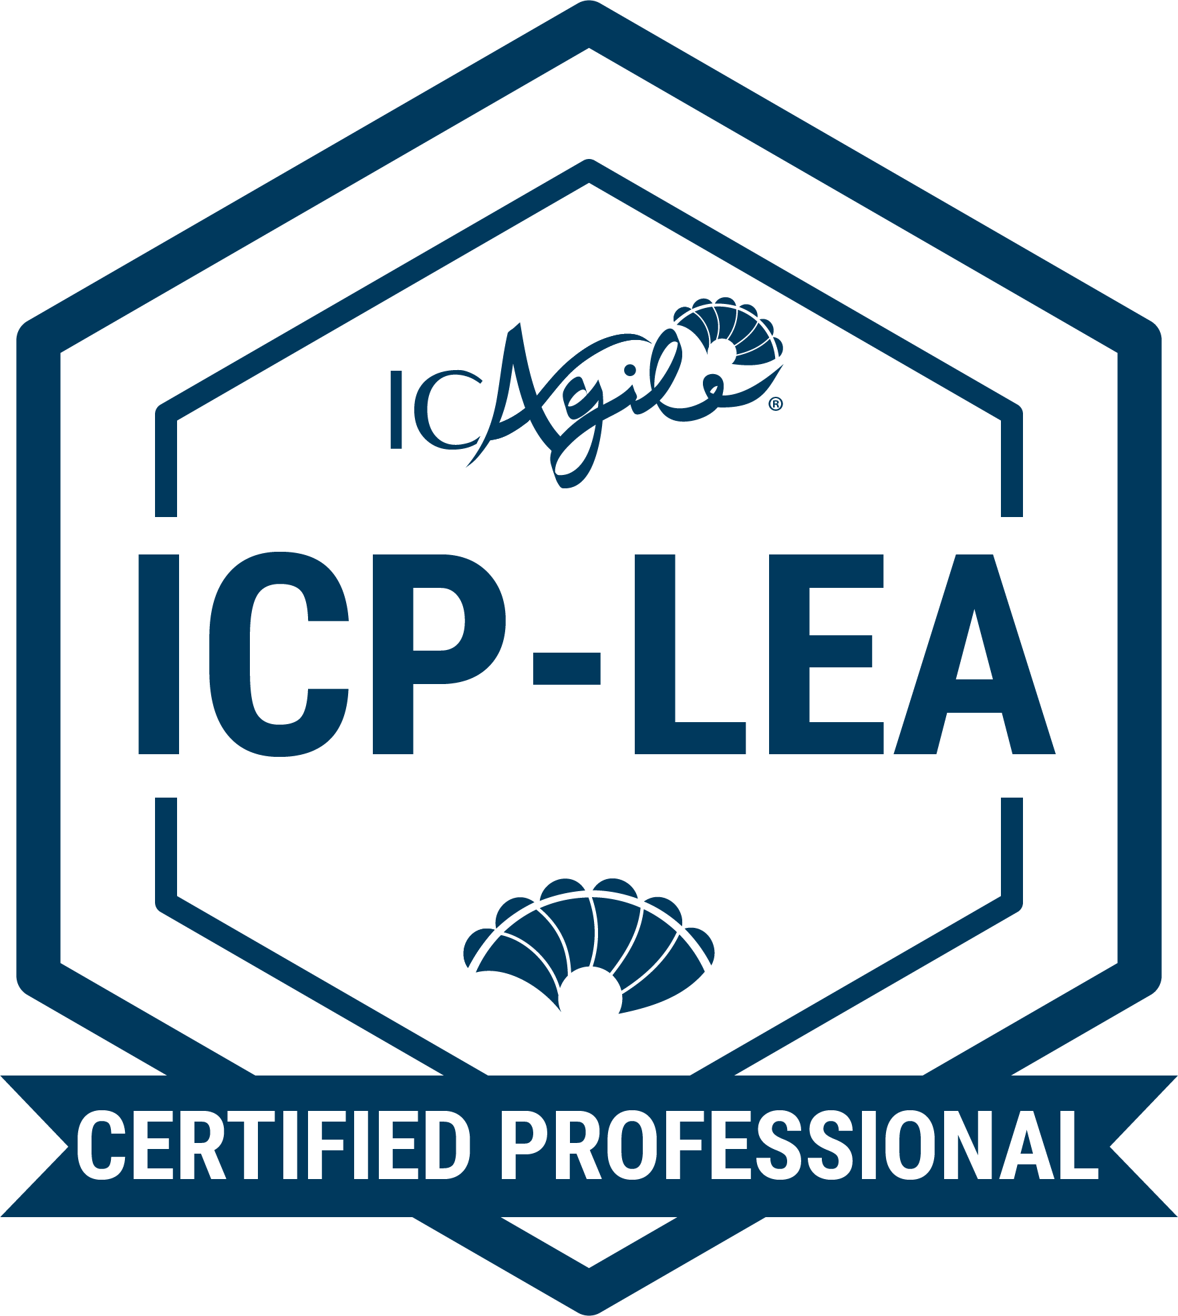
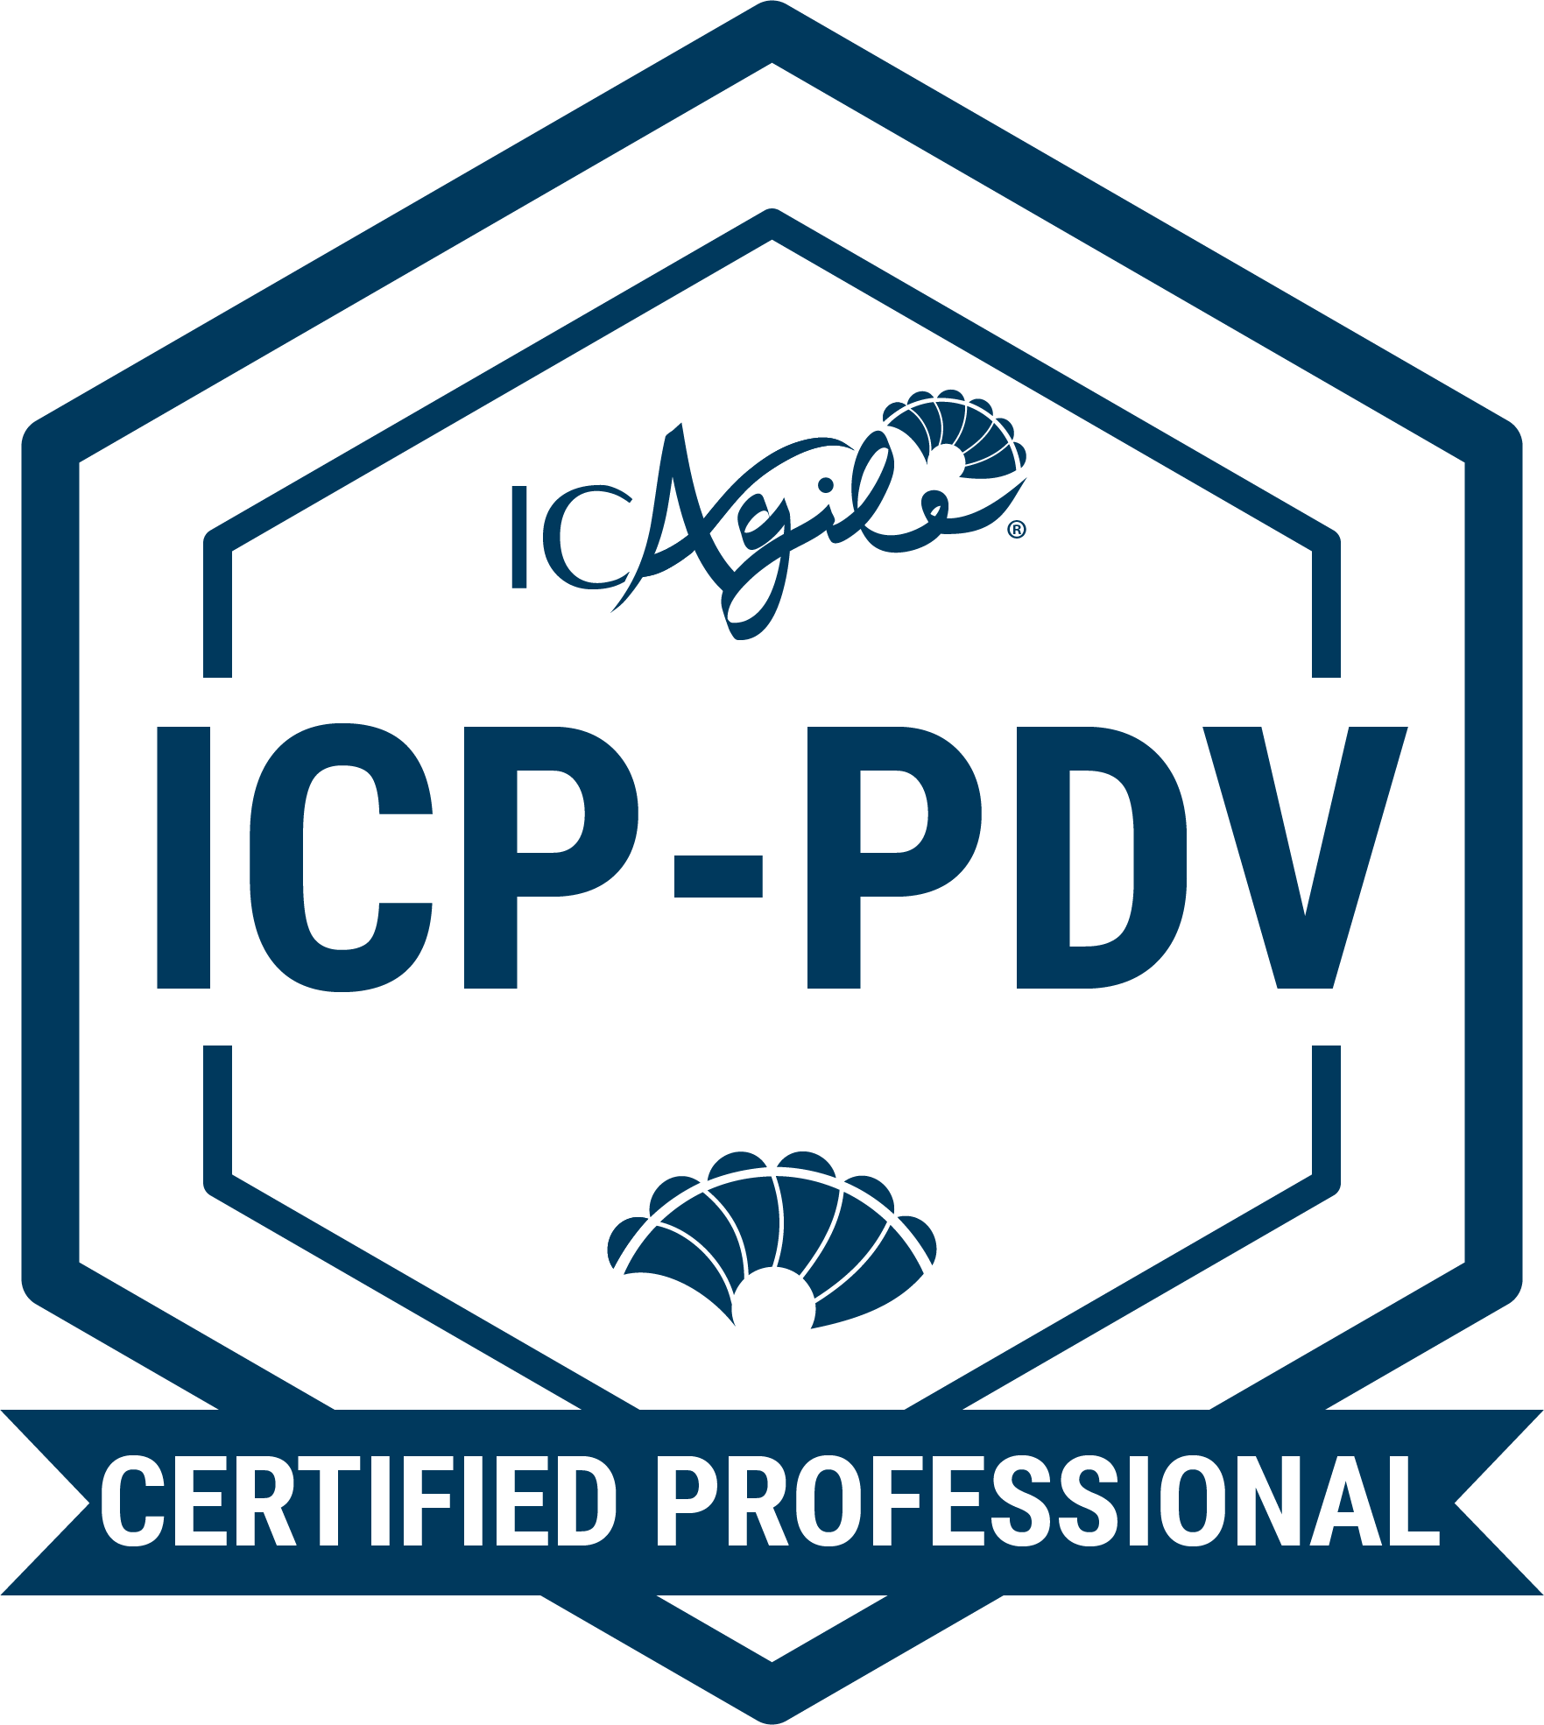
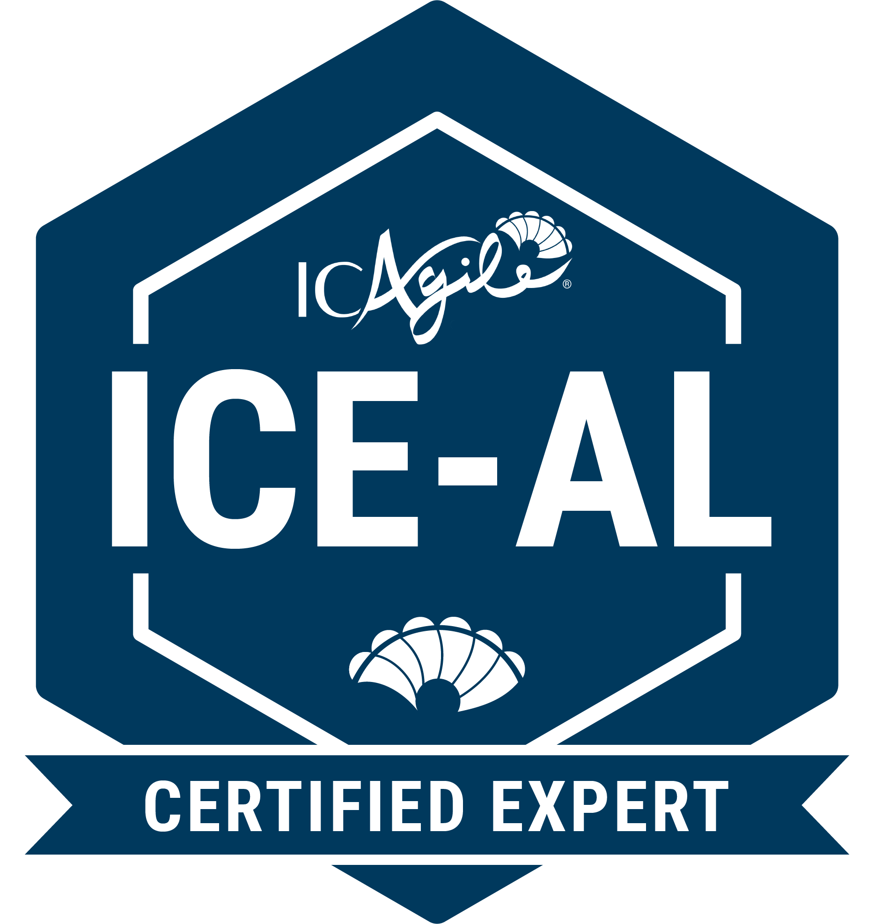
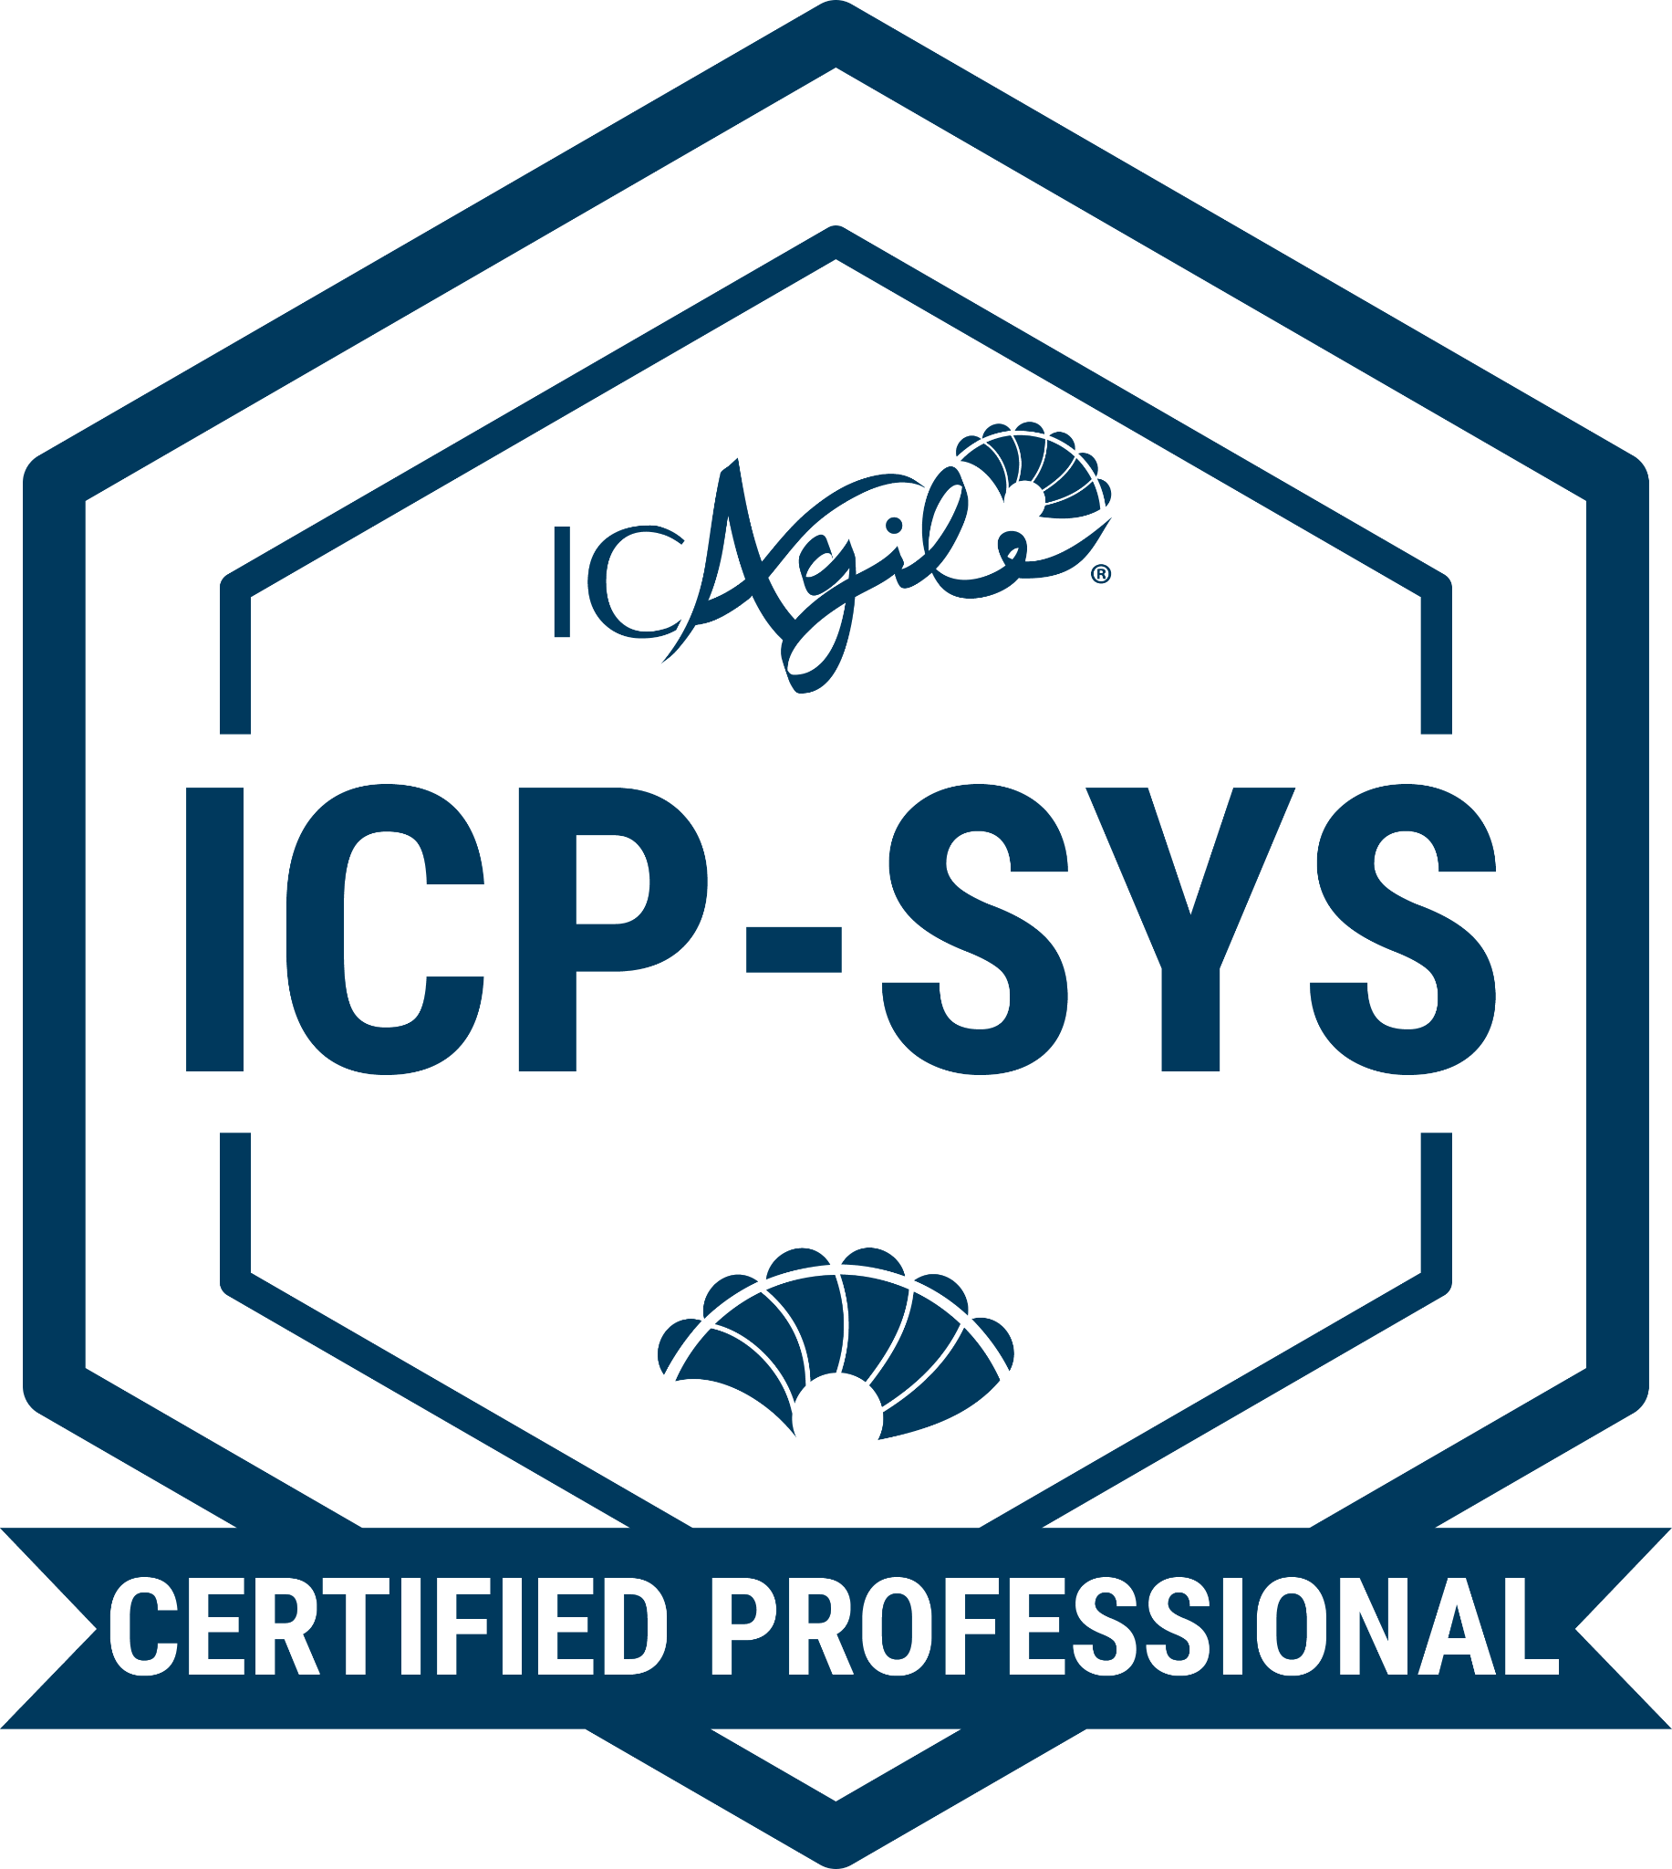
TRACKS IN LEADING CHANGE
Agile Team Coaching
Agile Fundamentals
Agile Team Facilitation
Agile Coaching
Expert in Agile Coaching
Enterprise Coaching
Business Agility Foundations
Enterprise
Agile
Coaching
Coaching Agile Transformations
Expert in Enterprise Coaching
Agility in Leadership
Business Agility Foundations
Leading with Agility
People Development
Expert in Agility in Leadership
Additional Recommended Certifications
Systems Coaching
Go Back to Learning Programs

Slide 6
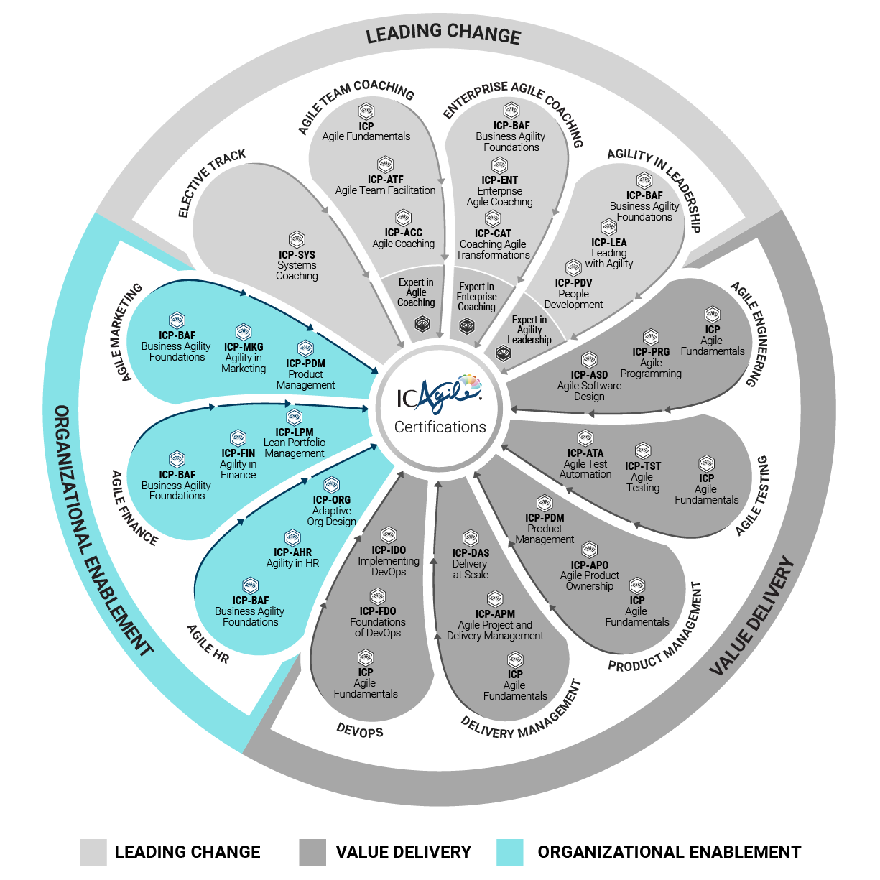
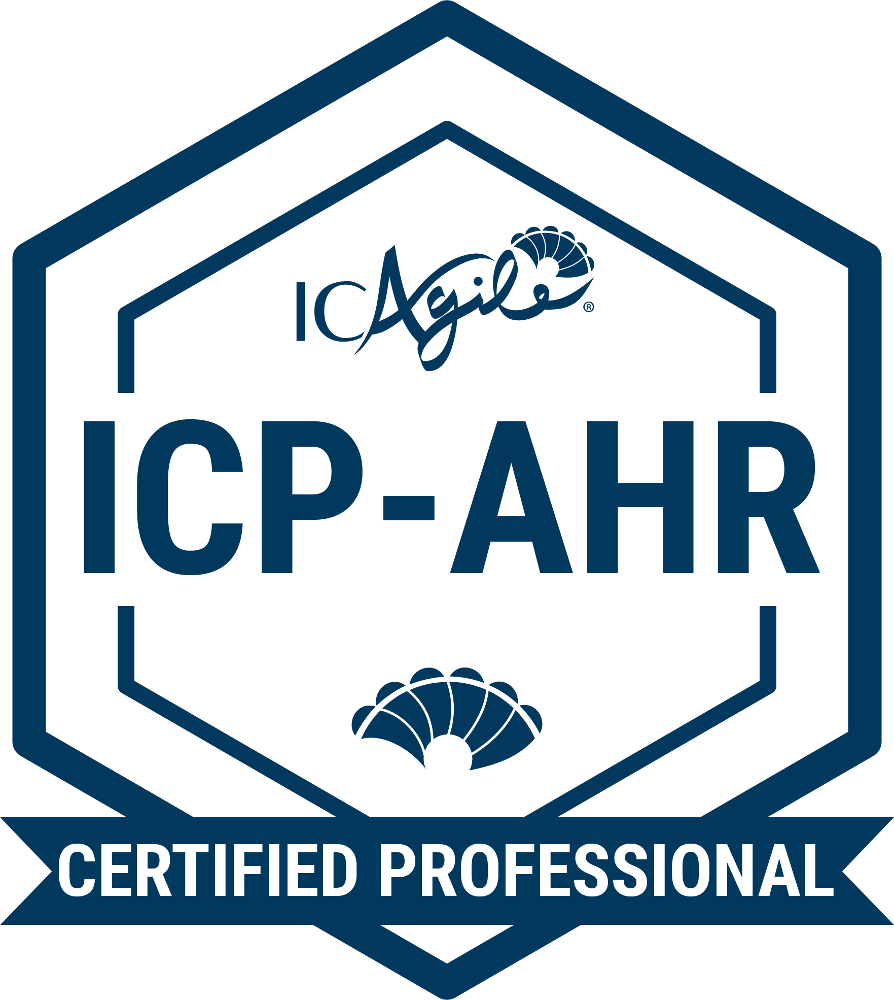
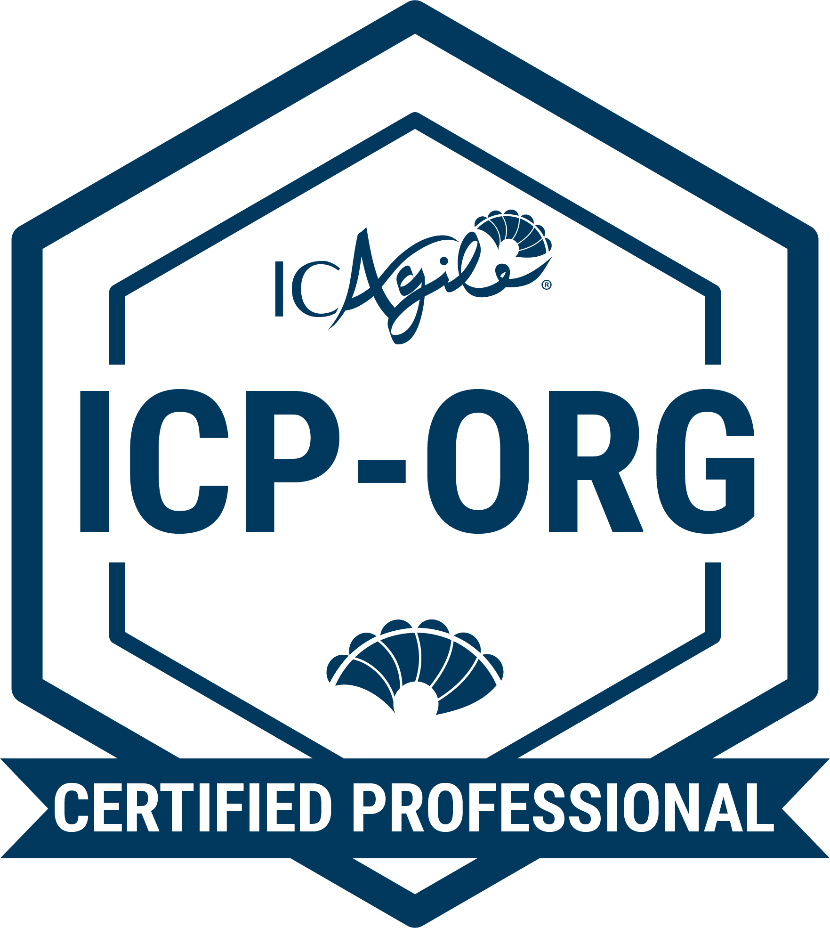
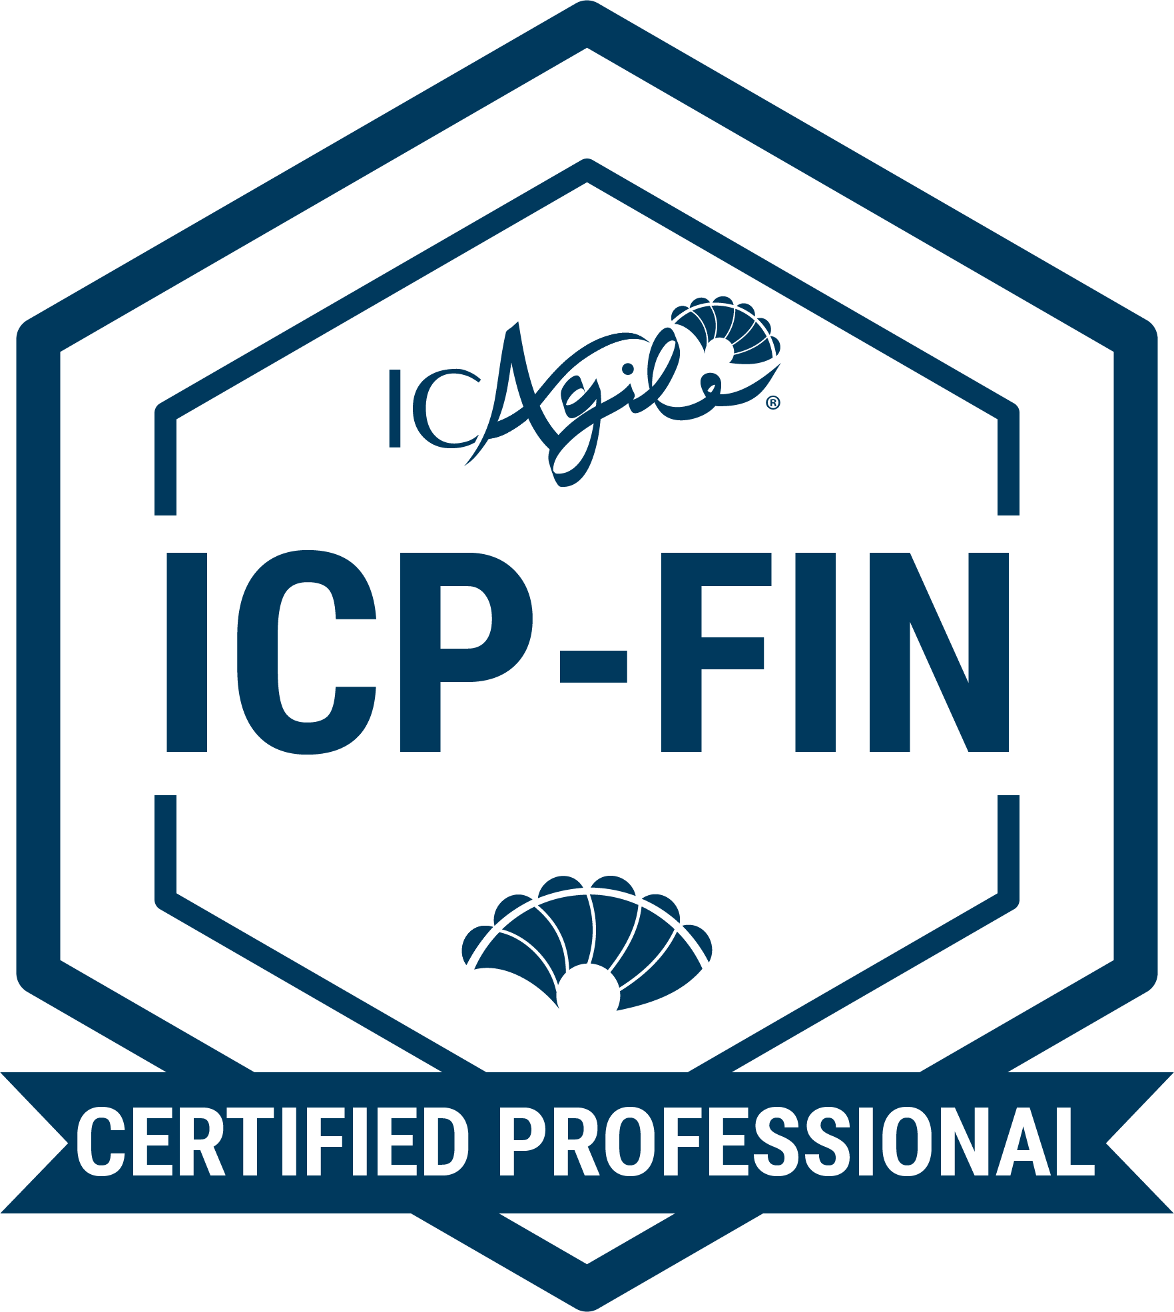
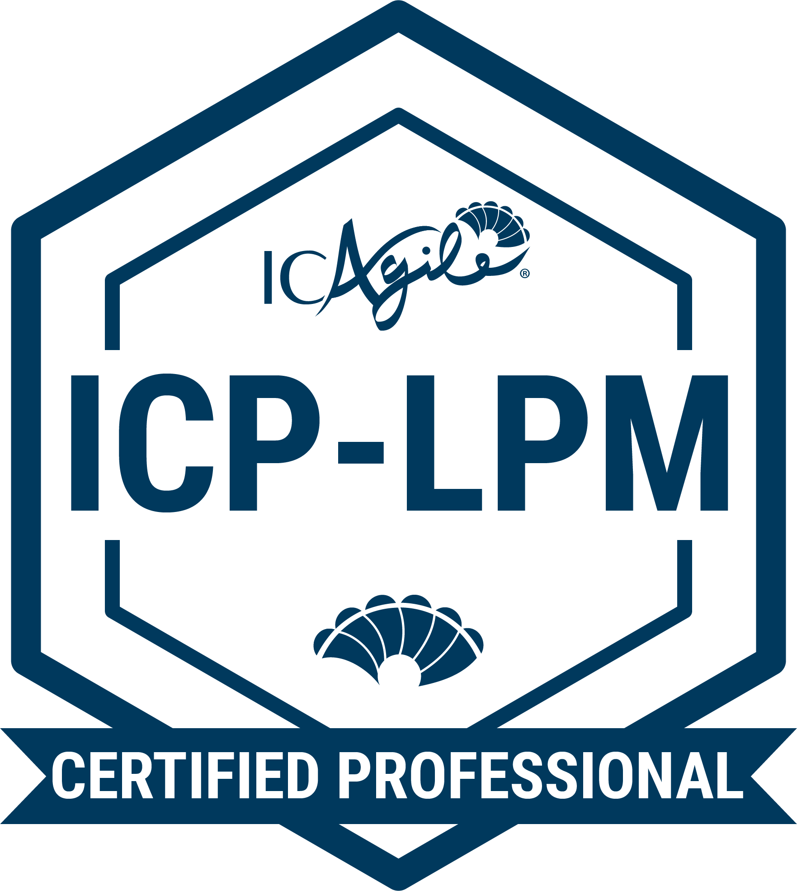
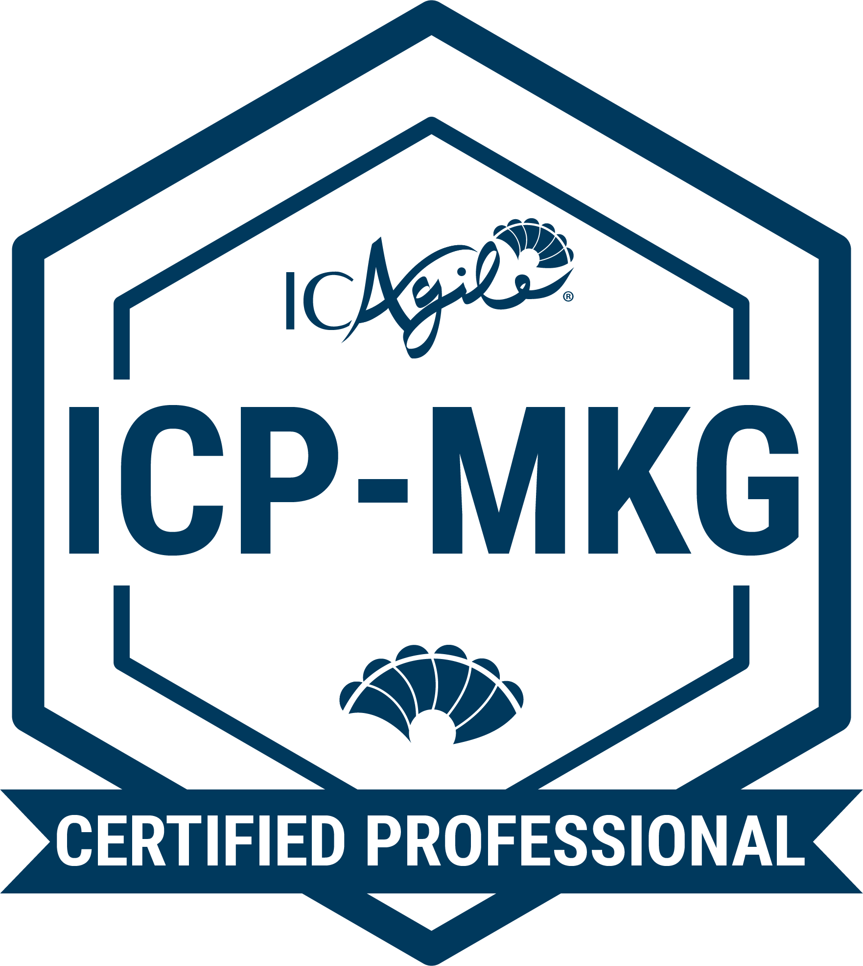
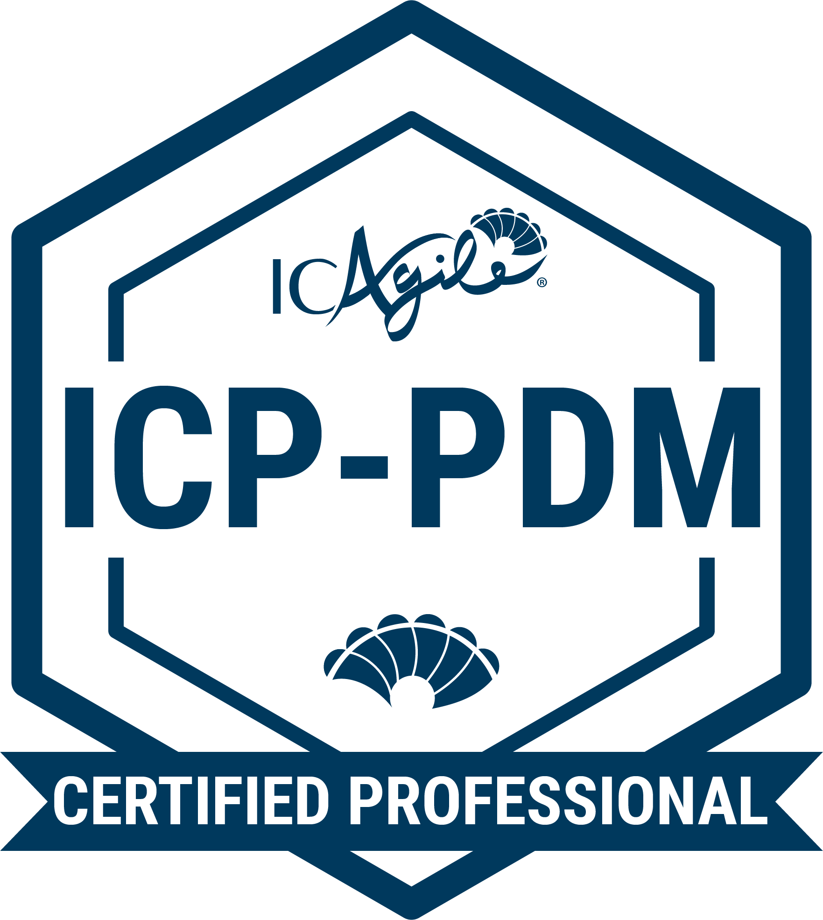
TRACKS IN
ORGANIZATIONAL ENABLEMENT
Agile HR
Business Agility Foundations
Agility in HR
Adaptive Org Design
Agile Finance
Business Agility Foundations
Agility in Finance
Lean Portfolio Management
Agile Marketing
Business Agility Foundations
Agility in Marketing
Product Management
Go Back to Learning Programs

Slide 7
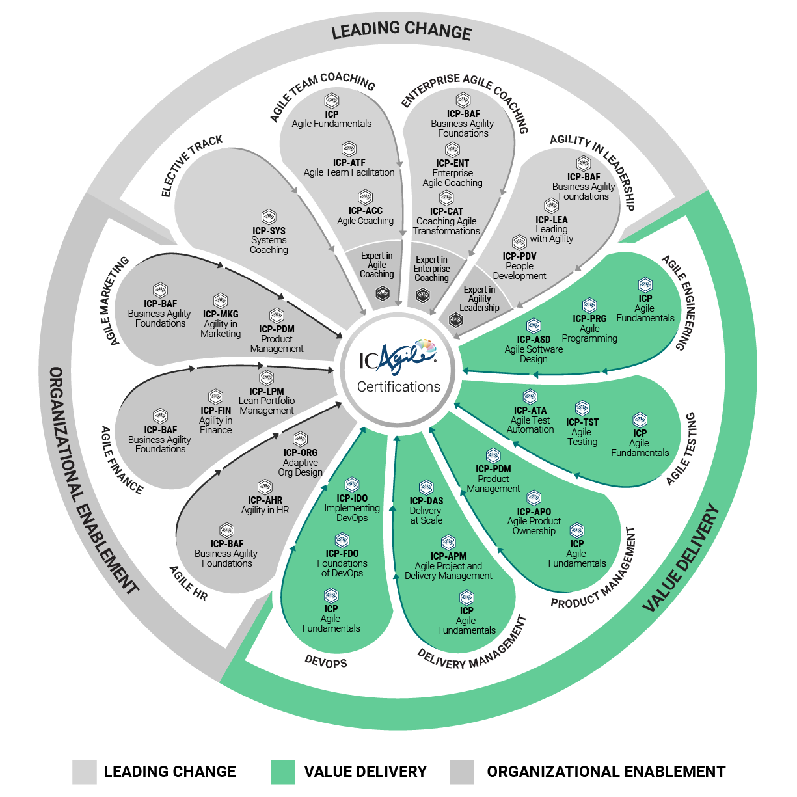
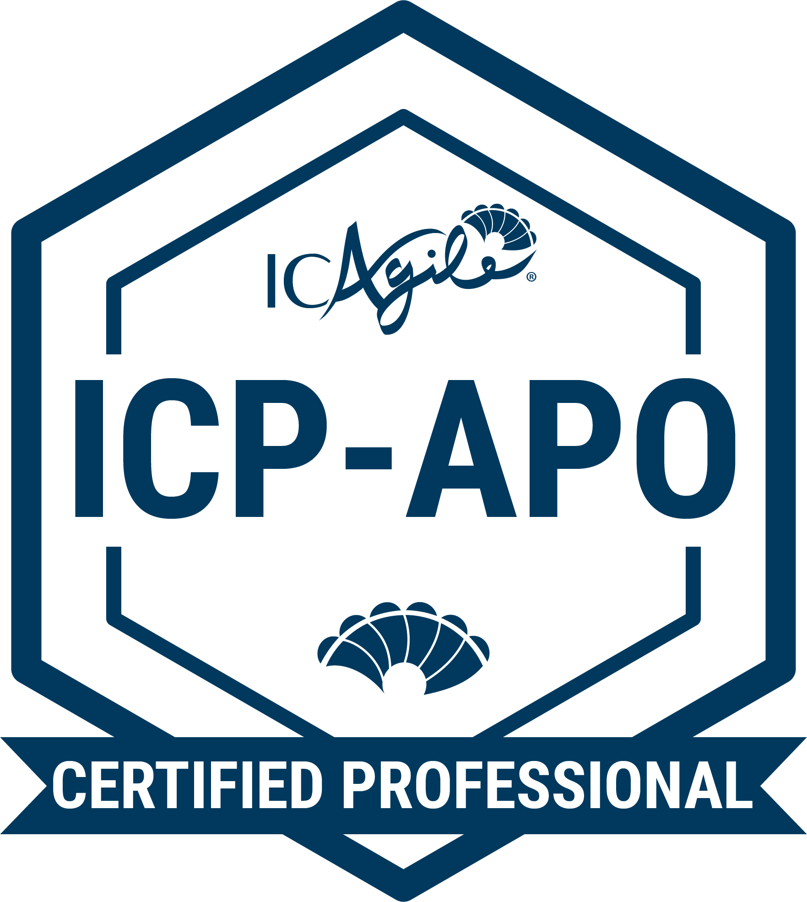
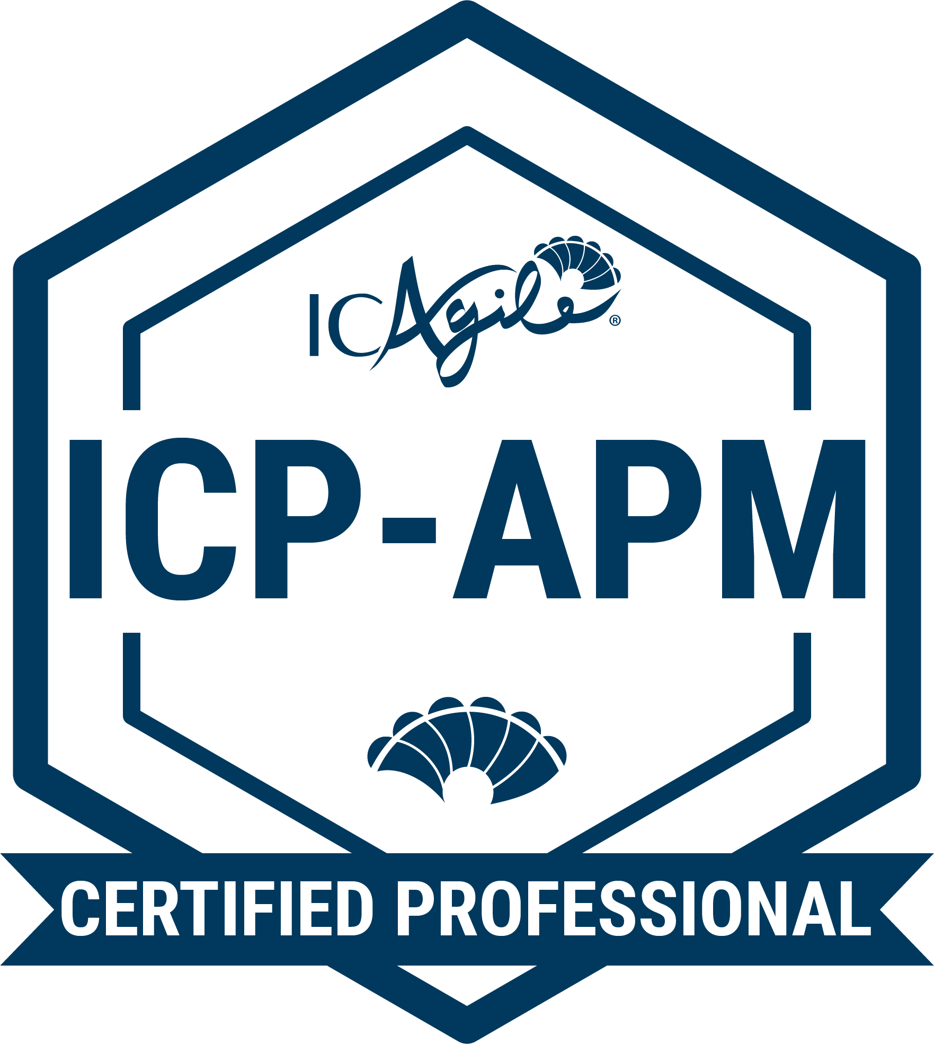
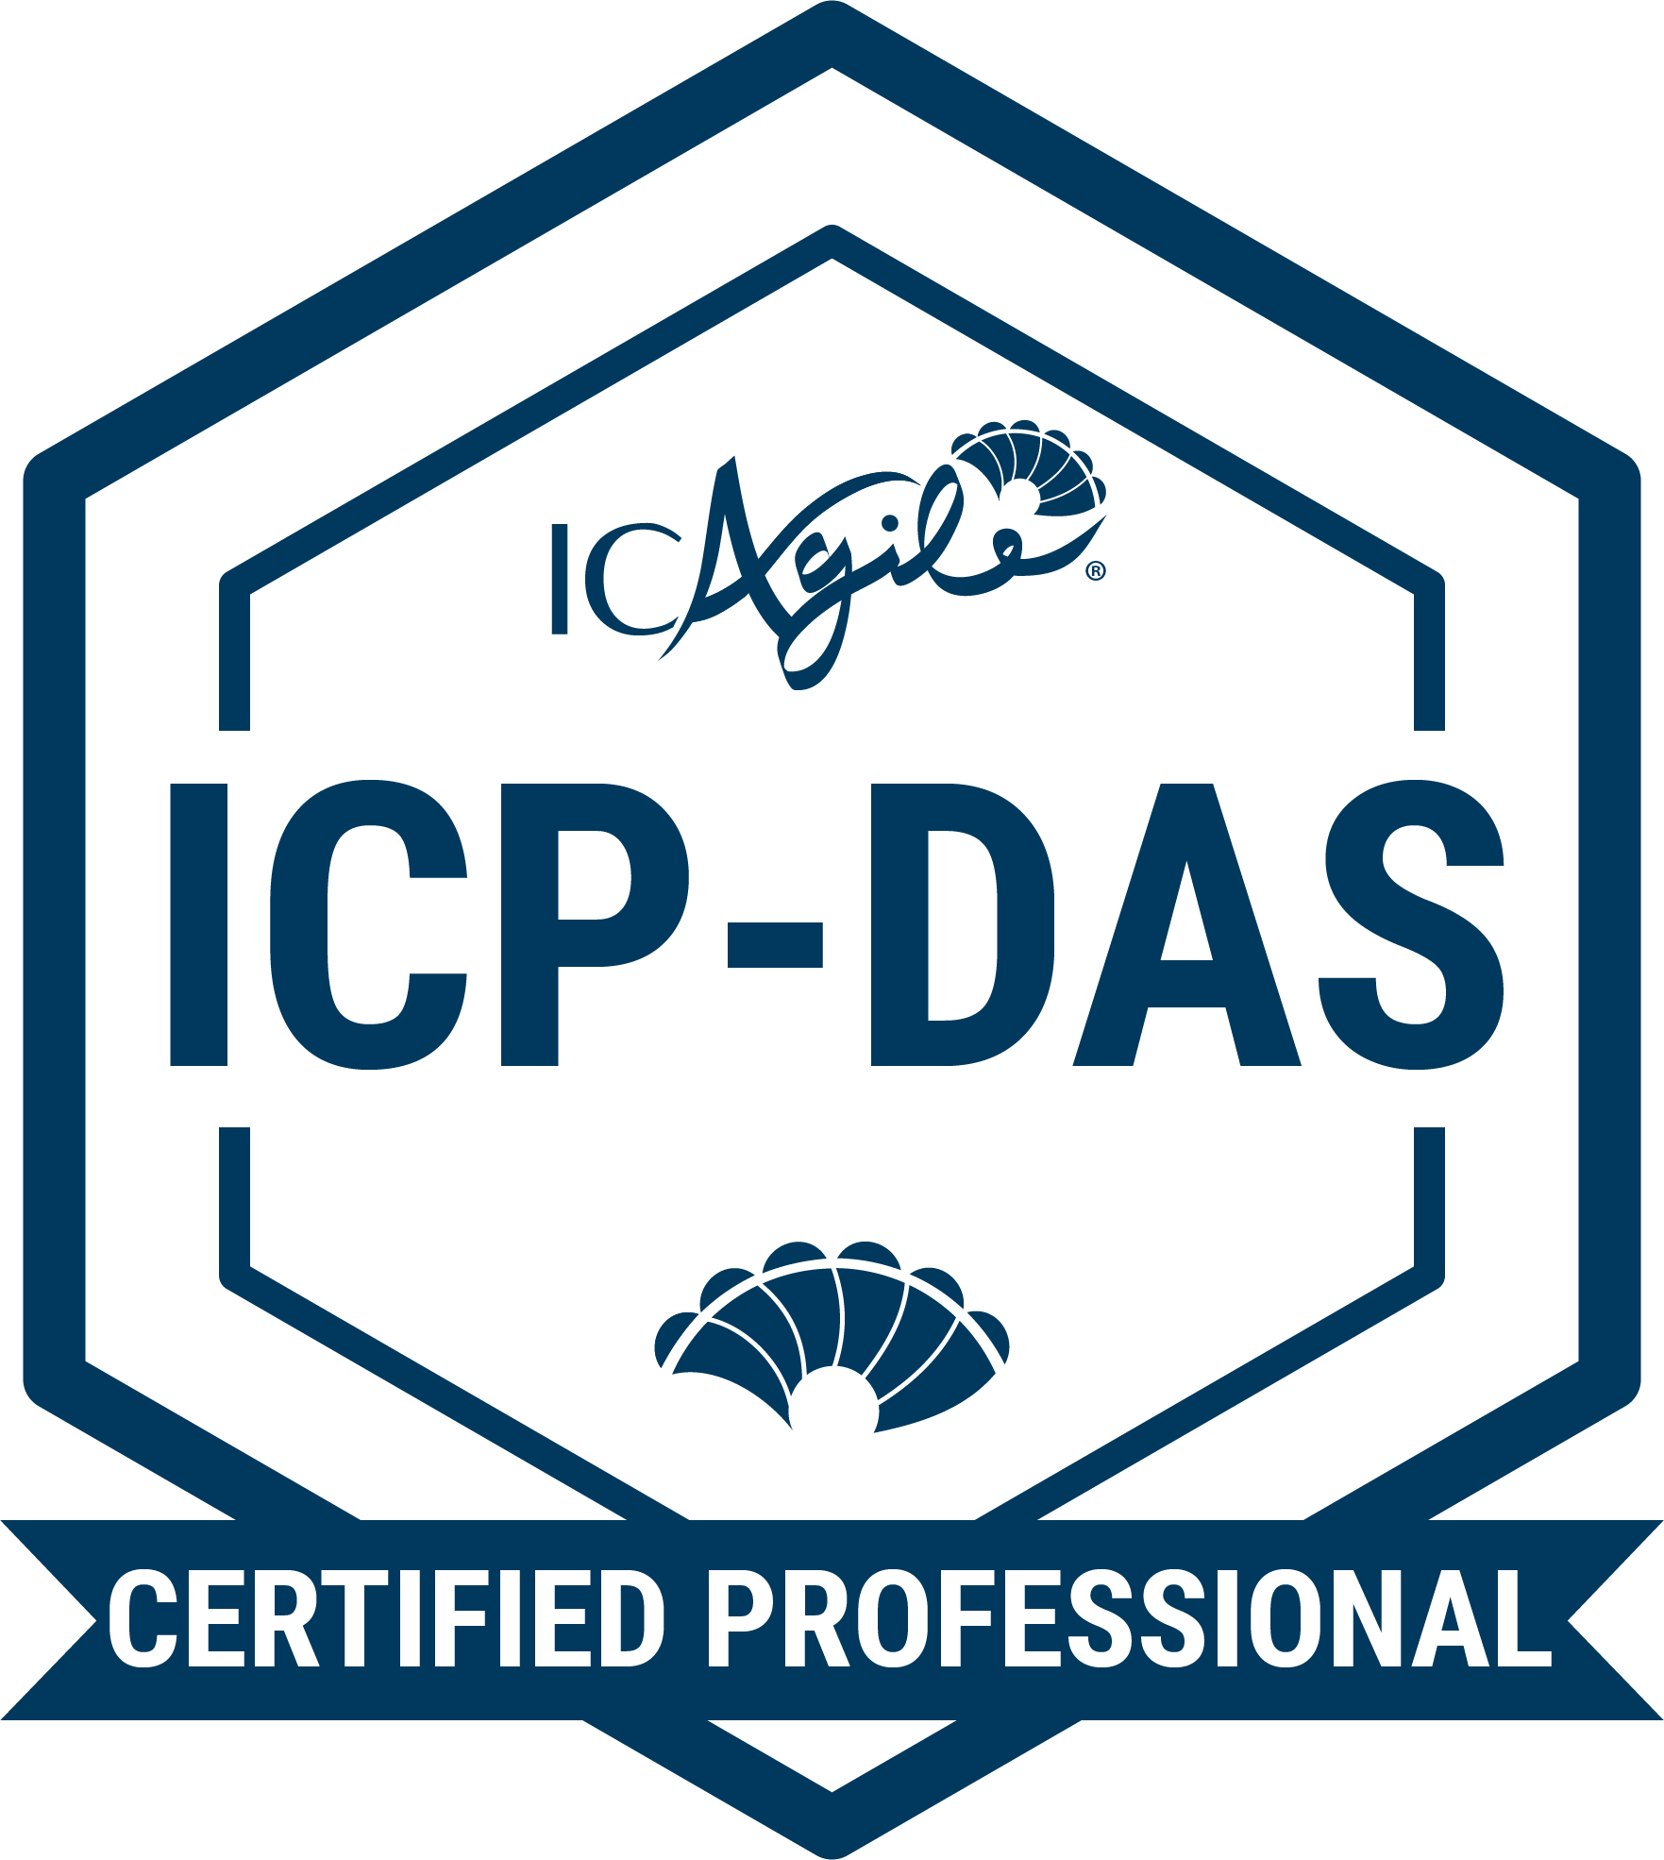
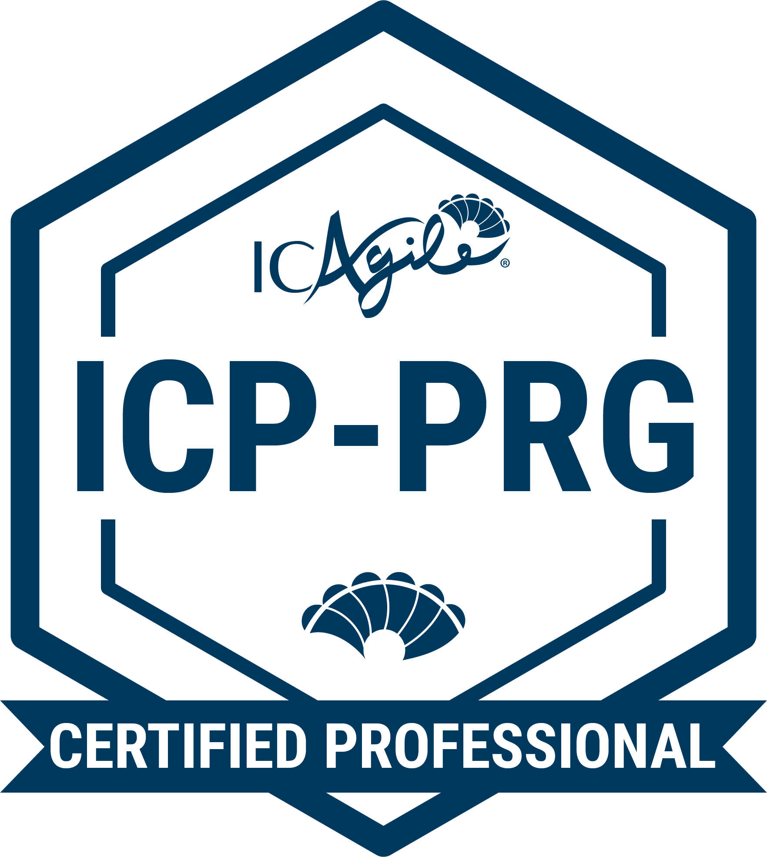
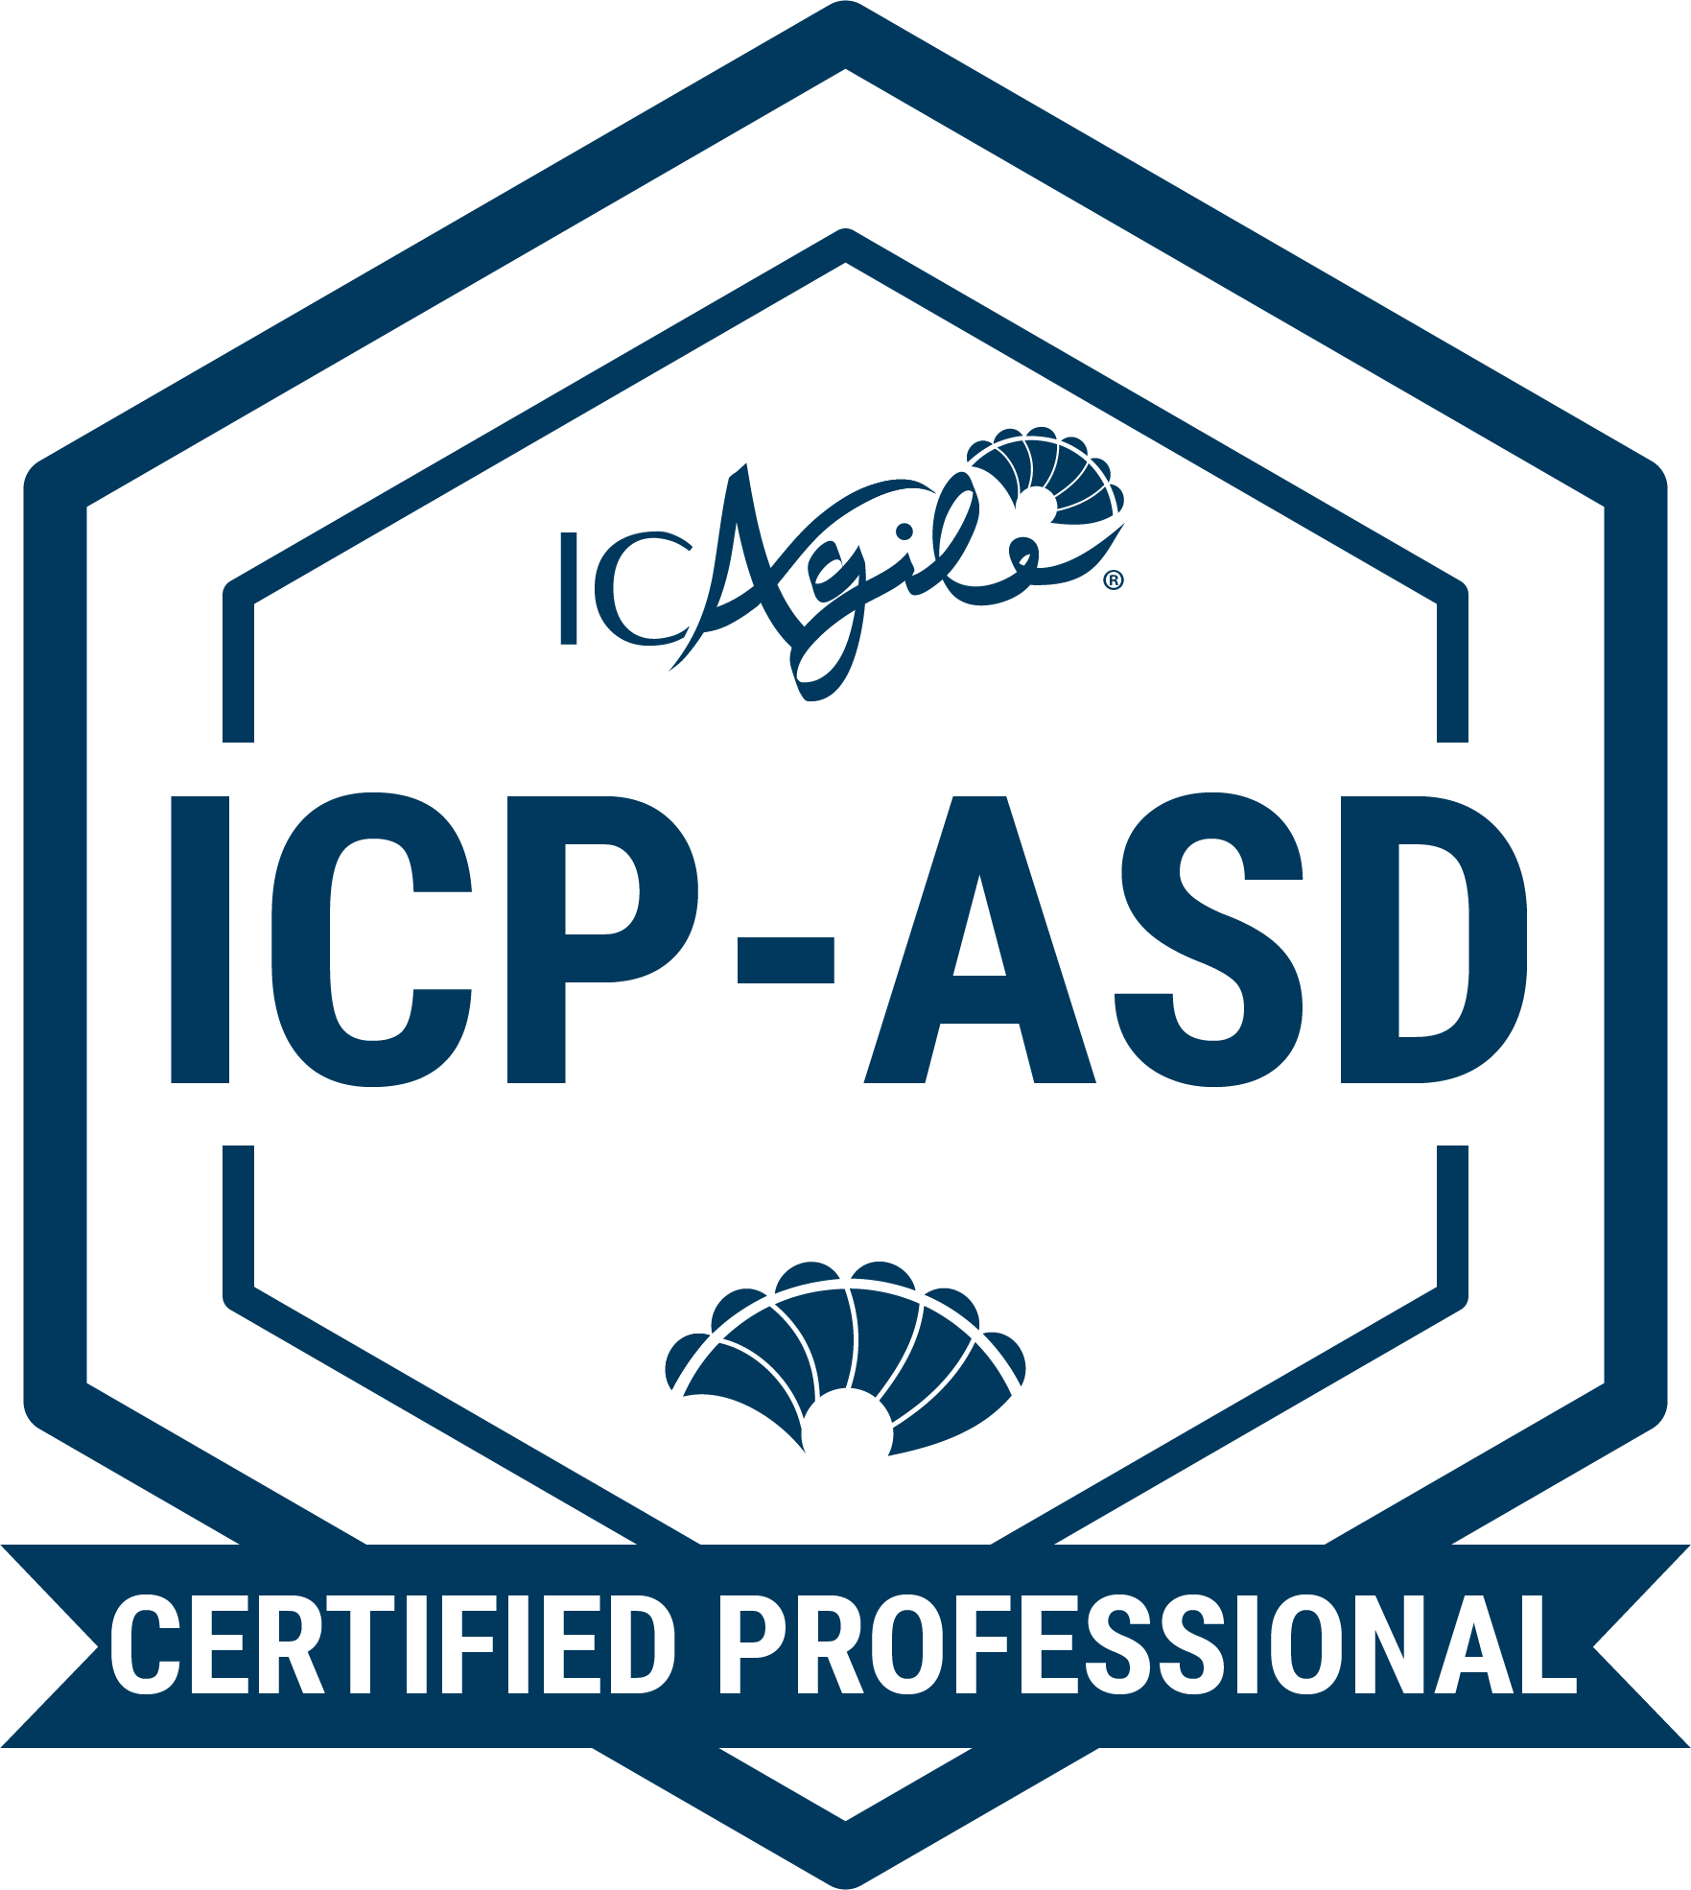
TRACKS IN VALUE DELIVERY
Product Management
Agile Fundamentals
Agile Product Ownership
Product Management
Delivery Management
Agile Fundamentals
Agile Project and Delivery Management
Delivery at Scale
Agile Engineering
Agile Fundamentals
Agile Programming
Agile Software Design
Go Back to Learning Programs

Slide 8
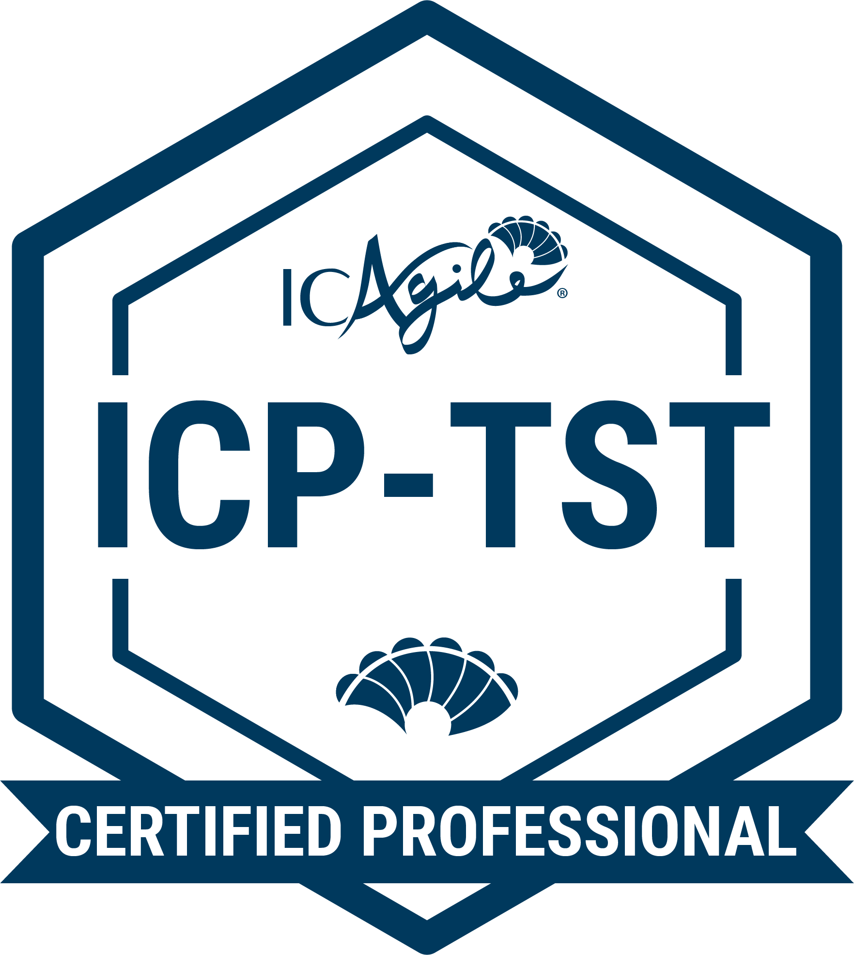
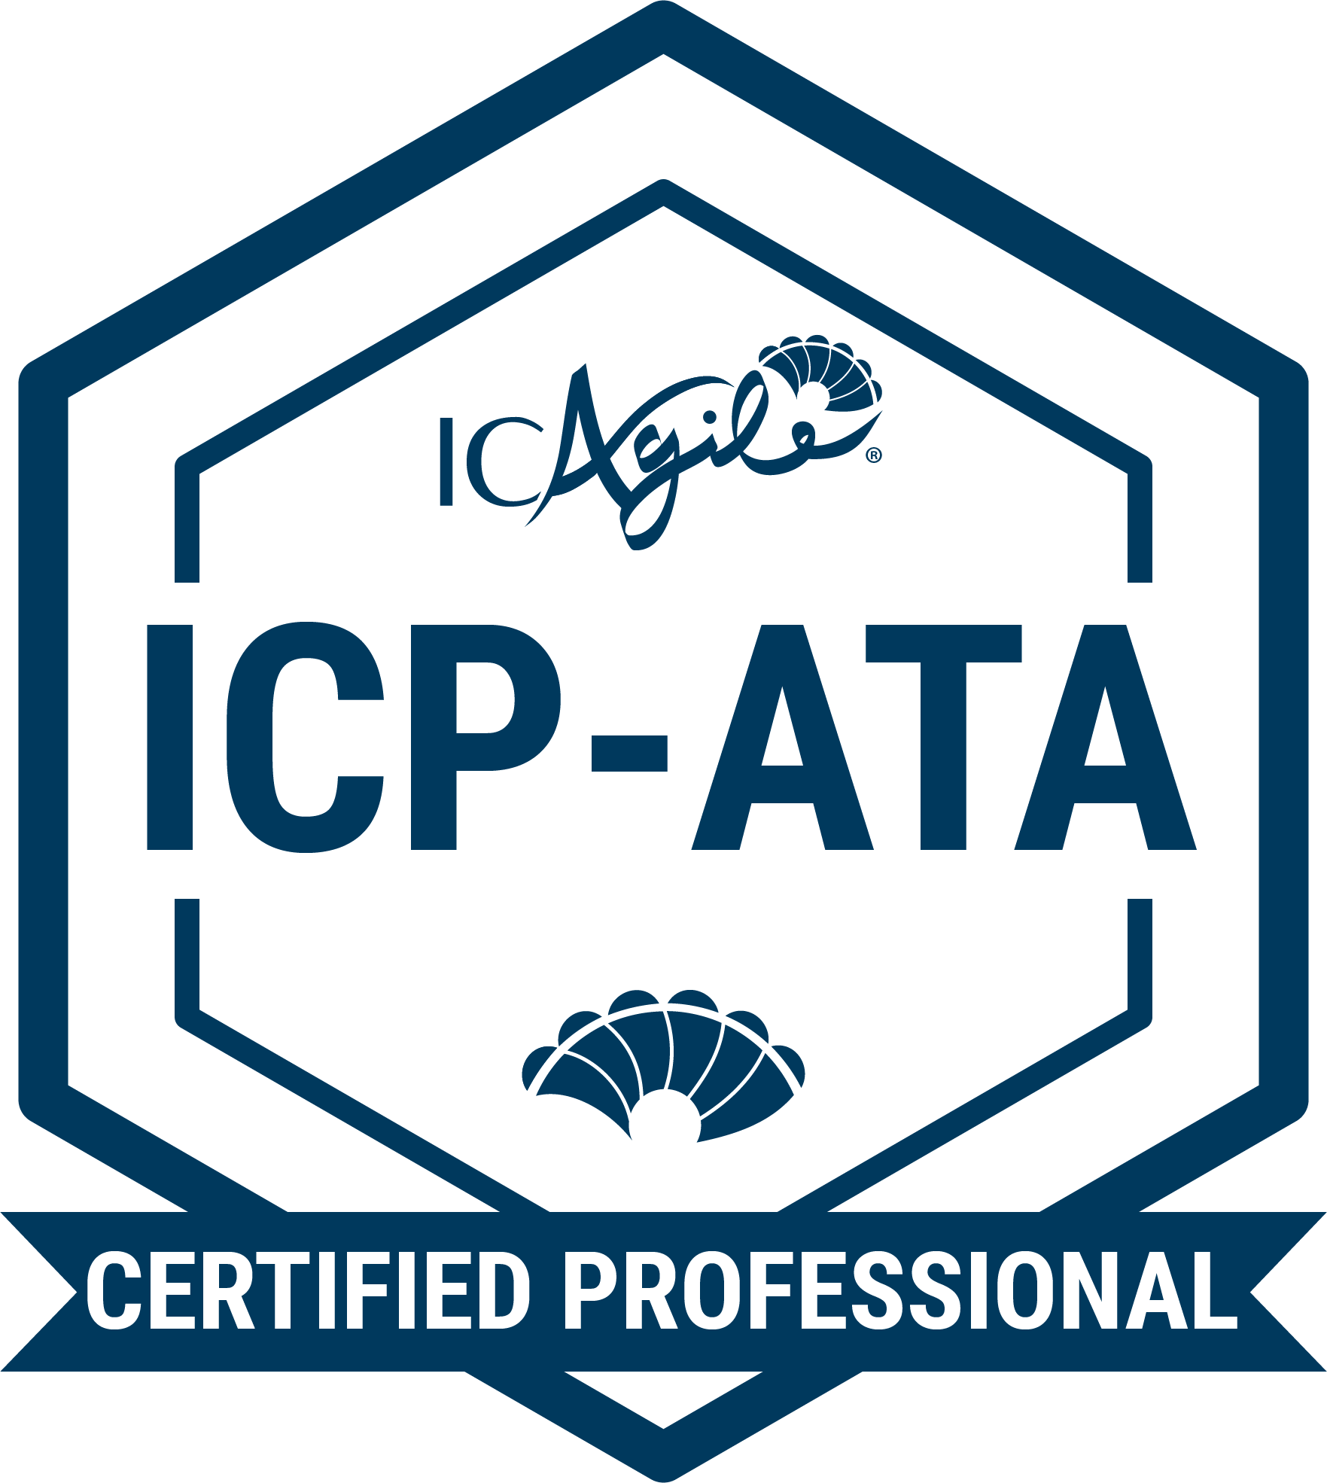
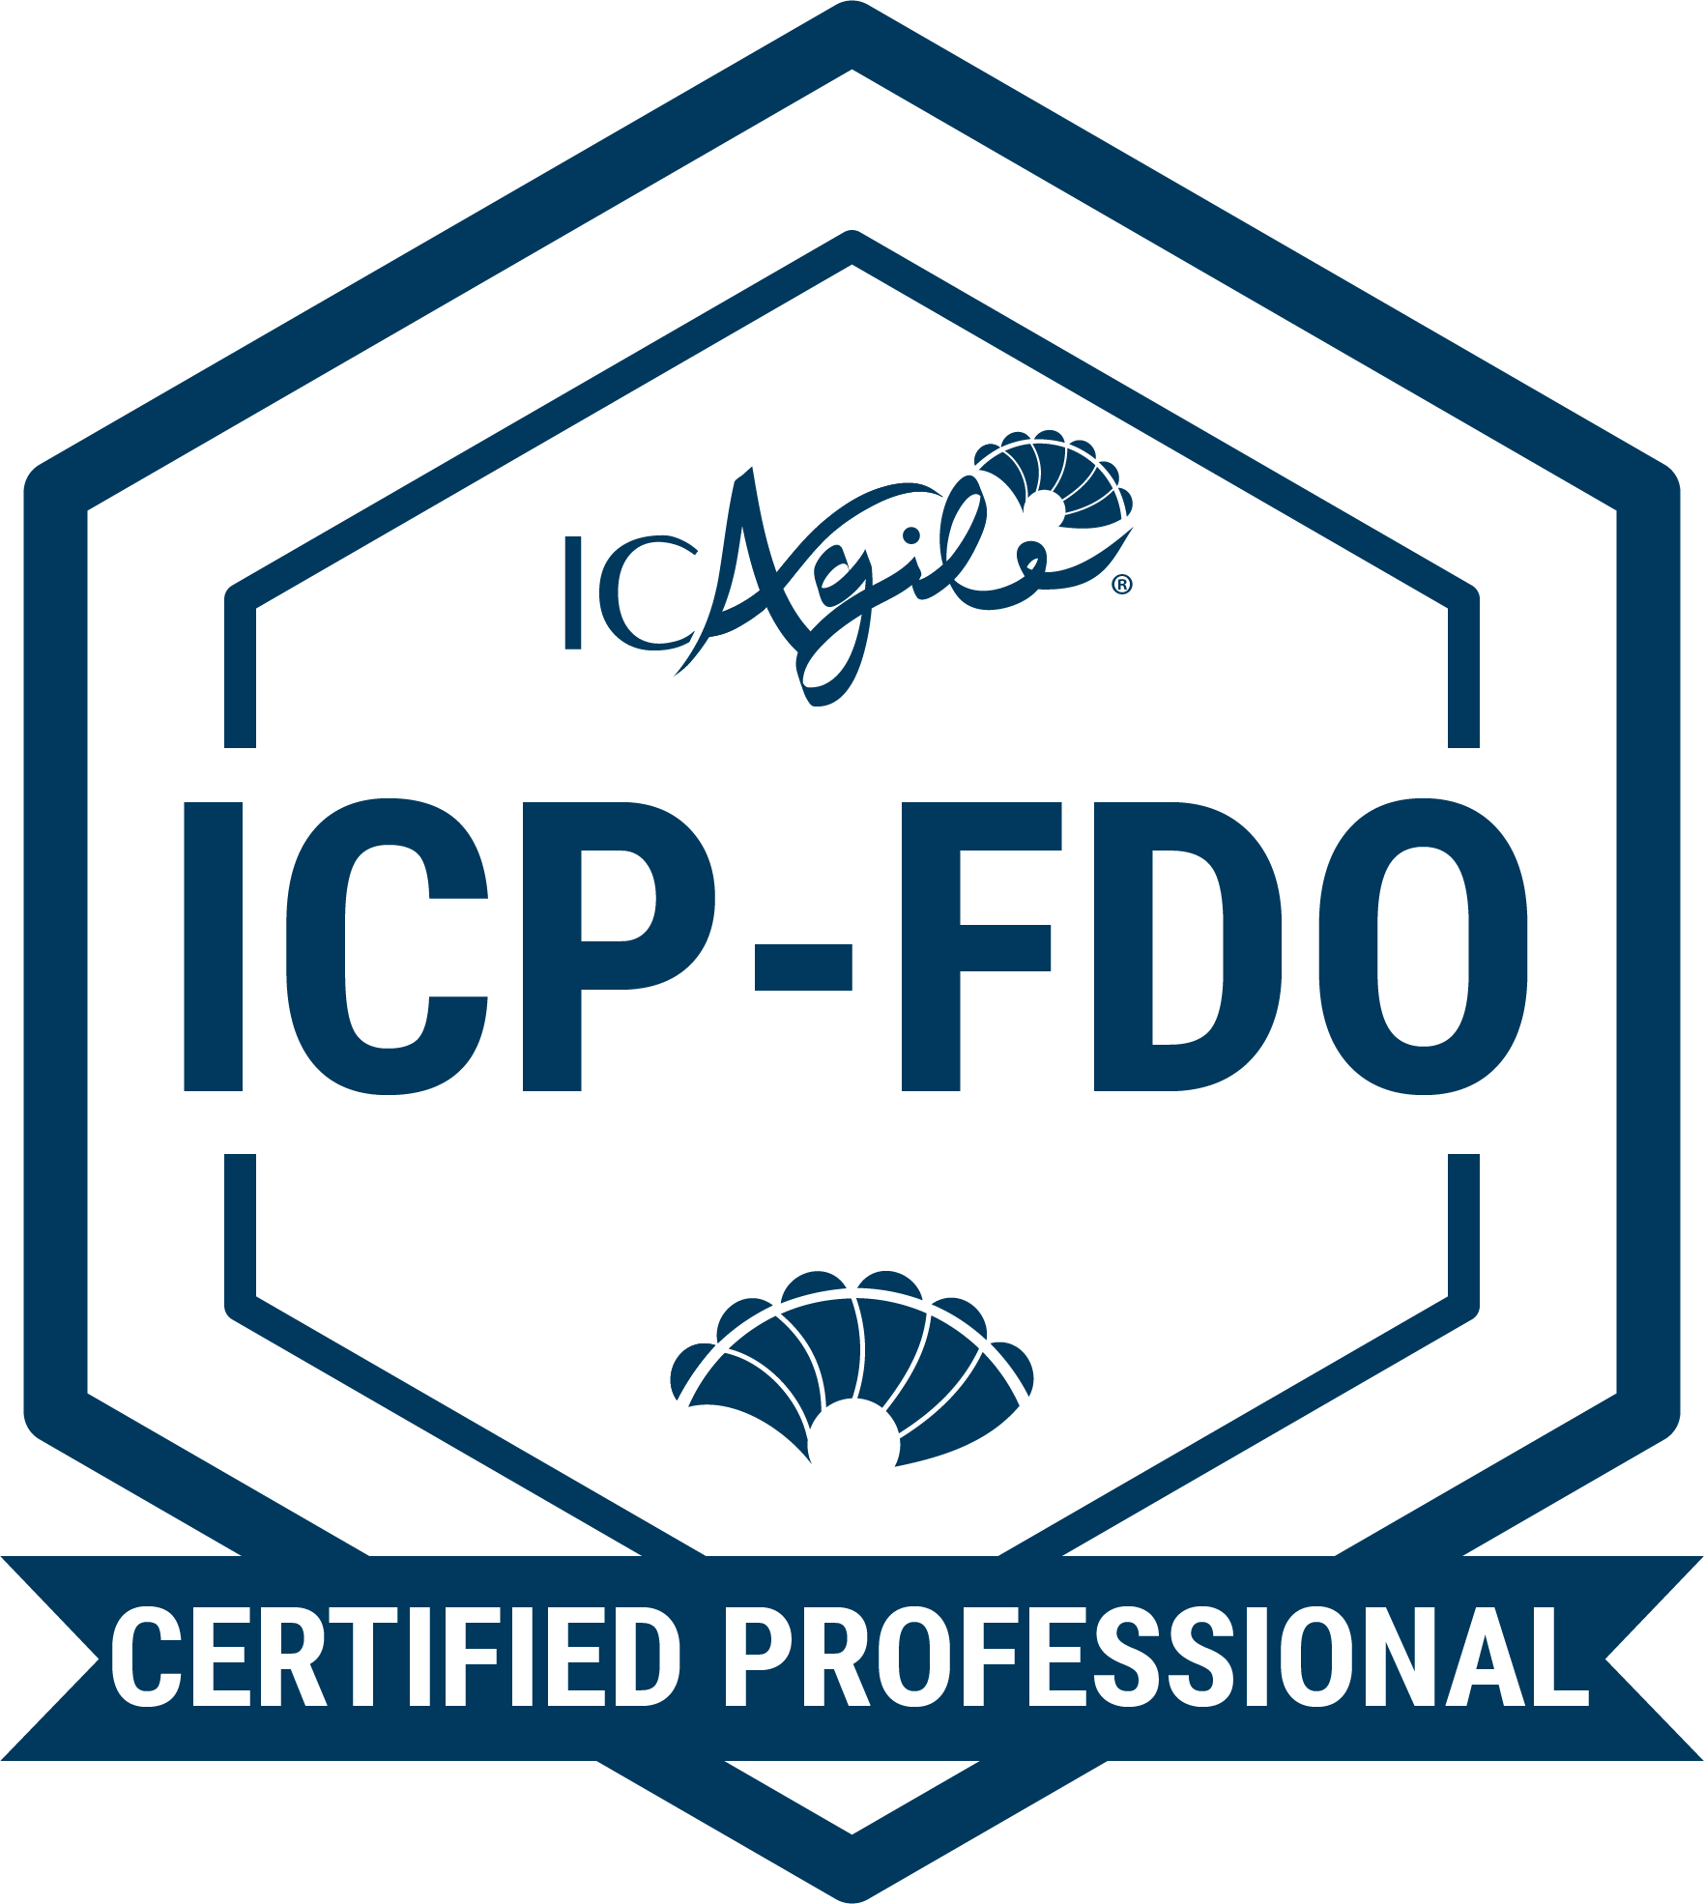
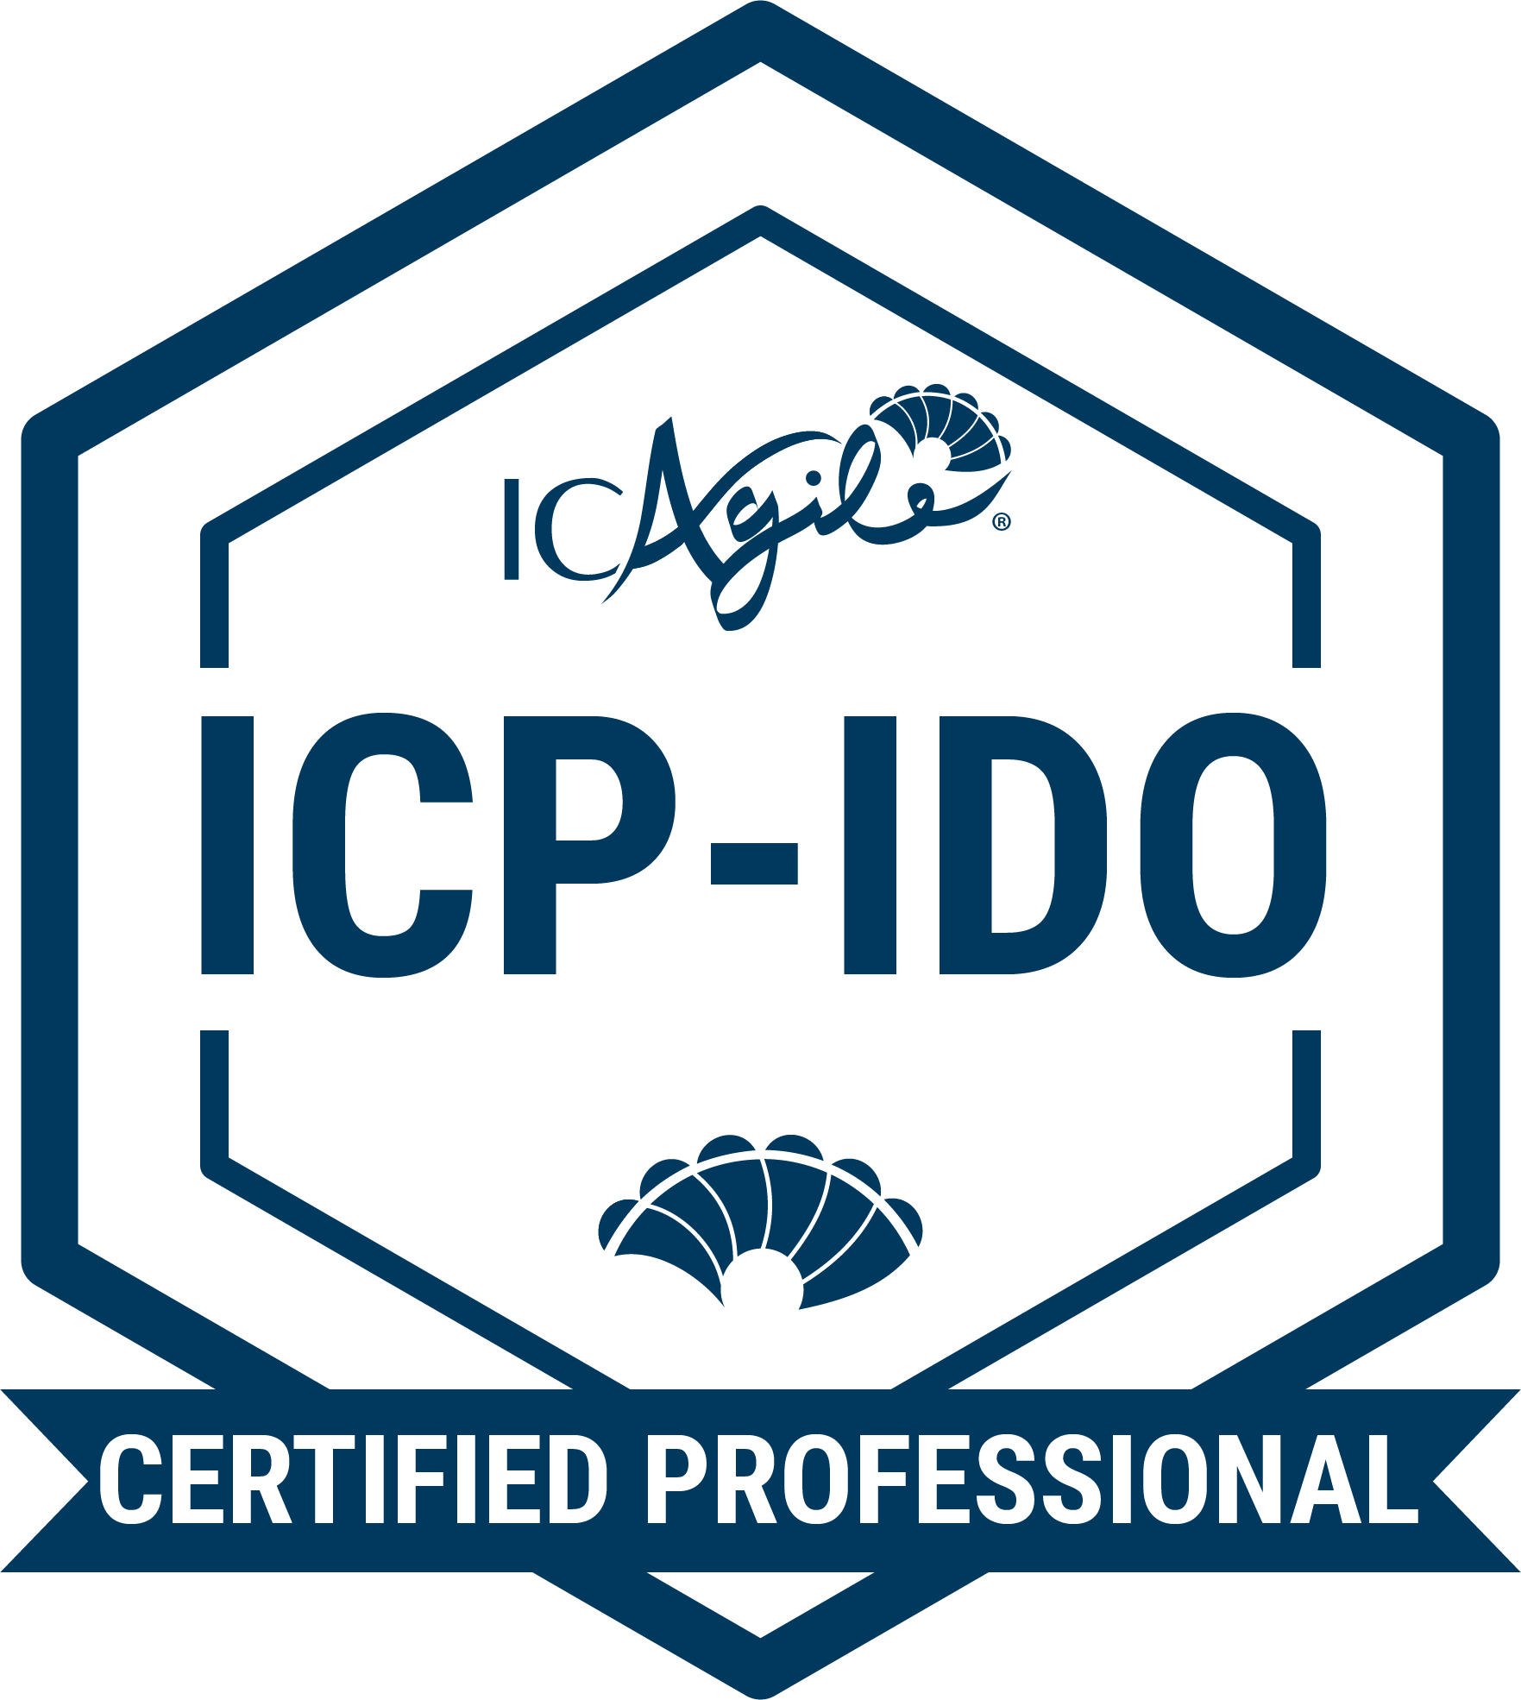
TRACKS IN VALUE DELIVERY
Agile Testing
Agile Fundamentals
Agile Testing
Agile Test Automation
DevOps
Agile Fundamentals
Foundations of DevOps
Implementing DevOps
Go Back to Learning Programs

Slide 9
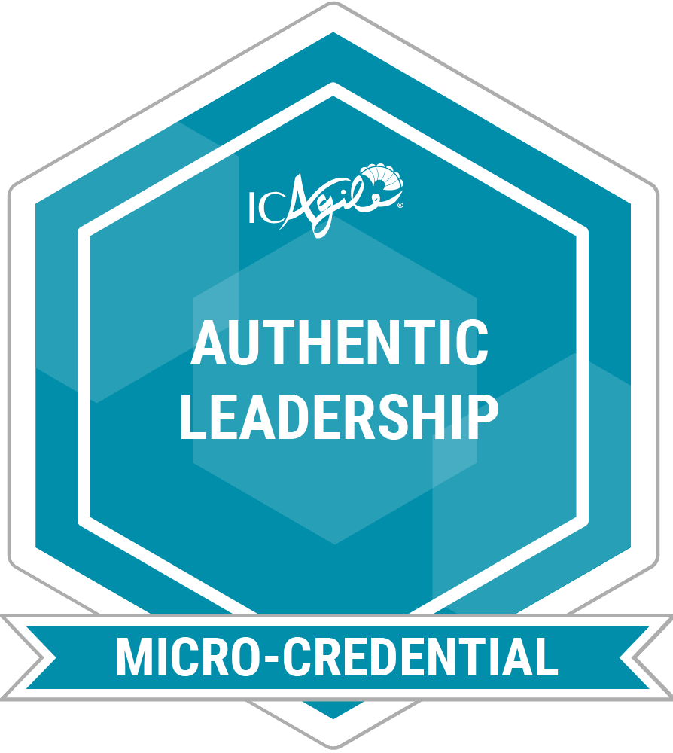
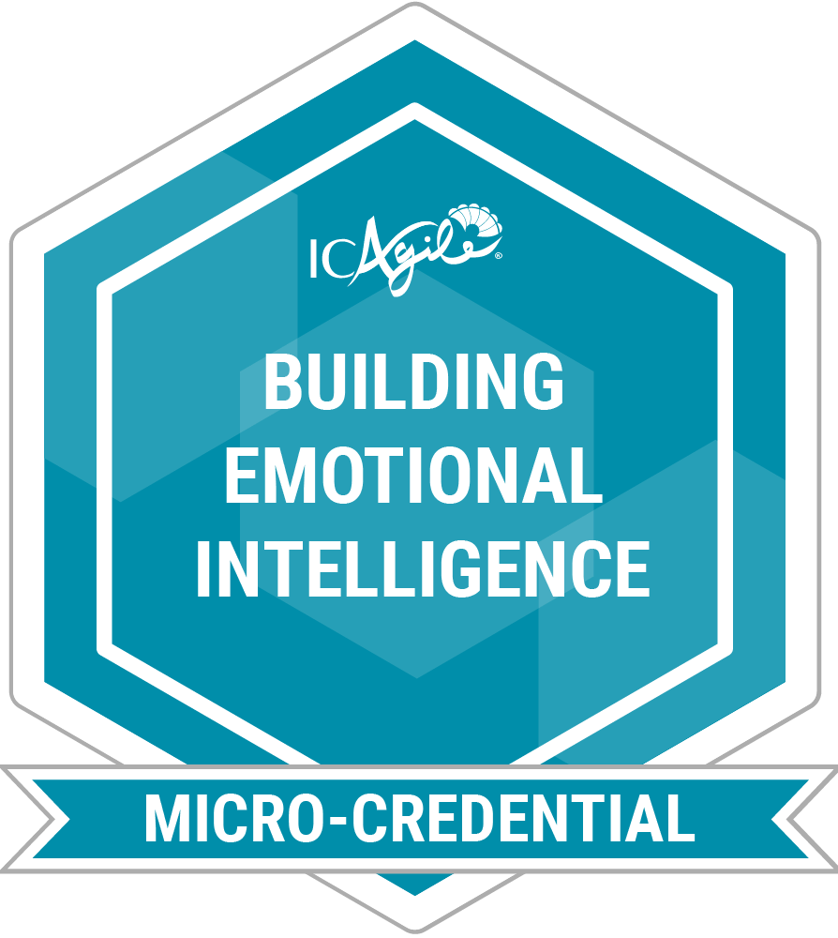
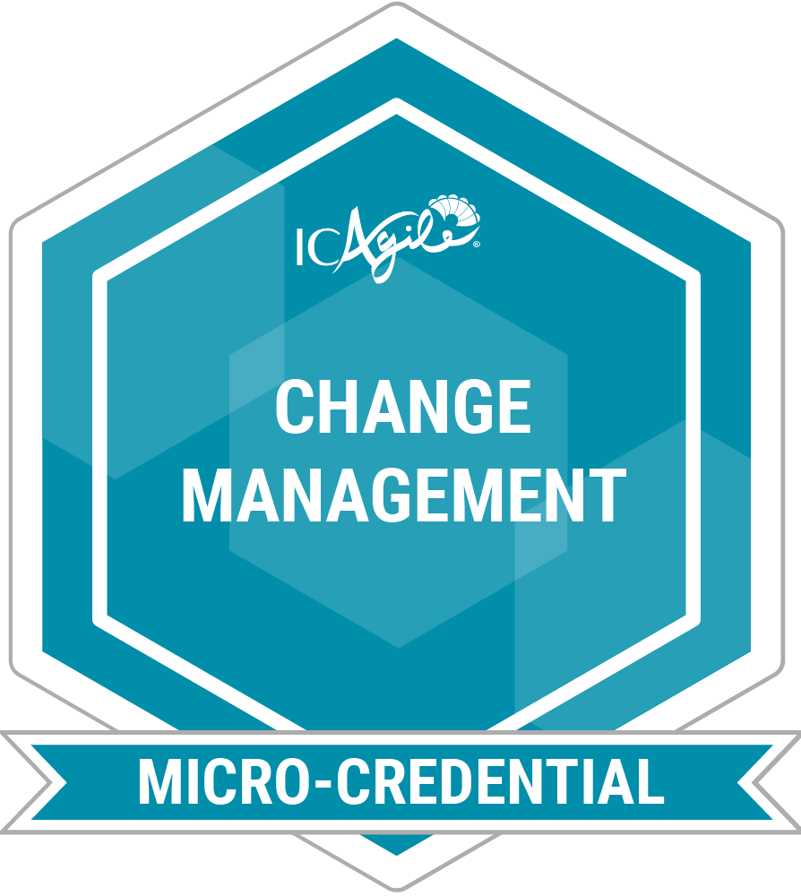
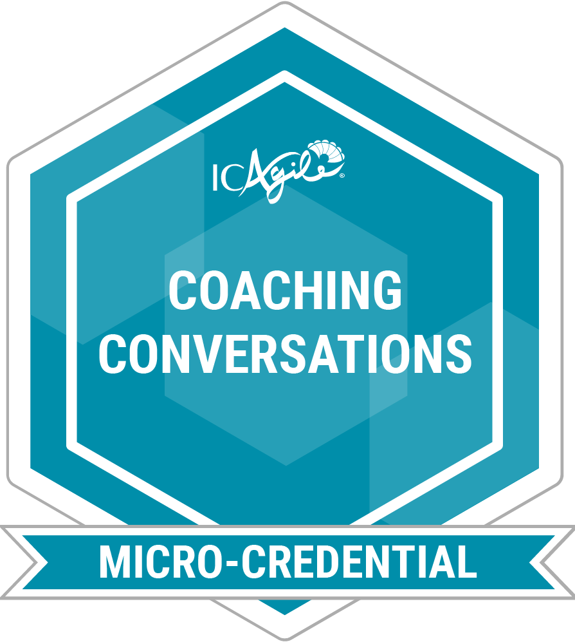
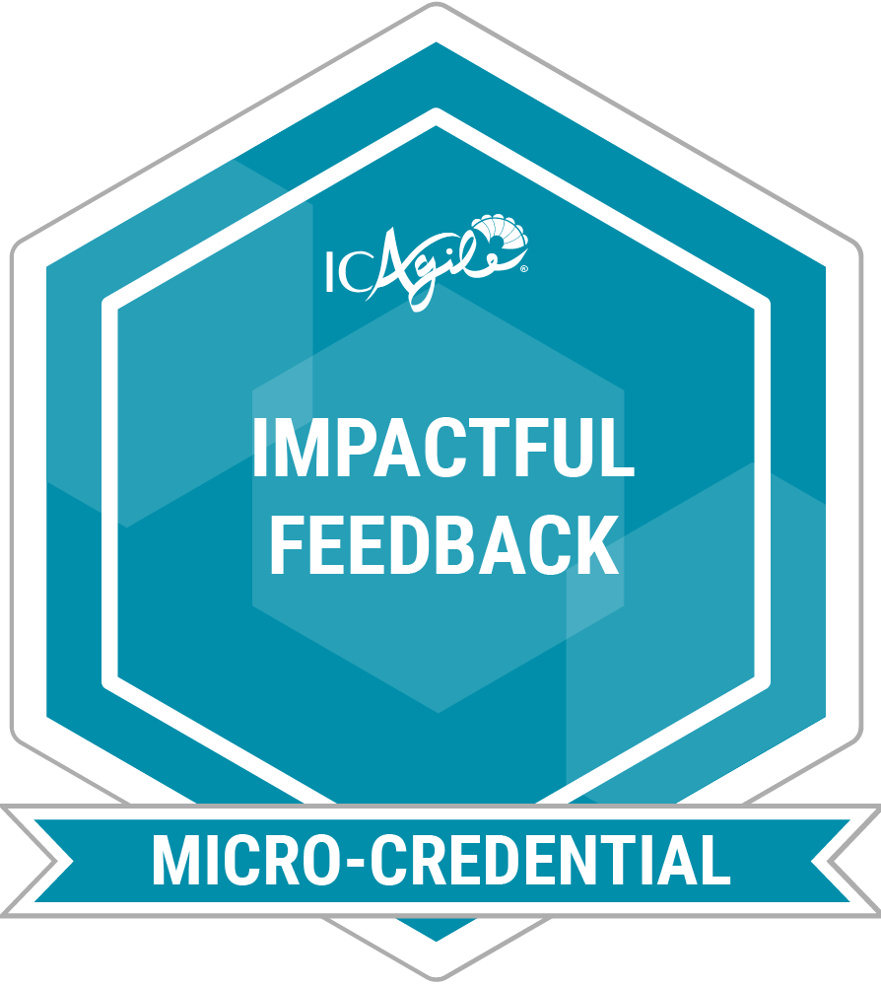
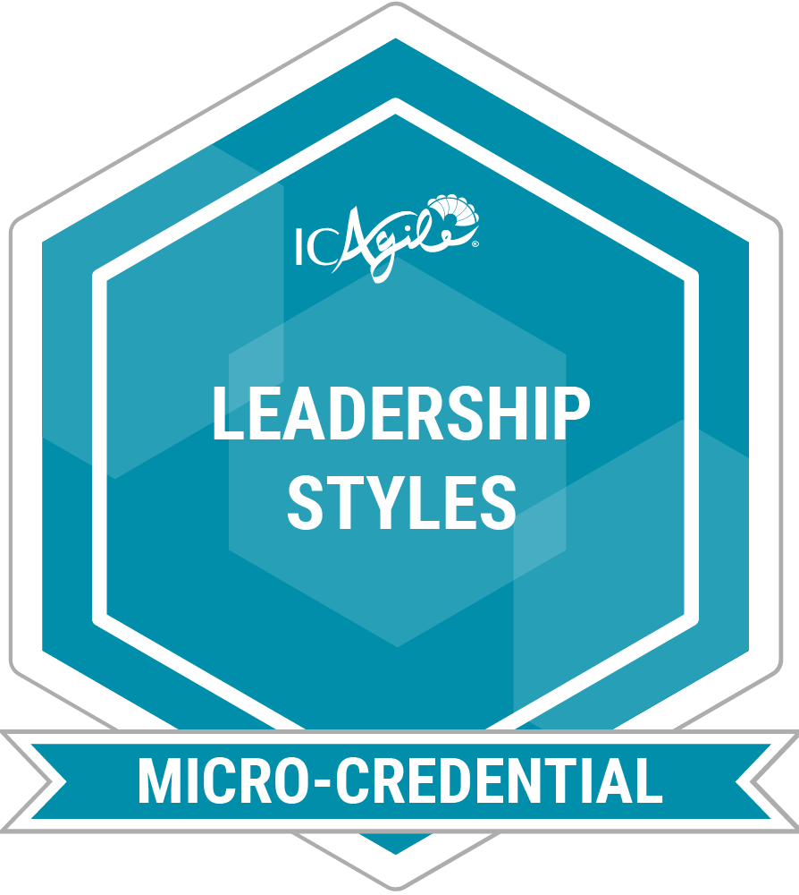
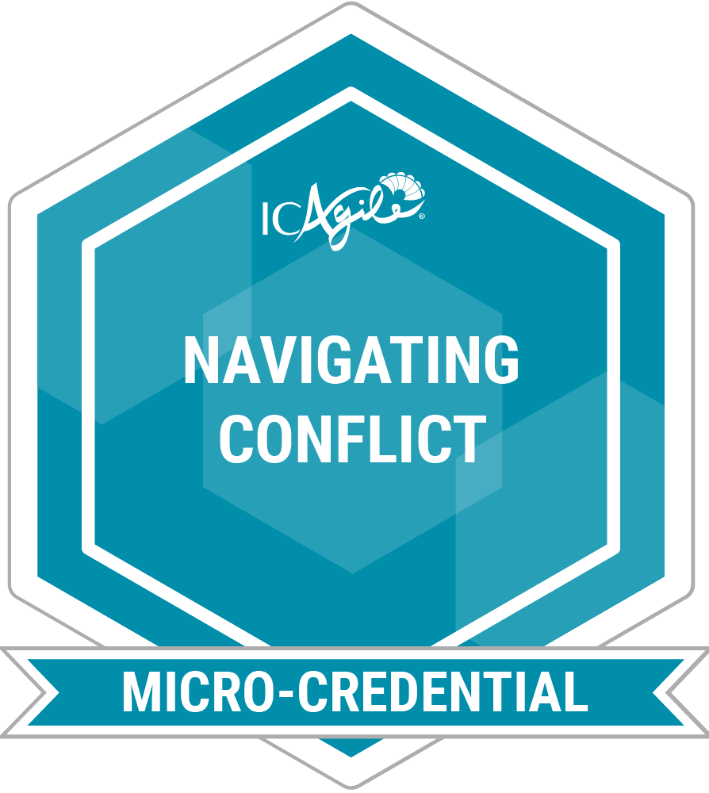
MICRO-CREDENTIALS
Micro-credential courses are short learning experiences designed to help you quickly gain practical, job-ready skills.
Leadership Essentials Skills Collection
Master the essentials of leadership with practical skills to build trust, navigate workplace challenges, and lead with confidence.
Authentic
Leadership
Building
Emotional
Intelligence
Change
Management
Coaching
Conversations
Impactful
Feedback
Leadership
Styles
Navigating
Conflict

Slide 10
Agile Fundamentals
ABOUT THIS CERTIFICATION
FEATURED LEARNING OUTCOMES
Agile Fundamentals (ICP) is an industry-recognized credential that demonstrates an understanding of the Agile mindset, values, principles, and foundational concepts. Professionals are grounded in what it means to "be agile while doing agile" and achieve organizational agility without specific focus on any single agile methodology or framework (i.e. Scrum, Kanban, XP, DSDM, SAFe, etc.).
Origins of Agile
Establishing the Agile Mindset
Incremental Development
Product Adaptation
DESIGNED FOR
Professionals who are in technical and product roles and are starting their agile learning journey.
Go Back to Learning Programs

Slide 11
Business Agility Foundations
ABOUT THIS CERTIFICATION
FEATURED LEARNING OUTCOMES
Achieving the ICAgile Certified Professional in Business Agility Foundations (ICP-BAF) demonstrates an ability to articulate the values, principles, and dimensions of business agility. Business agilists can formulate an action plan for applying agility in their workplaces and can appraise and use a variety of frameworks, tools, and techniques to jumpstart the organizational and individual transformation towards a more responsive, value-driven reality.
The Need for Business Agility
Developing a Growth Mindset
Implementing and Sustaining Business Agility
Action Plans and Tools to Accelerate Business Agility
DESIGNED FOR
Professionals who are in business-focused roles and are starting their agile learning journey.
Go Back to Learning Programs

Slide 12
Leading with Agility
ABOUT THIS CERTIFICATION
FEATURED LEARNING OUTCOMES
This knowledge-based designation is an industry-recognized credential that demonstrates knowledge of the key aspects of organizational agility capability and agile leadership. It verifies a firm grasp of the core skills for developing personal agility, relationship agility, and leading change and transformation.
Organizational Agility Capability
Leadership Styles
Emotional Intelligence in Relationships
Leader as Agent of Transformation
PART OF THE AGILITY IN LEADERSHIP TRACK
DESIGNED FOR
Leaders and emerging leaders at all career and organizational levels.
Go Back to Learning Programs

Slide 13
People Development
ABOUT THIS CERTIFICATION
FEATURED LEARNING OUTCOMES
This designation demonstrates a leader’s commitment to grow others and to create environments in their organization where individuals, teams, and teams of teams thrive. They understand the importance of creating a container of generative learning to enable people, the organization and its agility.
People as the Catalyst for Agility
Cultivating a Culture of Learning
Hire to Elevate, not Delegate
Leadership at Every Level
PART OF THE AGILITY IN LEADERSHIP TRACK
DESIGNED FOR
Leaders and emerging leaders at all career and organizational levels.
Go Back to Learning Programs

Slide 14
COMING SOON
Expert in Agility in Leadership
ABOUT THIS CERTIFICATION
FEATURED LEARNING OUTCOMES
Some of the key competencies covered by this certification will include building adaptive capability in organizations, leading people and managing systems through complexity and uncertainty, and developing leadership in others.
The ICE-AL is currently being developed by our community of thought leaders.
PART OF THE AGILITY IN LEADERSHIP TRACK
DESIGNED FOR
Leaders at all levels in the organization who want to build leadership competencies that will support transformational journeys for people and organizations. It is for professionals who recognize that leadership is a role within functioning systems rather than a specific position.
Go Back to Learning Programs

Slide 15
Enterprise Agile Coaching
ABOUT THIS CERTIFICATION
FEATURED LEARNING OUTCOMES
As one of ICAgile’s most advanced knowledge-based certifications, the ICP-ENT designation validates an understanding of enterprise agile coaching skills needed to enable organizational structure and process improvements in support of achieving business agility.
Enterprise Coaching Enables Business Agility
Organization Design and Structure
Coaching the Organization
Boundary Spanning Facilitation
PART OF THE ENTERPRISE COACHING TRACK
DESIGNED FOR
Agile coaches at the enterprise and portfolio level and transformational leaders.
Go Back to Learning Programs

Slide 16
Coaching Agile Transformations
ABOUT THIS CERTIFICATION
FEATURED LEARNING OUTCOMES
As one of ICAgile’s most advanced knowledge-based certifications, the ICP-CAT certification validates knowledge of how to coach leadership and culture change in support of achieving business agility.
Organizational Culture and Alignment
Organization and Human Change Process
Coaching and Advising Leaders
Learning Journeys and Professional Development
PART OF THE ENTERPRISE COACHING TRACK
DESIGNED FOR
Agile coaches at the enterprise and portfolio level and transformational leaders.
Go Back to Learning Programs

Slide 17
Expert in Enterprise Coaching
ABOUT THIS CERTIFICATION
FEATURED COMPETENCIES
This competency-based designation represents an advanced standard for disciplinary capability. It requires successful completion of an Accredited Expert Program that guides qualified candidates on a journey to build competence over time alongside a cohort of peers. Earning an ICE-EC verifies the skills required to be an effective practitioner in the discipline of Enterprise Coaching.
Designs the Change Strategy
Develops Transformational Leaders
Coaches Individuals and Systems
Designs Organizational Structures
PART OF THE ENTERPRISE COACHING TRACK
DESIGNED FOR
Enterprise, program, and team-level Agile Coaches who are eager to build competencies alongside a cohort to become an effective Enterprise Coach.
Go Back to Learning Programs

Slide 18
Agile Team Facilitation
ABOUT THIS CERTIFICATION
FEATURED LEARNING OUTCOMES
The Agile Team Facilitation certification is an industry-recognized credential that demonstrates an understanding of group facilitation tools and techniques for effectively designing meetings and workshops that both engage the entire audience and drive towards agreed-upon outcomes.
  The Facilitation Mindset
  Facilitating Collaborative Conversations
  Facilitating Selected Agile Meetings
  Adjusting Facilitation Given Team Maturity
PART OF THE AGILE TEAM COACHING TRACK
DESIGNED FOR
Current or aspiring agile coaches, scrum masters, product owners, agile managers, and project managers.
Go Back to Learning Programs

Slide 19
Agile Coaching
ABOUT THIS CERTIFICATION
FEATURED LEARNING OUTCOMES
Designed by key thought leaders who defined the discipline of agile coaching, the Agile Coaching certification verifies an understanding of the tools, skills, and techniques needed to coach agile teams.
Conducting the Coaching Conversation
Contrasting Mentoring with Coaching
Helping Team Members Experience the Agile
Mindset Shifts
Leadership Engagement
PART OF THE AGILE TEAM COACHING TRACK
DESIGNED FOR
Current or aspiring agile coaches, scrum masters, product owners, agile managers, and project managers.
Go Back to Learning Programs

Slide 20
Expert in Agile Coaching
ABOUT THIS CERTIFICATION
FEATURED COMPETENCIES
This competency-based designation verifies competencies in key skills that are imperative to becoming an effective agile coach. ICE-AC distinguishes professionals who can facilitate, coach, mentor, and teach at a level that can unlock the potential of agile teams.
Uses Agile Subject Matter Expertise to Adapt Agile Practices Being Facilitated
Holds Space for an Agile team to Deepen its Learning and Reach Desired Outcomes
Develops Teams While Effectively Dealing with Complex Situations
Relays a New Concept or Technique in a Meaningful Way
PART OF THE AGILE TEAM COACHING TRACK
DESIGNED FOR
Agile coaches who have a passion for servant leadership and a desire to build competencies in facilitation, professional coaching, mentoring, and teaching in service of agile teams.
Go Back to Learning Programs

Slide 21
Systems Coaching
ABOUT THIS CERTIFICATION
FEATURED LEARNING OUTCOMES
This certification outlines key concepts in Systems Coaching and how to apply them within any organizational context. It helps agile team coaches, enterprise coaches, and leaders improve their ability to work with complex adaptive systems and is recommended for
professionals who are deepening their skills on the Agile Team Coaching, Enterprise Coaching, and Agility in Leadership tracks.
Systems Thinking
What is Systems Coaching?
Professional Coaching for Systems Coaches
Facilitation for Systems Coaches
RECOMMENDED AS PART THE FOLLOWING TRACKS
DESIGNED FOR
Agility in Leadership
Enterprise Coaching
Agile Team Coaching
Agile team coaches, enterprise coaches, and leaders who want to learn how to work with and coach systems.
Go Back to Learning Programs

Slide 22
Agile Product Ownership
ABOUT THIS CERTIFICATION
FEATURED LEARNING OUTCOMES
Achieving the Agile Product Ownership certification validates knowledge to understand customer needs and effectively deliver valuable products and services through key agile practices such as adaptive prioritization and planning. Students will learn how to align backlogs to the product vision, and balance the needs of the business, teams, and customers to maximize value delivered.
Skills and Behaviors for Agile Product Ownership
Working with Customers and Stakeholders
Product Planning and Development
Assessing Value Delivered
PART OF THE PRODUCT MANAGEMENT TRACK
DESIGNED FOR
Business analysts, product owners, and product managers.
Go Back to Learning Programs

Slide 23
Product Management
ABOUT THIS CERTIFICATION
FEATURED LEARNING OUTCOMES
This certification validates the skills required to discover, position, and deliver winning products in a competitive landscape. Product Management professionals take a strategic and external-facing view of the product life cycle to align product strategy with their organization’s purpose and customers’ needs.
The Product Lifecycle
Metrics that Matter for Products
Designing Hypothesis Tests and Experiments
Teams Across the Product Lifecycle
PART OF THE PRODUCT MANAGEMENT TRACK
DESIGNED FOR
Product managers, product owners, and portfolio managers.
Go Back to Learning Programs

Slide 24
Agile Project and Delivery Management
ABOUT THIS CERTIFICATION
FEATURED LEARNING OUTCOMES
The Agile Project and Delivery Management certification verifies that the holder possesses the skills for successful Lean and Agile product delivery using various approaches, including projects and value-streams. The learner will be able to identify dependencies and blockers, enable rapid feedback and learning, and facilitate incremental value delivery.
Delivery Agility
Manage the System, Empower the Team
Deliver Value Continuously
Planning and Monitoring
PART OF THE DELIVERY MANAGEMENT TRACK
DESIGNED FOR
Delivery managers and delivery team leads.
Go Back to Learning Programs

Slide 25
Delivery at Scale
ABOUT THIS CERTIFICATION
FEATURED LEARNING OUTCOMES
This certification demonstrates an individual’s skills to apply agile management skills to enterprise-level product development using value-streams, projects, and programs. It validates proficiency in organizing effective outcomes, eliminating waste, maximizing value-delivery, and communicating value and progress across an organization.
Optimize the System
Empower the Organization to Deliver
Align Value Delivery at Scale
PART OF THE DELIVERY MANAGEMENT TRACK
DESIGNED FOR
Delivery managers and delivery team leads.
Go Back to Learning Programs

Slide 26
Agile Programming
ABOUT THIS CERTIFICATION
FEATURED LEARNING OUTCOMES
Earning the Agile Programming (ICP-PRG) certification demonstrates the ability to inspect and adapt code efficiently and effectively to accommodate new insights, product changes, and technical innovations. Designees know how to move away from traditional waterfall development and into developer collaboration techniques, like pair programming and collective code ownership.
Refactoring and Legacy Code Management
Acceptance Testing and Automated Tests
Collaborative and Test-Driven Development
Version Control and Continuous Integration
PART OF THE AGILE ENGINEERING TRACK
DESIGNED FOR
Software developers, application programmers, systems designers, technical architects, development managers, and technical leads.
Go Back to Learning Programs

Slide 27
Agile Software Design
ABOUT THIS CERTIFICATION
FEATURED LEARNING OUTCOMES
The Agile Software Design certification distinguishes professionals who can respond to customer goals, analyze the impact of technical debt, and determine the level of design needed at various stages of an agile project development cycle.
Effective Software Design
Sequencing Work throughout the Agile Lifecycle
Technical Leadership Skills
Applying Continuous Delivery
PART OF THE AGILE ENGINEERING TRACK
DESIGNED FOR
Software developers, application programmers, systems designers, technical architects, development managers, and technical leads.
Go Back to Learning Programs

Slide 28
Agile Testing
ABOUT THIS CERTIFICATION
FEATURED LEARNING OUTCOMES
This certification verifies that the recipient possesses the capability to apply the agile mindset to software testing in a real world environment. The Agile tester has the knowledge to identify key elements of the agile testing mindset, design testing based on features and user stories, and provide risk-based feedback on the quality of products through effective testing techniques.
Agile Testing Mindset
Testing Techniques
Agile Testing Process
PART OF THE AGILE TESTING TRACK
DESIGNED FOR
Agile testers, test engineers, test managers, developers, technical leads.
Go Back to Learning Programs

Slide 29
Agile Test Automation
ABOUT THIS CERTIFICATION
FEATURED LEARNING OUTCOMES
The industry-recognized certification validates knowledge of preparing and implementing test automation in an agile development and/or continuous integration environment.
Test Automation Strategy
Continuous Integration
Automated Story and Feature Testing
Automation Support for Integration and System Testing
PART OF THE AGILE TESTING TRACK
DESIGNED FOR
Agile testers, test engineers, test managers, developers, technical leads.
Go Back to Learning Programs

Slide 30
Foundations of DevOps
ABOUT THIS CERTIFICATION
FEATURED LEARNING OUTCOMES
The Foundations of DevOps certification demonstrates an individual's mindset change from traditional software development to agile and collaborative approaches by delivering software with the Operations team. Holders can show how DevOps leads to effectively coding, testing, scaling, and releasing software continuously.
The Case For DevOps
Configuration Management
Continuous Integration
Continuous Delivery
Operations
PART OF THE DEVOPS TRACK
DESIGNED FOR
Developers, testers, operations leads, DevOps engineers, and site reliability engineers.
Go Back to Learning Programs

Slide 31
Implementing DevOps
ABOUT THIS CERTIFICATION
FEATURED LEARNING OUTCOMES
Implementing DevOps is the next step for learners who want to apply their knowledge of DevOps. It verifies a professional’s ability to plan, build, monitor, and mature the CI/CD pipeline.
Planning the Pipeline
Building the Pipeline
Monitoring the Pipeline
Maturing the Pipeline
PART OF THE DEVOPS TRACK
DESIGNED FOR
Developers, testers, operations leads, DevOps engineers, and site reliability engineers.
Go Back to Learning Programs

Slide 32
Agility in HR
ABOUT THIS CERTIFICATION
FEATURED LEARNING OUTCOMES
Agility In HR distinguishes professionals who can assess organizations, teams, and management’s existing structures and develop an action plan for business agility, value flow, and team collaboration. It verifies an ability to help drive agile transformation in an organization, from sourcing talent to learning and development initiatives.
Embedding Agile/Lean Mindset and Core Values within Role Definition
Growth Mindset as an Enabler of Learning Cultures
Enabling Agility Throughout the Organization
Applying Agile Mindset and Practices to HR Initiatives and Operations
PART OF THE AGILE HR TRACK
DESIGNED FOR
HR professionals, HR managers, performance managers, recruitment managers, and talent development professionals.
Go Back to Learning Programs

Slide 33
Adaptive Org Design
ABOUT THIS CERTIFICATION
FEATURED LEARNING OUTCOMES
The Adaptive Org Design certification verifies that a professional understands the concepts behind and reasons for adaptive organization design. They know the importance of actively designing the organization to encourage agility in sense-making, learning, and experimentation. They also understand the frameworks, techniques, and methods used to dismantle information silos, reduce bureaucracy, and optimize value delivery throughout the organization.
Shifting to Cross-Functional Autonomous Teams
Distributing Power, Control, and Authority
Acknowledging Individuals as the Key to the Adaptive Network
Building Collective Intelligence
PART OF THE AGILE HR TRACK
DESIGNED FOR
HR professionals, HR managers, performance managers, recruitment managers, and talent development professionals.
Go Back to Learning Programs

Slide 34
Agility in Finance
ABOUT THIS CERTIFICATION
FEATURED LEARNING OUTCOMES
This certification demonstrates an individual’s skills to approach finance, accounting, and procurement with an agile mindset. It validates the ability to practice responsible stewardship of the organization’s funds and use new approaches that enable adaptation and rapid response to emerging circumstances in the business ecosystem.
Financial Reporting in Agile Organizations
Budgeting and Cost Management for Agility
Shifting from Fixed Budgets to Incremental Funding Allocations
Agile Principles and Accounting Ethics
PART OF THE AGILE FINANCE TRACK
DESIGNED FOR
Finance professionals, procurement professionals, business managers and executives, compliance professionals, accountants, and sales professionals.
Go Back to Learning Programs

Slide 35
Lean Portfolio Management
ABOUT THIS CERTIFICATION
FEATURED LEARNING OUTCOMES
This certification designates the ability to visualize, manage, and guide work to deliver value to customers, enable sustainability for the organization, and respond effectively to the changing business ecosystem.
The What and Why of Lean Portfolio Management
Align Execution to Strategy
Governing and Measuring LPM
Continuous Planning and Delivering
PART OF THE AGILE FINANCE TRACK
DESIGNED FOR
Product managers, product owners, portfolio managers, finance professionals, procurement professionals, business managers and executives, compliance professionals, accountants, and sales professionals.
Go Back to Learning Programs

Slide 36
Agility in Marketing
ABOUT THIS CERTIFICATION
FEATURED LEARNING OUTCOMES
The Agility In Marketing certification is an industry-recognized credential made by marketers, for marketers. It verifies an ability to articulate and implement agile marketing principles and deliver more responsive, customer-centric business outcomes.
Agile Marketing Drivers and Criticality
Tools for Adaptive, Customer-Centric Marketing
Delivering Marketing Value Through Cross-Functional Teams
Benefits of Short Iterations for Marketing Work
PART OF THE AGILE MARKETING TRACK
DESIGNED FOR
Marketing professionals, marketing leaders, and marketing managers.
Go Back to Learning Programs

Slide 37
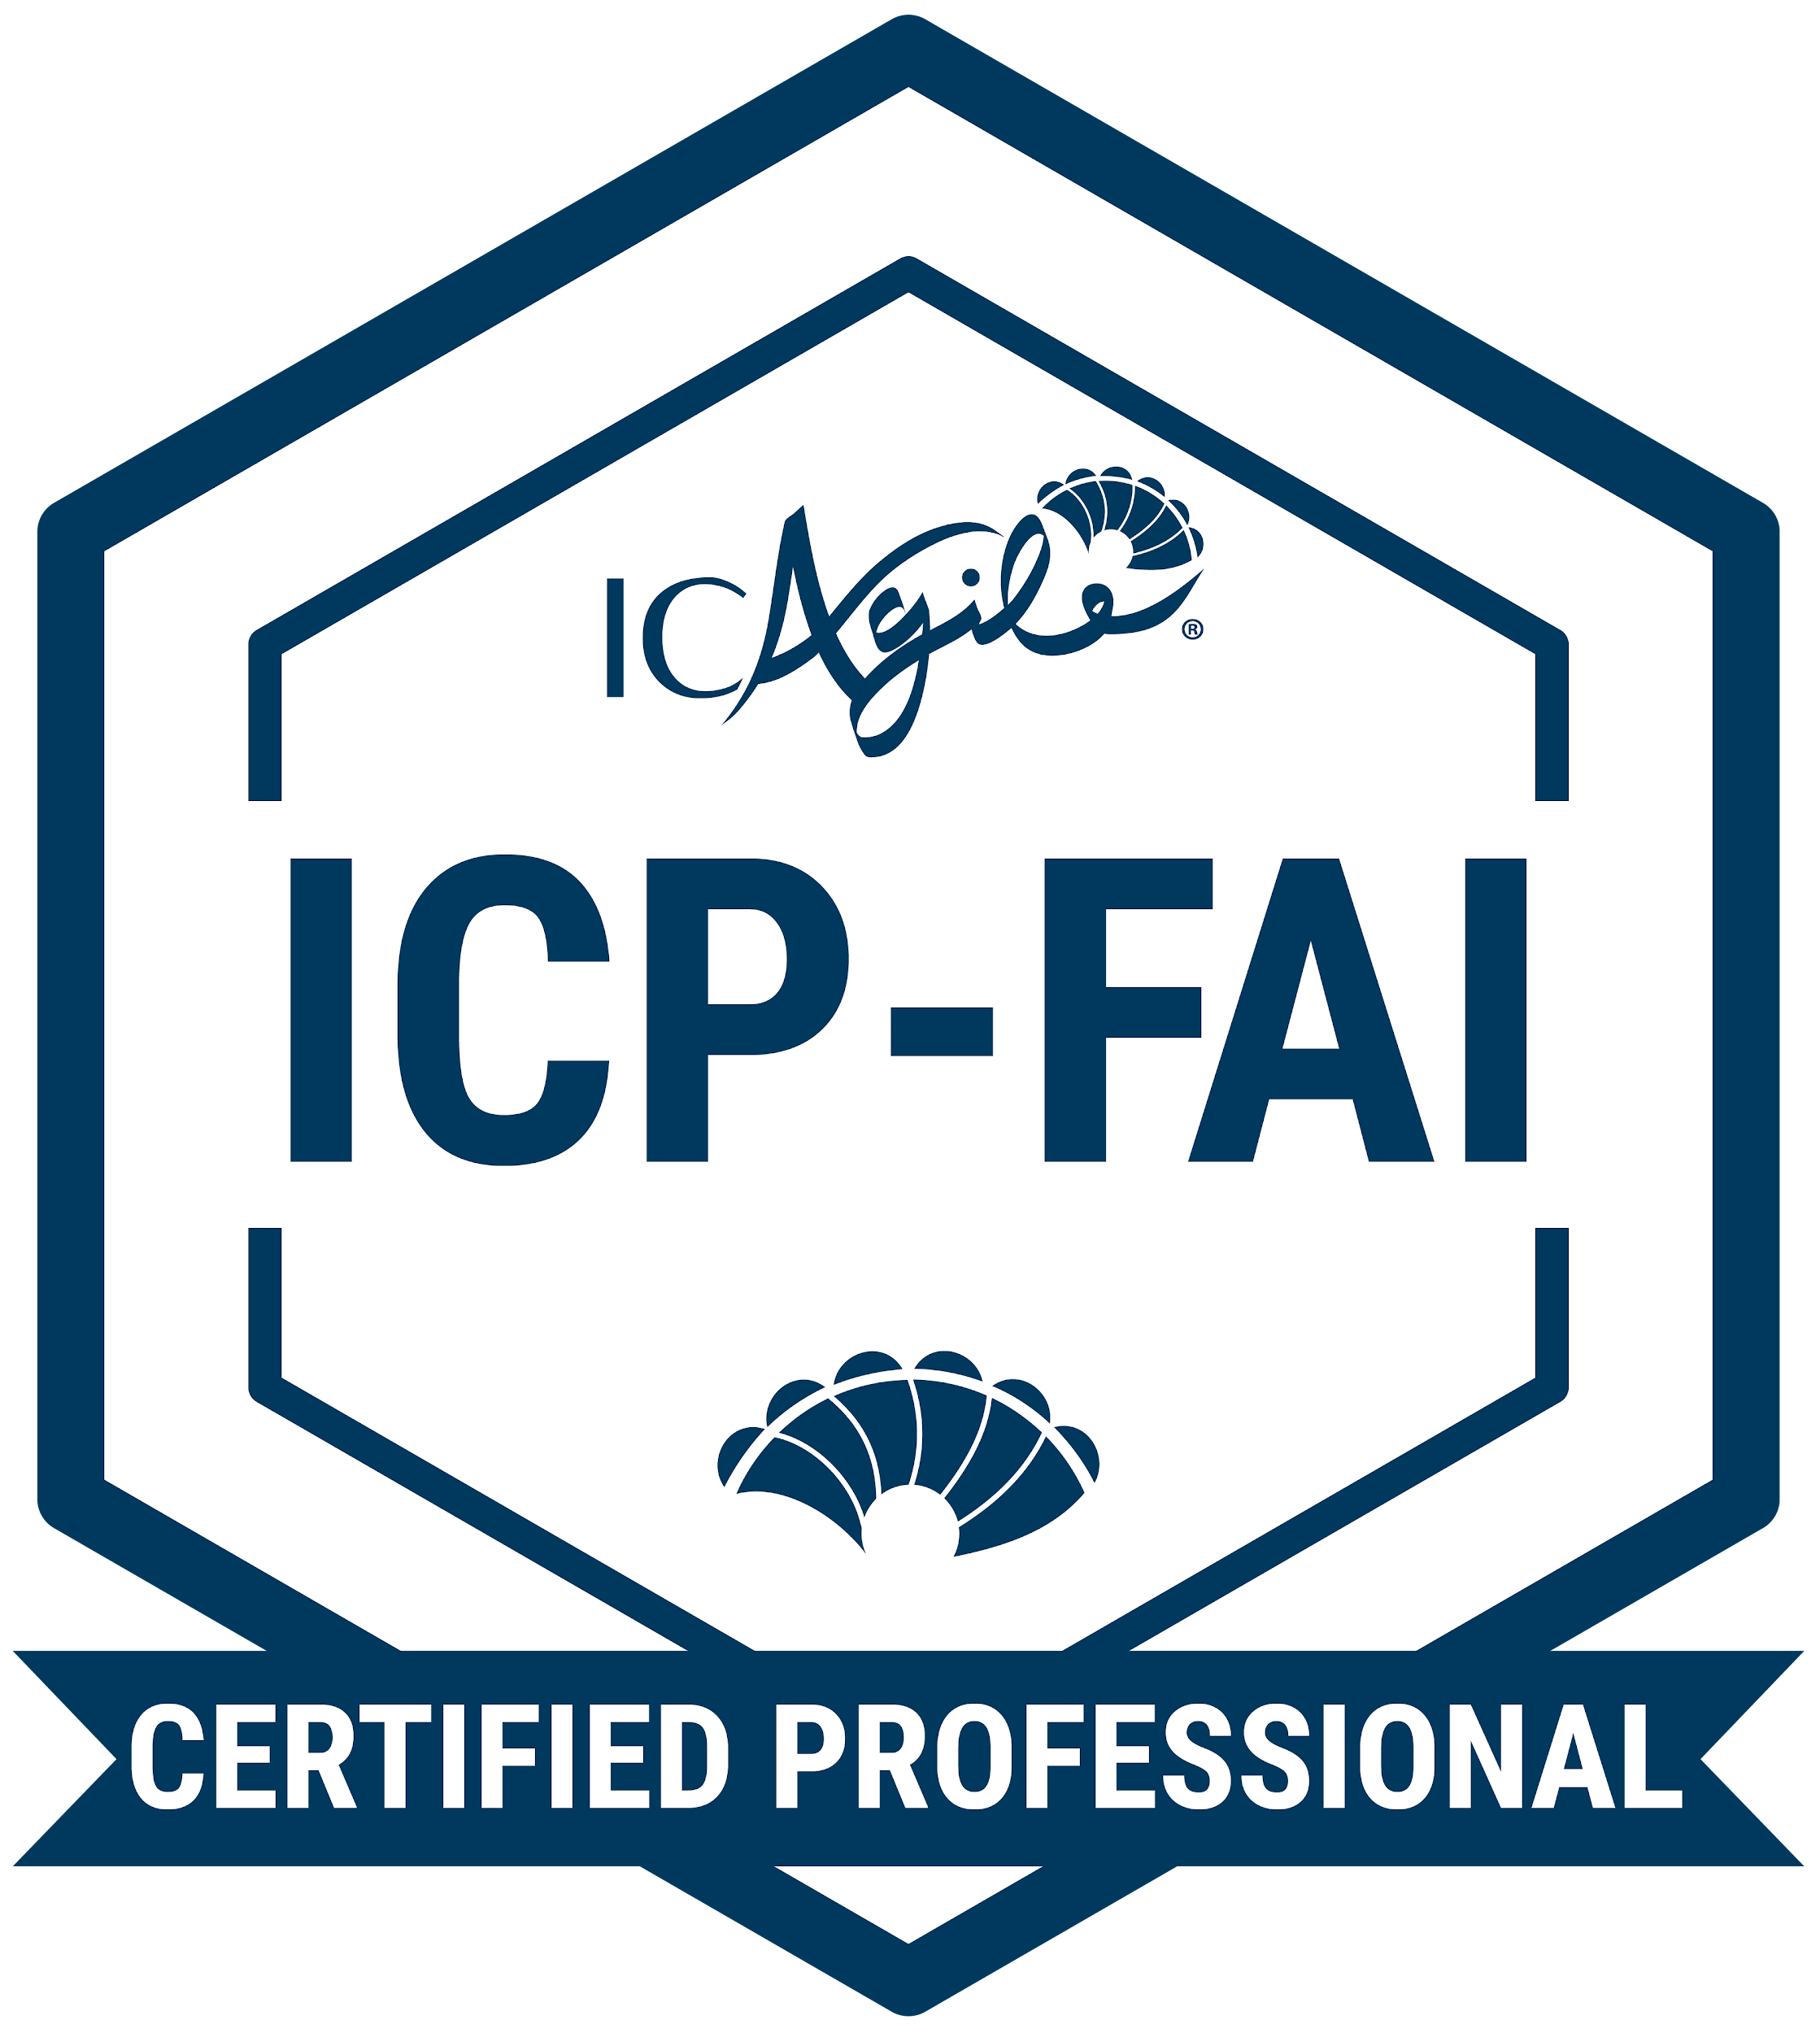
Foundations of Artificial Intelligence
ABOUT THIS CERTIFICATION
FEATURED LEARNING OUTCOMES
Learn how AI and machine learning can support your skills and creativity so that you can deliver work more efficiently. Understand the history and evolving state of AI, develop better prompt engineering techniques, and realize the strength of AI paired with your business strategies.
The history and evolution of AI and machine learning
Prompt engineering
Ethical challenges in the use of AI
Agile behaviors and AI
DESIGNED FOR
A broad range of professionals interested in understanding and applying AI in their organizations
Go Back to Learning Programs

Slide 38
Authentic Leadership
ABOUT THIS CERTIFICATION
FEATURED LEARNING OUTCOMES
In this authentic leadership training, professionals will explore their purpose and values to develop their authentic leadership style. By the end of this authentic leadership training course, you will have the clarity and confidence to empower yourself and others through authentic, value-driven leadership.
Discover the Impact of Authentic Leadership – Learn how leading authentically influences team trust and organizational culture.
Define Your Leadership Identity – Explore how your values show up in your leadership and identify areas for growth.
Create an Action Plan for Growth – Develop a vision and personal action plan to strengthen your capacity for authentic leadership.

Slide 39
Building Emotional Intelligence
ABOUT THIS CERTIFICATION
FEATURED LEARNING OUTCOMES
Enhance your leadership and interpersonal skills in this emotional intelligence course. Learn techniques to improve self-awareness, regulate emotions, and foster better relationships. By the end of this course, you will have the skills to navigate interpersonal dynamics with greater confidence and impact.
Develop Self-Awareness – Understand your emotions and how they impact your interactions and decision-making.
Enhance Emotional Regulation – Learn techniques to manage emotions effectively in high-stakes situations.
Strengthen Your Relationship Skills – Improve your ability to read emotions in others and build trust-based relationships.

Slide 40
Change Management
ABOUT THIS CERTIFICATION
FEATURED LEARNING OUTCOMES
In this change management training, professionals will gain essential skills to navigate organizational change in an effective and human-centric way. By the end of this course, you’ll be equipped with the knowledge and tools to respond to change in a human-centric way.
Understand Change Management Models – Define what change means in an organizational setting and explore different models for managing it.
Navigate Human & Organizational Responses to Change – Learn how people and organizations typically react to change and discover strategies to support smooth transitions.
Apply Change Management Models – Explore practical frameworks for leading change and learn when to use them for maximum effectiveness.

Slide 41
Coaching Conversations
ABOUT THIS CERTIFICATION
FEATURED LEARNING OUTCOMES
This micro-credential helps leaders and professionals conduct impactful coaching sessions with active listening and powerful questions. By the end of this course, you will be able to confidently apply foundational coaching skills in real-world leadership scenarios.
Understanding Coaching: Learn what professional coaching is and how it differs from leadership, mentoring, and consulting.
Foundational Coaching Skills: Master the key skills of presence, active listening, and powerful questioning, and learn how to apply them in coaching conversations.
The Coaching Conversation: Discover how to structure and lead effective coaching conversations that inspire action and accountability.

Slide 42
Impactful Feedback
ABOUT THIS CERTIFICATION
FEATURED LEARNING OUTCOMES
Develop the skills to give and receive feedback. Learn to manage difficult conversations with employees and build a culture of continuous growth. By the end of this course, you’ll have the skills and confidence to engage in meaningful feedback conversations that support individual and team development.
Understand the Power of Feedback – Discuss how impactful feedback supports growth, builds trust, and improves performance.
Deliver Impactful Feedback – Learn techniques to deliver feedback that is clear, constructive, and developmental.
Receive Feedback Effectively – Understand how to solicit and process feedback to foster continuous improvement.

Slide 43
Leadership Styles
ABOUT THIS CERTIFICATION
FEATURED LEARNING OUTCOMES
Master the art of people-first leadership. In this leadership styles training, professionals learn different styles of leadership and practice choosing the right style for any situation. By the end of this course, you’ll have the confidence and flexibility to lead effectively in a variety of situations.
Understand Leadership Mindsets & Behaviors – Explore the mindset, behaviors, and attitudes needed for people-first leadership.
Develop Leadership Versatility – Compare and contrast different leadership styles and learn when to apply each for maximum impact.
Enhance Decision-Making – Analyze workplace scenarios and determine the most effective leadership approach in each situation.
Assess & Grow Your Leadership Skills – Identify your dominant leadership style and discover areas for personal growth.

Slide 44
Navigating Conflict
ABOUT THIS CERTIFICATION
FEATURED LEARNING OUTCOMES
Gain practical skills for conflict management in the workplace. This micro-credential helps leaders and professionals navigate conflict with confidence and clarity. By the end of this course, you will have the skills to engage in and resolve workplace conflicts with confidence.
Understand Your Conflict Style – Identify your default responses to conflict and learn strategies for navigating conflict in a healthy way.
Develop Conflict Resolution Skills – Gain practical skills to engage in difficult conversations with empathy and curiosity.
Turn Conflict into Growth – Learn to reframe conflict as an opportunity for understanding, collaboration, and growth.

Slide 45
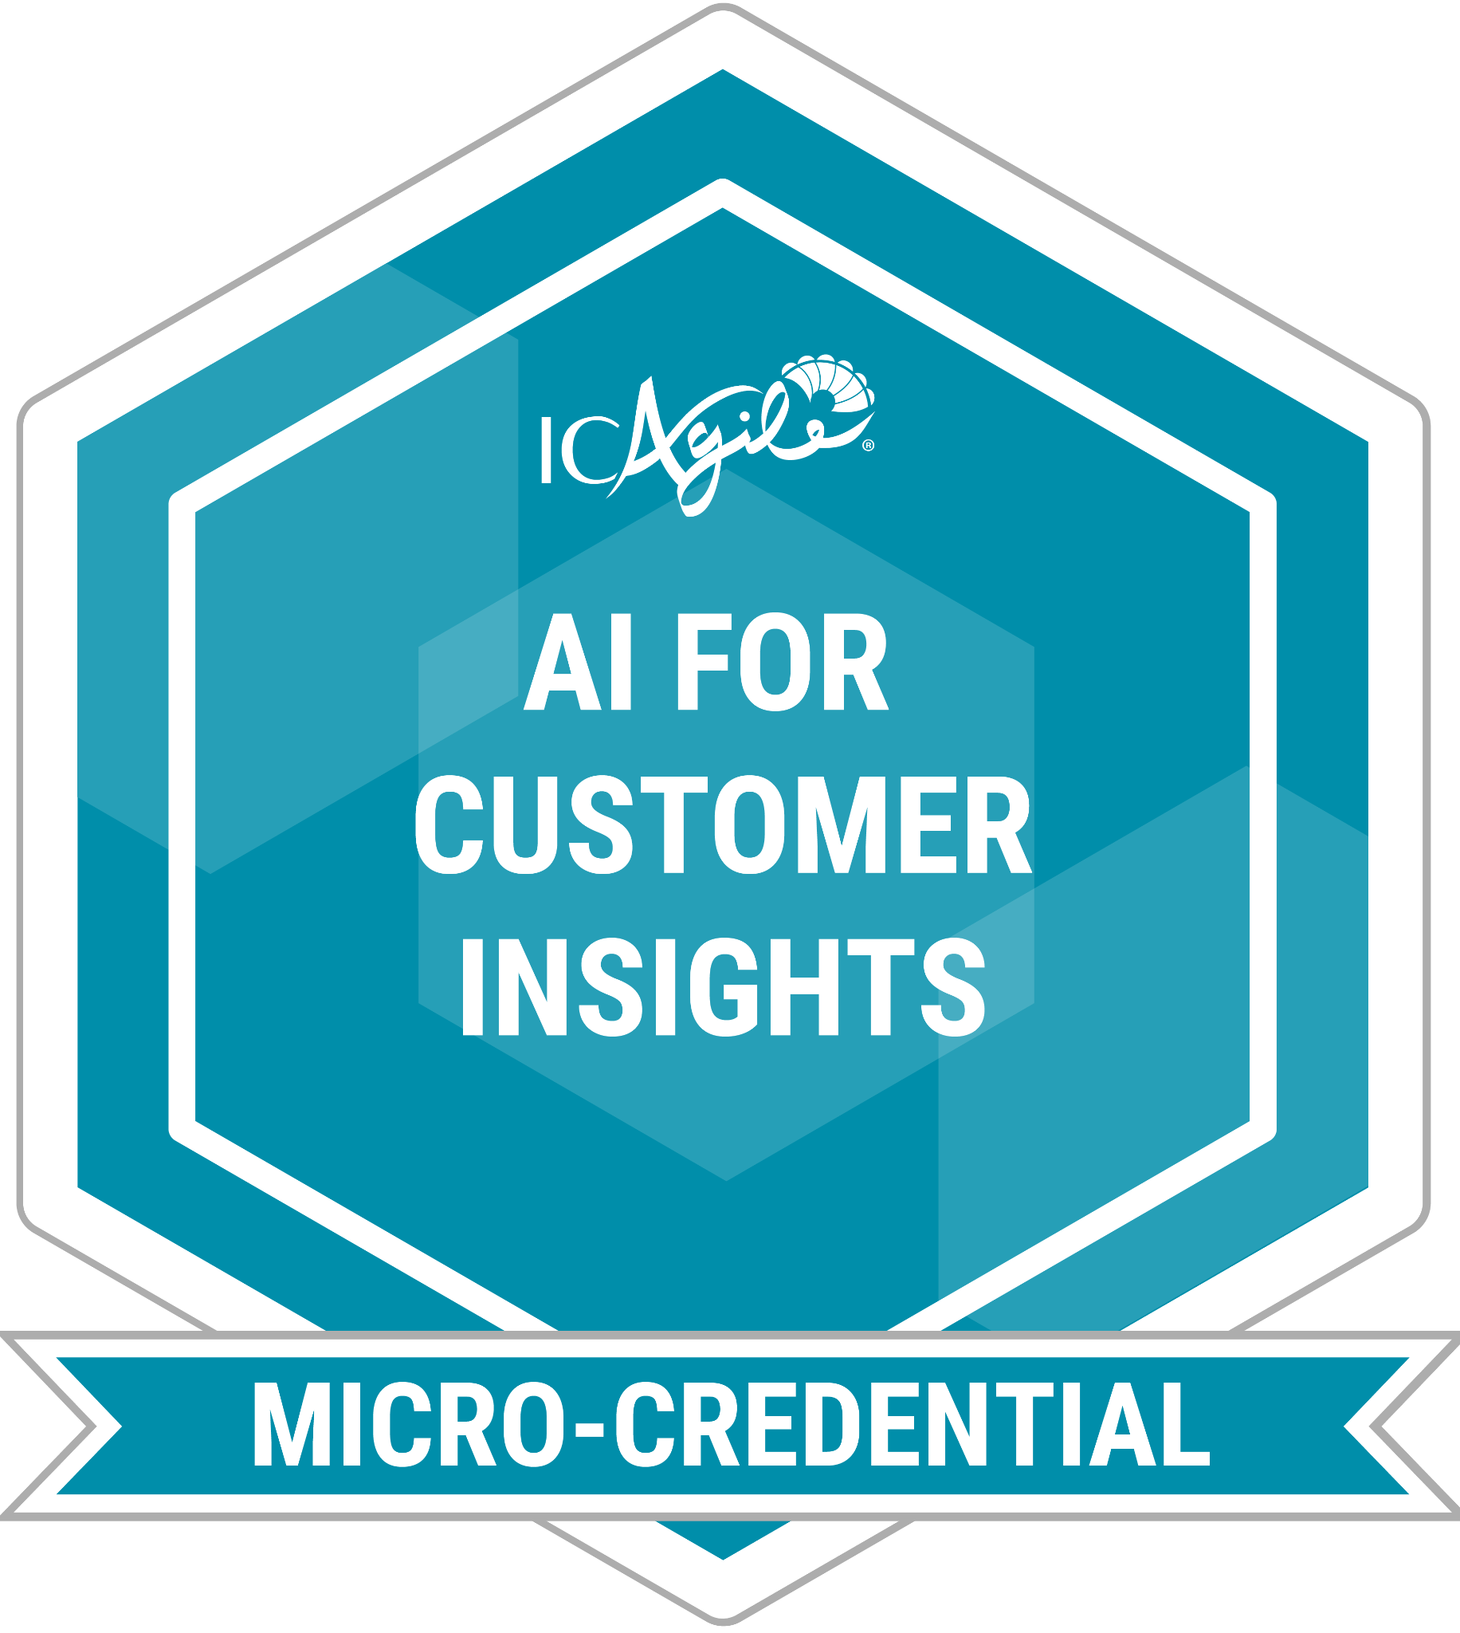
AI for Customer Insights
ABOUT THIS CERTIFICATION
FEATURED LEARNING OUTCOMES
The AI for Customer Insights Micro-Credential equips professionals with practical experience applying artificial intelligence tools to identify, understand, and capture feedback from their customers.
Understand AI Customer Profiles – Learn to analyze AI-generated customer segments, uncover behaviors, and identify potential risks.
Design AI Feedback Strategies – Develop practical approaches for collecting meaningful customer feedback using AI.
Turn AI Insights into Action – Evaluate AI-generated insights to enhance customer interactions, inform decisions, and navigate ethical considerations.

Slide 46
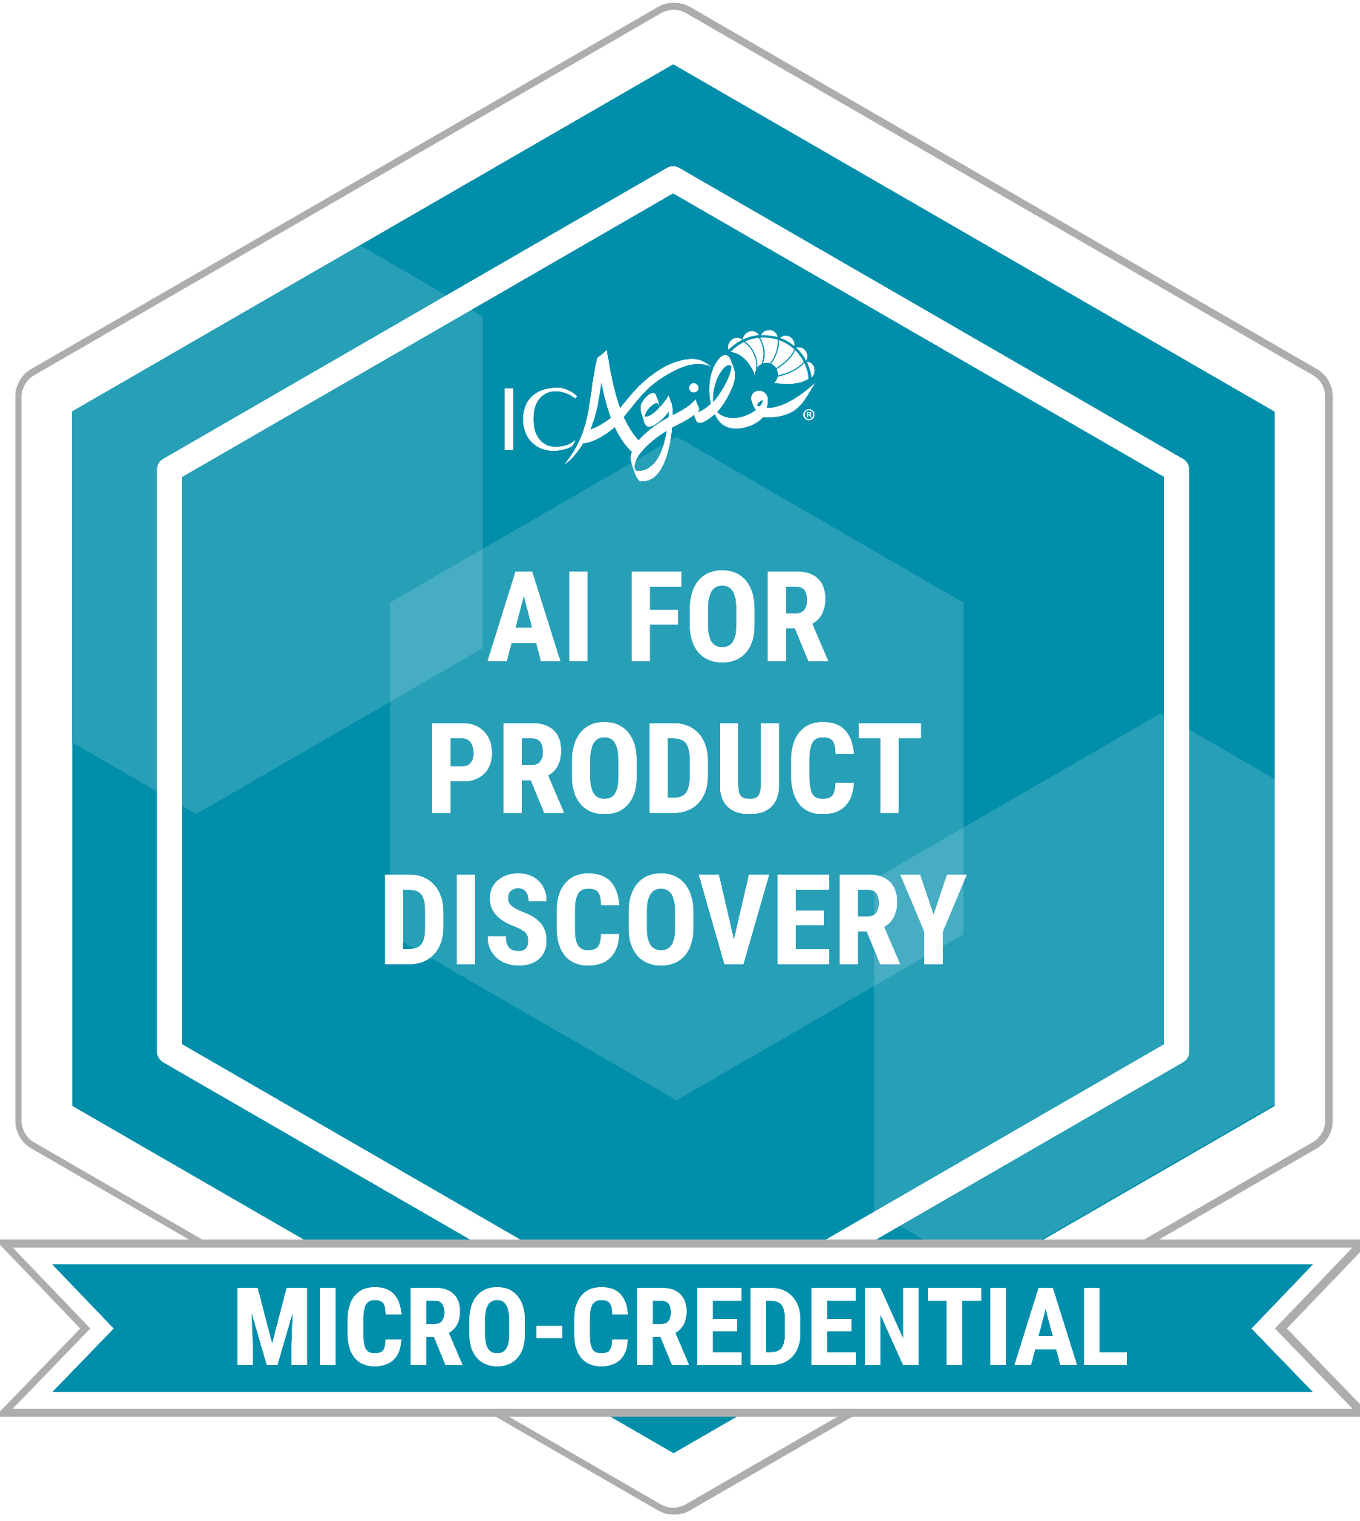
AI for Product Discovery
ABOUT THIS CERTIFICATION
FEATURED LEARNING OUTCOMES
This micro-credential provides hands-on experience applying AI tools to accelerate and enhance product discovery work.
Identify Real Customer Problems – Use AI to analyze interviews, surveys, or support tickets and uncover opportunities.
Expand and Refine Ideas – Generate, cluster, and evaluate product ideas with AI support and human judgment.
Create Discovery Artifacts – Use AI to design artifacts such as prototypes, customer surveys, or journey maps.

Slide 47
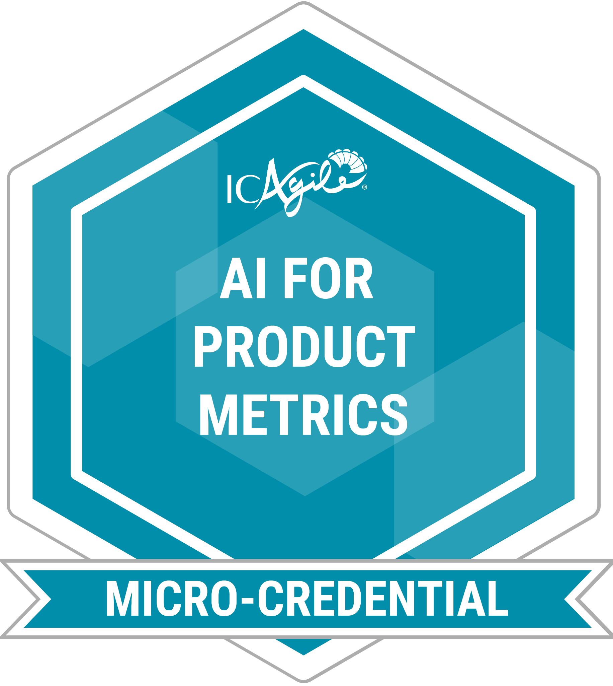
AI for Product Metrics
ABOUT THIS CERTIFICATION
FEATURED LEARNING OUTCOMES
What if AI could take the guesswork out of your product decisions? This micro-credential offers a hands-on introduction to using AI tools to identify, track, and act on product analytics.
Uncover Meaningful Metrics – Use AI to identify the most relevant product health and performance indicators.
Analyze Product Outcomes – Apply AI to evaluate feature success, customer impact, and usage trends.
Drive Data-Informed Action – Translate AI insights into clear next steps for product teams.

Slide 48

AI for Product Planning
ABOUT THIS CERTIFICATION
FEATURED LEARNING OUTCOMES
Improve product planning with AI. Learn to apply AI tools for roadmaps, backlogs, and release plans to increase clarity, efficiency, and alignment.
Generate Smarter Roadmaps – Use AI to create product roadmaps that align with strategic objectives and business goals.
Prioritize with Confidence – Apply AI-supported frameworks (like RICE or MoSCoW) and integrate human judgment to shape backlogs.
Design Outcome-Oriented Releases – Develop AI-assisted release plans that balance feasibility, value, and time-to-market trade-offs.

Slide 49

AI for Product Strategy
ABOUT THIS CERTIFICATION
FEATURED LEARNING OUTCOMES
Build your strategic edge with AI. Practice using AI tools to uncover opportunities, evaluate initiatives, and craft strategies that align with business goals.
Spot Trends and Opportunities – Interpret AI-generated insights to inform product direction.
Shape Strategy with AI – Use AI to identify challenges and propose product initiatives.
Prioritize with Confidence – Apply frameworks that combine AI insights with human judgment.

Slide 50
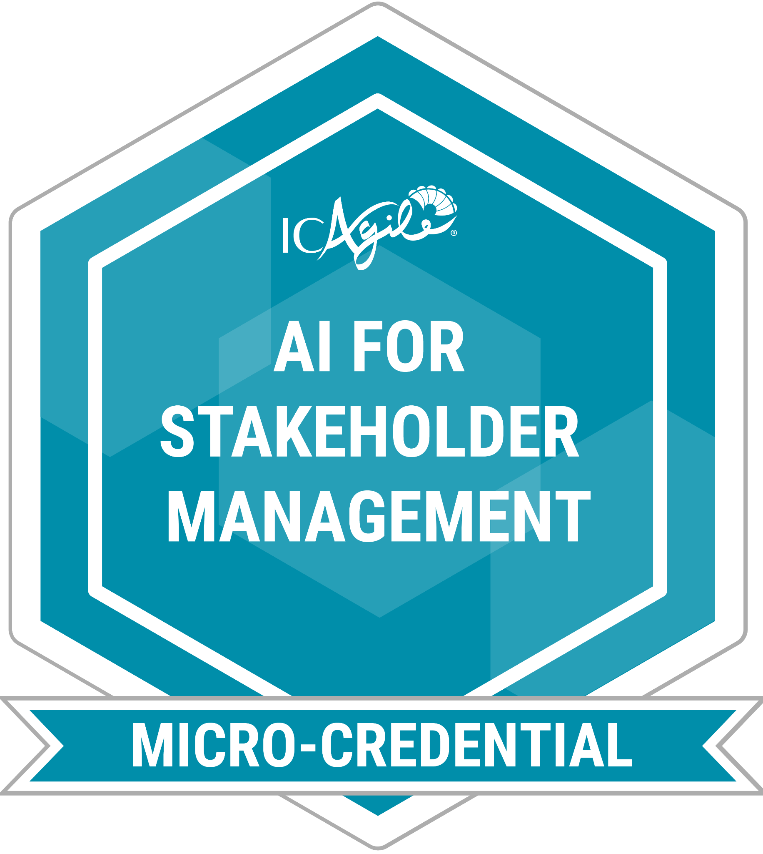
AI for Stakeholder Management
ABOUT THIS CERTIFICATION
FEATURED LEARNING OUTCOMES
Explore how AI can sharpen your approach to stakeholder management in this hands-on micro-credential course.
Use AI to Analyze Stakeholders – Apply techniques like sentiment analysis, influence mapping, and persona generation to uncover stakeholder needs.
Design AI-Assisted Communication Plans – Build tailored stakeholder communication strategies using AI tools, aligning with distinct communication styles and priorities.
Balance AI with Human Skills – Explore where AI can support stakeholder engagement versus where human judgment and interaction are essential.

Slide 51
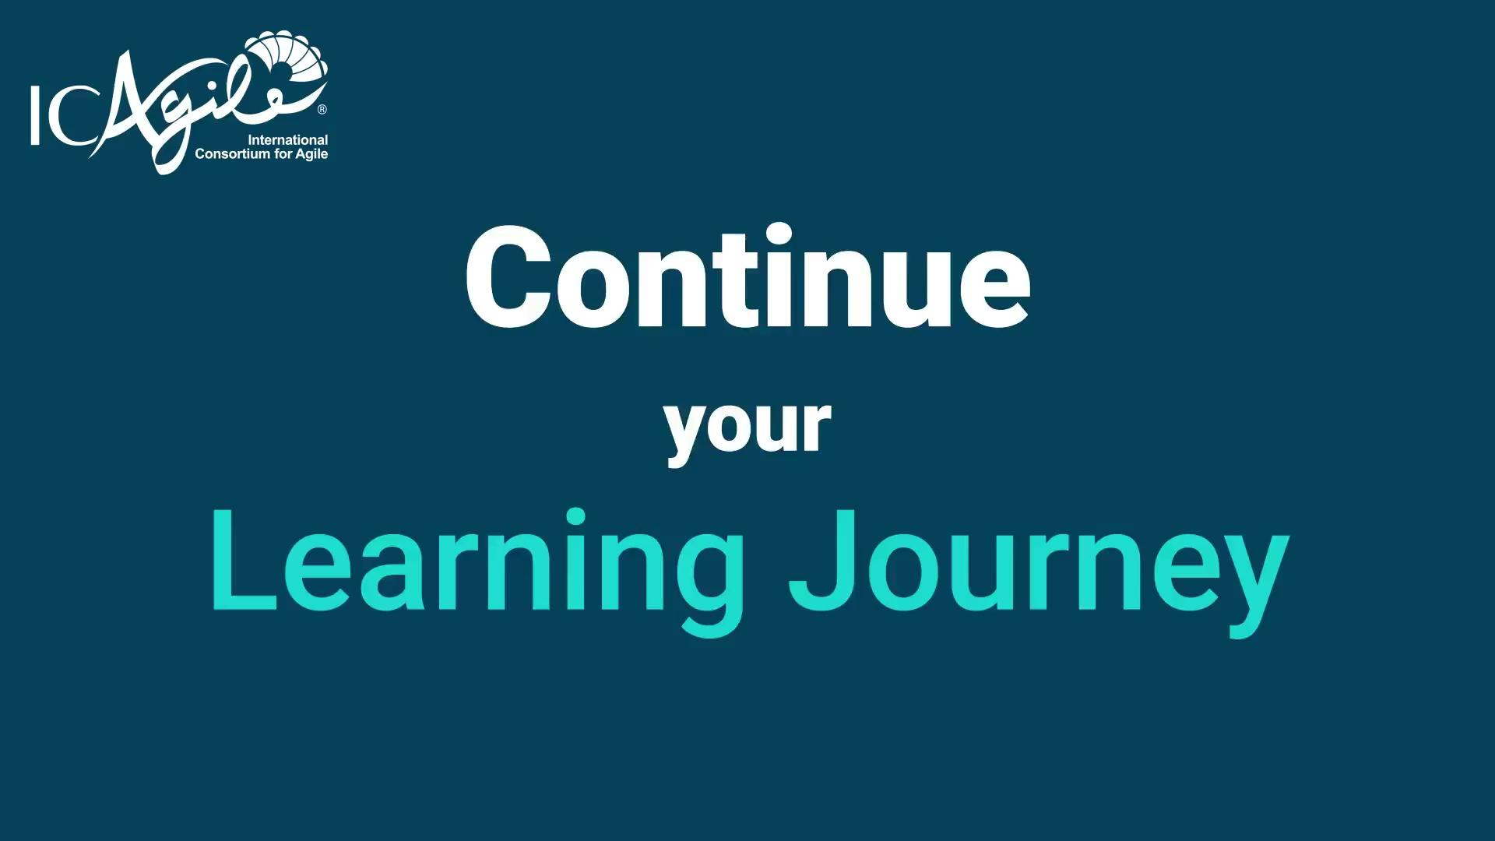
Notes:
End-of-Class Video

